Slide 2
Commissioned by The PiXL Club Ltd. August 2021
This resource is strictly for the use of The PiXL Club (“PiXL”) subscribing schools and their students for as long as they remain PiXL subscribers. It may NOT be copied, sold, or transferred to or by a third party or used by the school after the school subscription ceases. Until such time it may be freely used within the PiXL subscribing school by their teachers and authorised staff and any other use or sale thereof is strictly prohibited.
All opinions and contributions are those of the authors. The contents of this resource are not connected with, or endorsed by, any other company, organisation or institution. This resource may contain third party copyright material not owned by PiXL and as such is protected by law. Any such copyright material used by PiXL is either provided under licence or pending a license.
PiXL endeavour to trace and contact third party copyright owners. If there are any inadvertent omissions or errors in the acknowledgements or usage, this is unintended and PiXL will remedy these on written notification.
© The PiXL Club Ltd. 2021. All Rights Reserved.

Slide 3
Chapter 2
Contents
Understand what patience is and why it is important
Analyse your own and others’ experiences of being patient
Identify ways to be patient

Slide 4
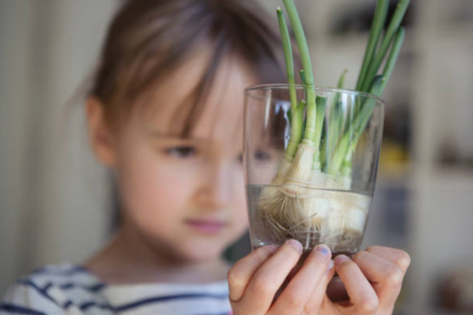
‘Patience is a key element of success.’
Bill Gates, entrepreneur and
tech pioneer
Page 31

Slide 5
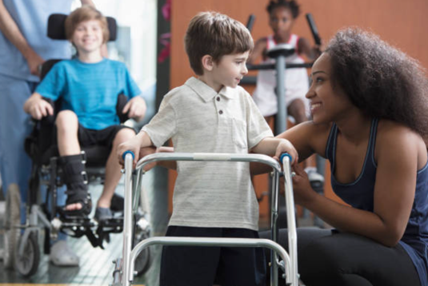
Get Talking: What does it mean to have patience?

Slide 6
What does it mean to have patience?
Having long term goals
Waiting for something without getting frustrated
Controlling our emotions and actions
Remaining calm when we find something difficult
Understanding that some tasks can take a long time

Slide 7
Why is patience important?
It isn’t just about waiting for things.
It is about doing things with focus and care.
It is about working at something and not being afraid to do it again and again until you get it right.
It is about waiting for the right time or for other people.
It is about showing self-control when you feel frustrated or impatient.

Slide 8
Get Drawing: Flossy and the high five
Task: Read Clare’s story about her dog Flossy and the high five on pages 32–34.
Clare showed patience when teaching her dog to give her a high five.
Draw a comic strip story of a time when you showed patience. Consider showing:
What activity / task / goal you were achieving.
Who or what was involved.
Did anyone help you?
What strategies did you use?
Did you talk to yourself to keep your patience?

Slide 9
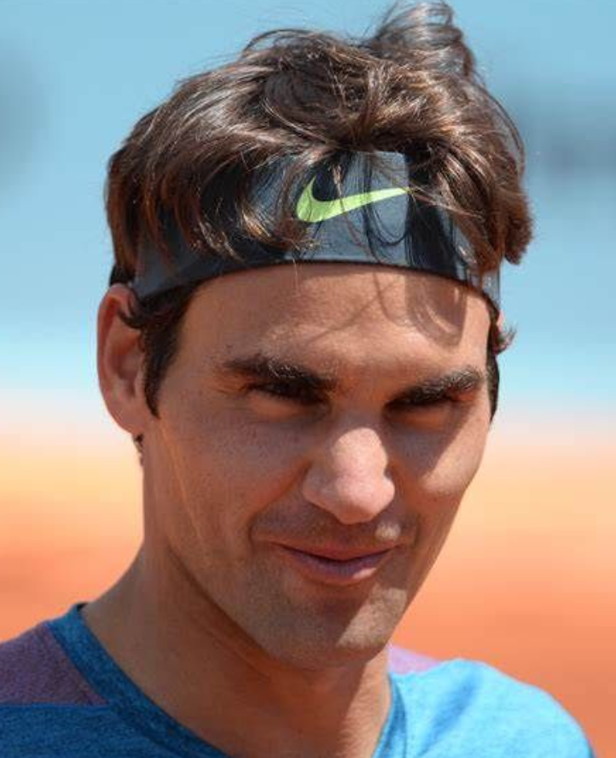
‘I think once you find that peace, that place of peace and quiet, or harmony… or confidence – that’s when you start playing at your best.’
Roger Federer
Page 39

Slide 10
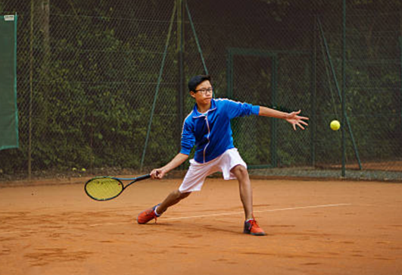
Game changers
Task: Read about Roger Federer and how he learnt about the power of patience after seeing a replay of himself as a junior tennis player on page 38.
What did Roger realise?
What impact would being patient have on his tennis matches and career?

Slide 11
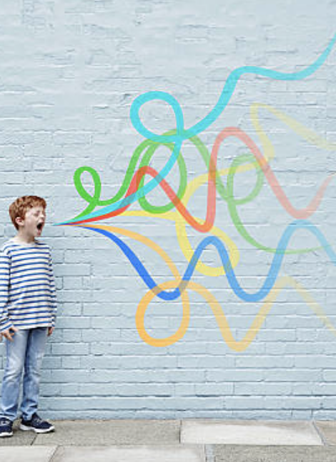
Patience superpower
Task:
Think of a time when you have been impatient – explain the situation and draw a picture to show how you reacted and how it made you feel.
Think of a time when you were patient – explain the situation and draw a picture to show how you reacted and how it made you feel.
Now compare both your pictures and share them with a partner.
What is your patience superpower? How can you keep calm, cool and remain focused?

Slide 12
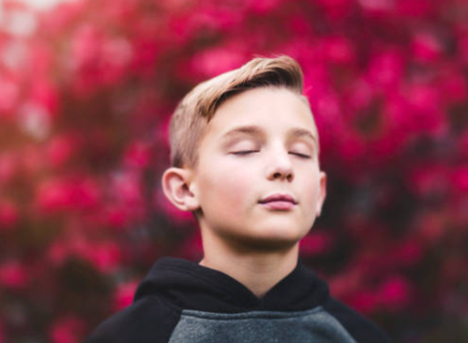
Get Reading: Practically perfect patience
Read through Clare’s top tips on being patient on page 43.
Take a deep breath in through your nose and count to 5 as you breathe out.
Move your head round in a circle, one way and then the other. Roll your shoulders 5 times, shake your hands out.
Move your hips from side to side. Then rotate your feet (one at a time if you’re standing up!).
Look out of the window or around you and notice every detail: colours, textures, smells, sounds; the way things move or how the clouds are chasing across the sky.
Count to 10 and back down to zero. Remember to take lots of slow, deep breaths.

Slide 13
Get Thinking: The year of sporting patience
Task:
Read pages 35–37 about how certain athletes coped whilst the Olympic Games were postponed.
In what ways were the athletes inventive?
How did their ideas help them to be patient?

Slide 14
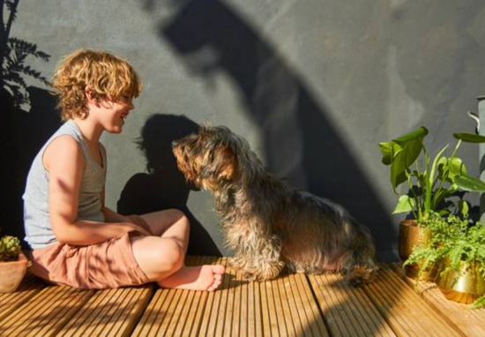
Get Writing: Practising patience
Task:
Working in pairs, think of three things you can do that can help you to be patient.
Try practising them together.
Write them down and get ready to share one of them with the class.
Try and be as creative and inventive as possible!

Slide 15
Get Designing: Patience superpower
Task:
List all the occasions when you might need your patience superpower.
Design a bookmark with your patience superpowers on it to remind you when you get frustrated or annoyed.

Slide 16
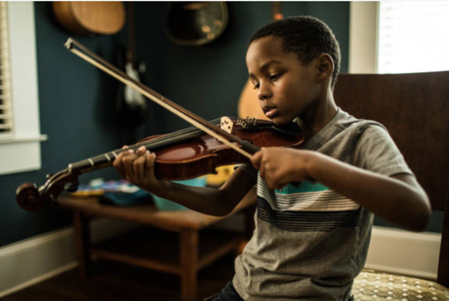
Get Talking: What’s your ‘thing’?
Think about something you love doing: cycling, dancing, playing an instrument, football, shooting basketball hoops, cooking, maths, gaming, drawing, painting, skateboarding. Talk about ‘your thing’ with a partner.
Clare says that if you can be patient when doing something you love, you can transfer your ‘patience superpower’ to things that make you feel frustrated or impatient.

Slide 17
Summary: A final word from Clare
Title description
‘Patience is not expecting everything to happen at once, but exercising self-control and doing things with focus and care. I struggled with patience and insecurity when I was young, but I’ve learned so much about it from inspirational people around me and people that I admire from afar. I hope some of the people you’ve read about in this book inspire you!’
Page 191

