Slide 1
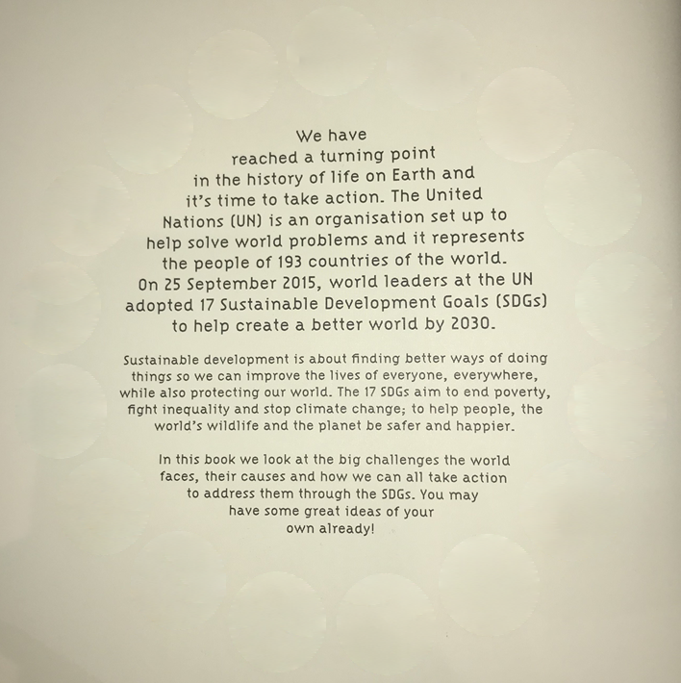

https://www.un.org/sustainabledevelopment/

Slide 2
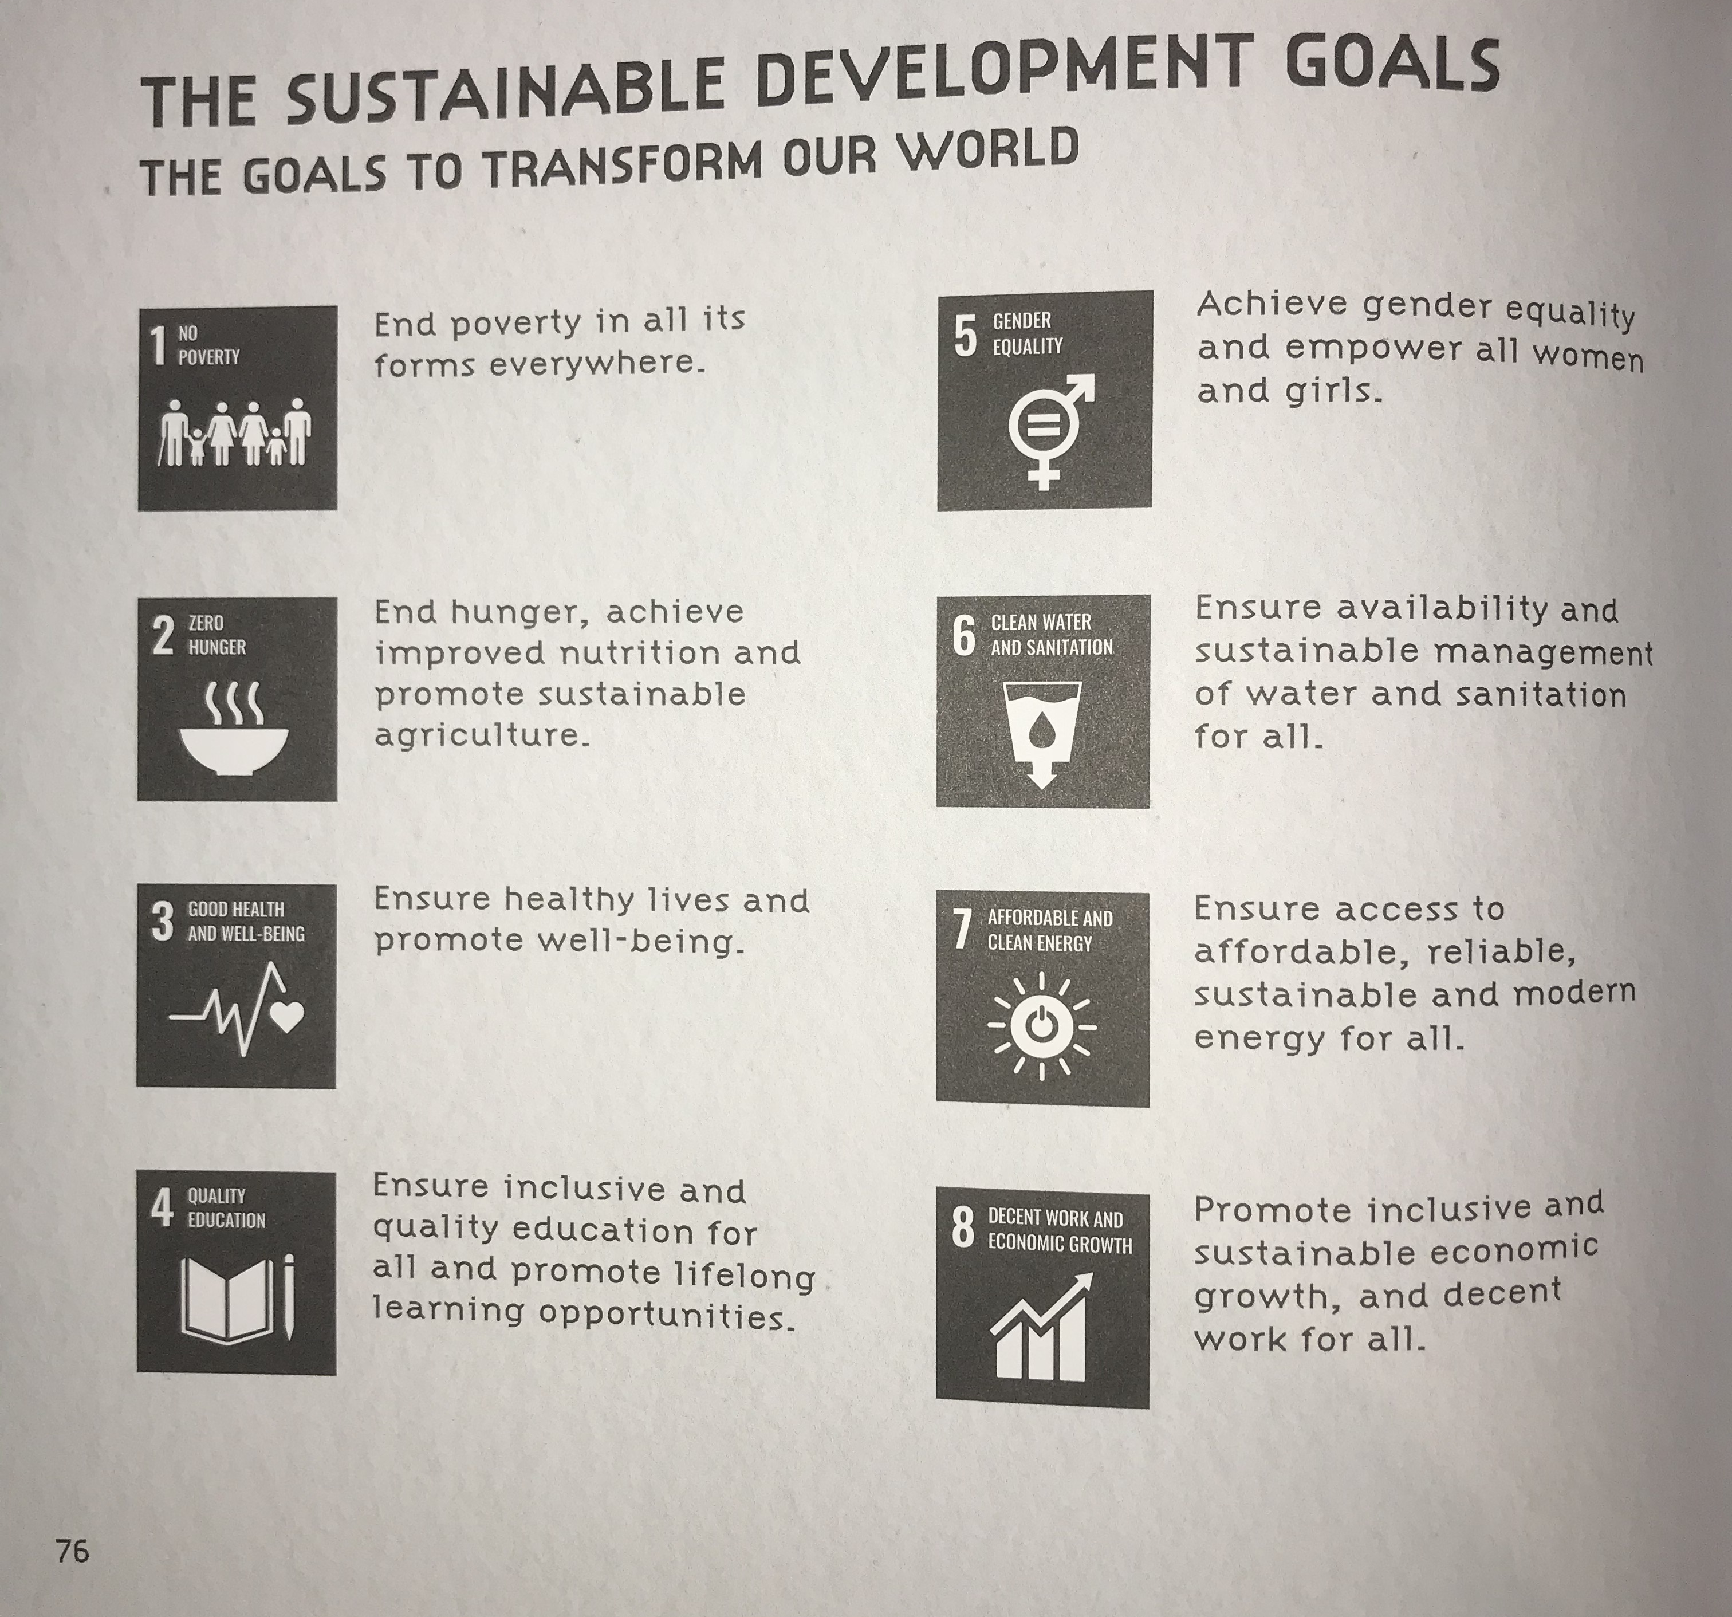
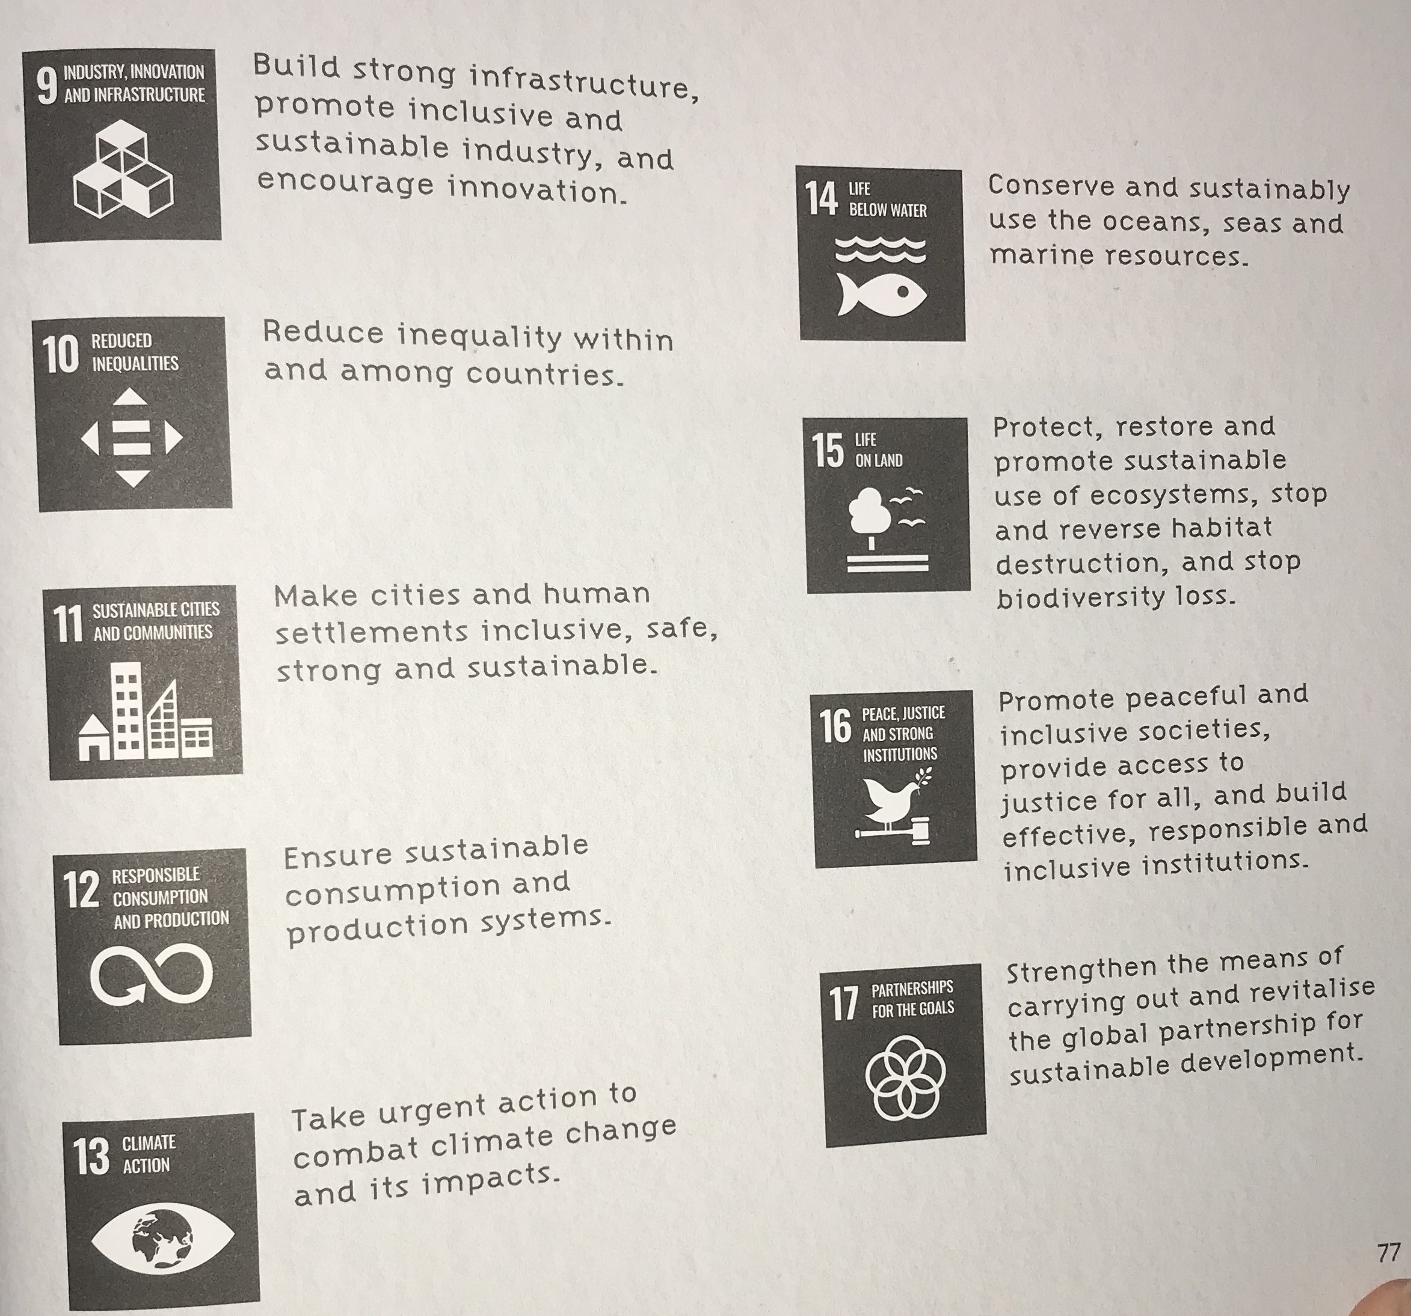

Slide 3


















Slide 4
End Poverty | Zero Hunger | Good Health and Wellbeing | Quality Education | Gender Equality | Clean water and Sanitation
Affordable and Clean Energy | Decent Work and Economic Growth | Industry, Innovation and Infrastructure | Reduced Inequalities | Sustainable Cities and Communities | Responsible Consumption and Production
Climate Action | Life Below Water | Life on Land | Peace. Justice and Strong Institutions | Partnerships for the Goals

Slide 5
Most important priority
Least important priority

Slide 6
Key words to use:
change
vital
essential
important
impact
necessary
critical
significant

