Slide 1
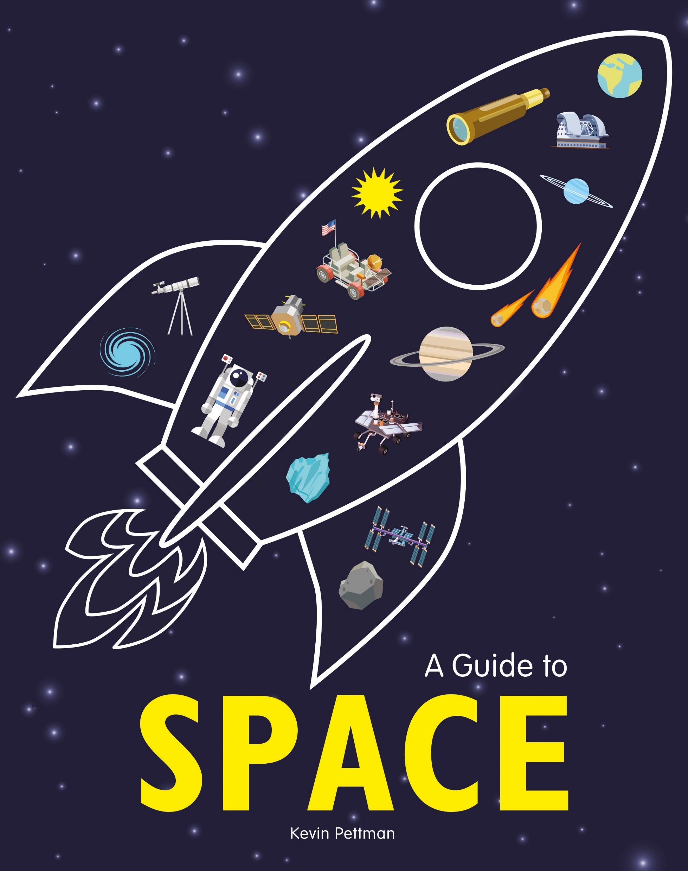


The Big Topic: Space
A Guide to Space
Welcome to the infographic guide to the most exciting place outside Earth: SPACE!
Discover mind-boggling facts, figures and amazing explorations in eye-popping infographics. Great for visual learners in KS2.
9781526307378 £12.99
Cross-Curricular Lesson Ideas
This is a bright and engaging, fact-filled book that is perfect to share in a KS2 classroom to get your pupils excited about space travel. These resources are written with the KS2 National Curriculum for Year 5 and Year 6 in mind.
Space Words
Terrific Temperatures
Space Quiz
Planet Wars
Resources created by:

Slide 2
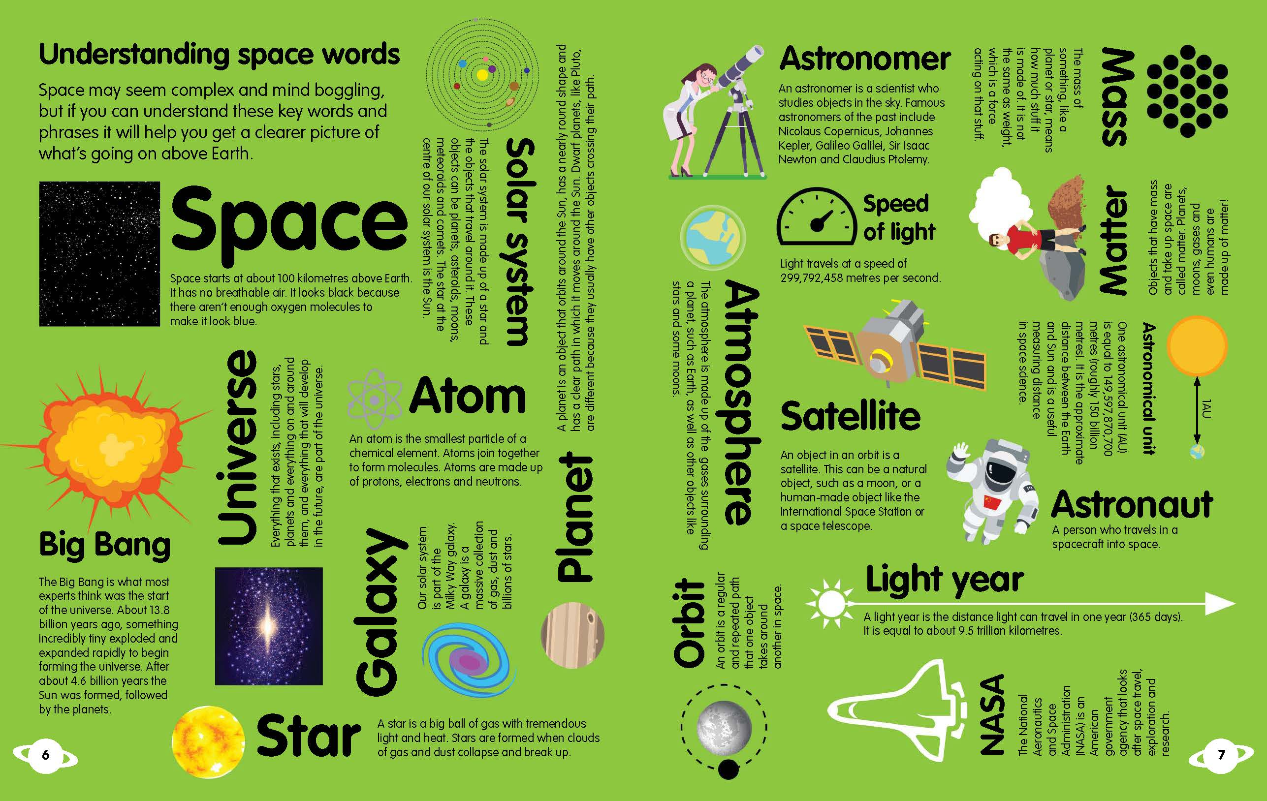
The Big Topic: Space
Space Words
Vocabulary is so incredibly important. Developing pupils’ vocabulary will improve their future success. This double page spread, giving high value to words, is an excellent page to keep coming back to.
Pair up pupils to challenge each other. One partner reads the definition, the other says the word. Try it the other way, where the partner gives the word and the other gives a definition. A few minutes on this each day and pupils will be space word experts in no time!
As you learn about space travel, and read through the book, let pupils create their own space word collection. They can recreate the graphic style of this page.

Slide 3
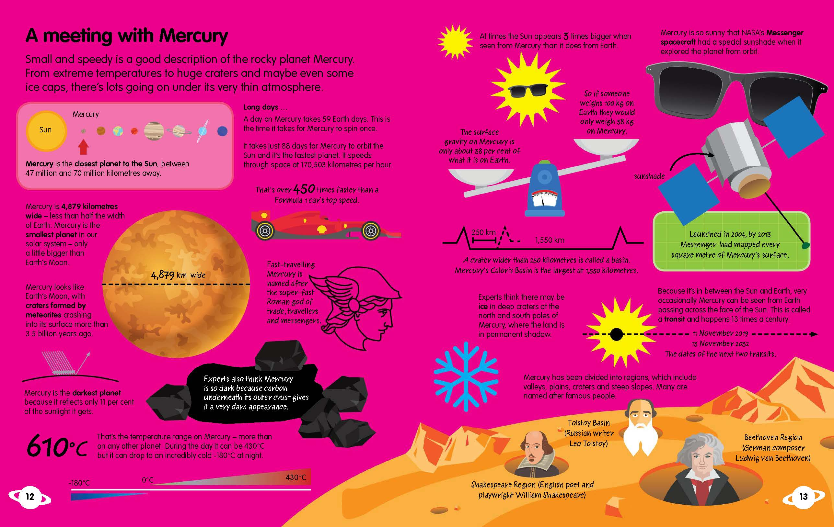
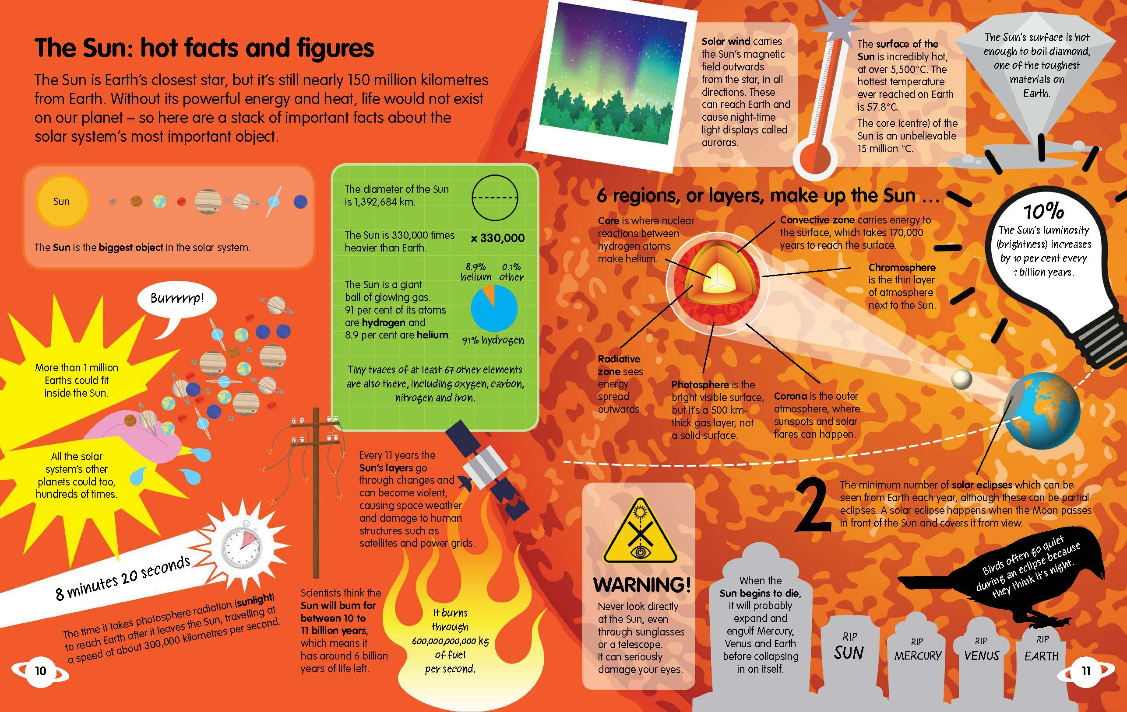
The Big Topic: Space
Terrific Temperatures
Temperatures appear on most pages in the book. Get pupils to scan for specific information for this task. Point out that temperatures are recorded in degrees Celsius, so this is a great clue to search the page for (ºC).
It is good skill to be able to retrieve information from one form of text and to organise in another way. Use the table on the next page for pupils to record their findings. Discuss with them that they may not be able to fill in each box.
Now try creating a graph with this data. Discuss which type of graph would best show the information found.
Discuss what the graph shows very clearly. Encourage pupils to come up with a generalisation in paired discussions. Talk starters should help structure responses:
We have noticed that….
We spotted a pattern that…
The closer the planet to the sun…….
The further away the planet from the sun…….

Slide 4
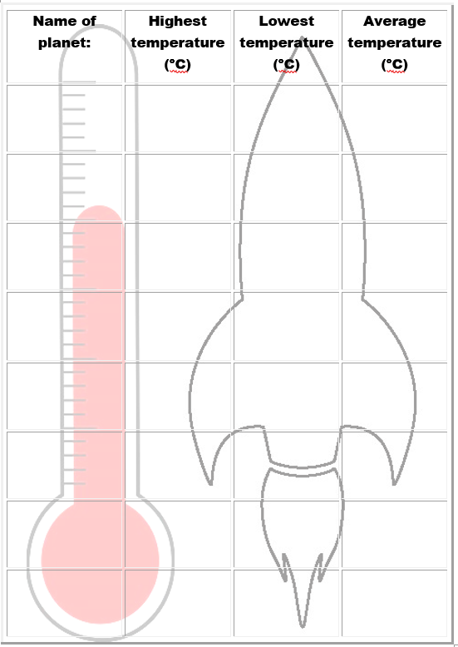
The Big Topic: Space
Terrific Temperatures

Slide 5
The Big Topic: Space
Space Quiz
Each page of this book is jam-packed with facts for pupils to devour. Giving pupils a purpose and outcome to their reading can improve engagement and motivation.
Set up pupils into small teams. Each team will create a round in The BIG Space Quiz, for the rest of their classmates to compete in. Give each team a planet to pose their questions on.
The next page will guide groups to read all the information and help them to create a variety of questions. Each question should have 1 correct response and 3 incorrect responses, making the quiz multiple choice.
When it comes to playing the quiz, let each team create a name for themselves (this could link to their planet). The team should also select a question reader. Encourage the reader to use a clear voice, so the teams have a fair chance of answering. When they read the four options for answers, the need to be really careful not to reveal which is the correct answer. Discuss a clear neutral voice here.

Slide 6
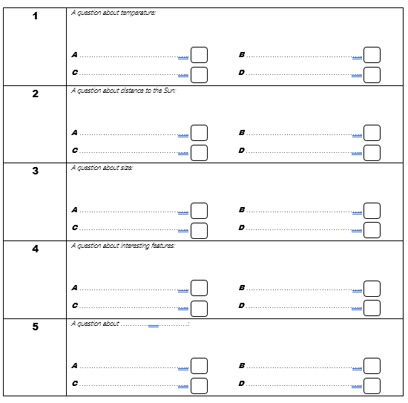
The Big Topic: Space
The BIG Space Quiz
The…………………………………… Round
Planet name goes here
Created by………………………………………………………… Team

Slide 7
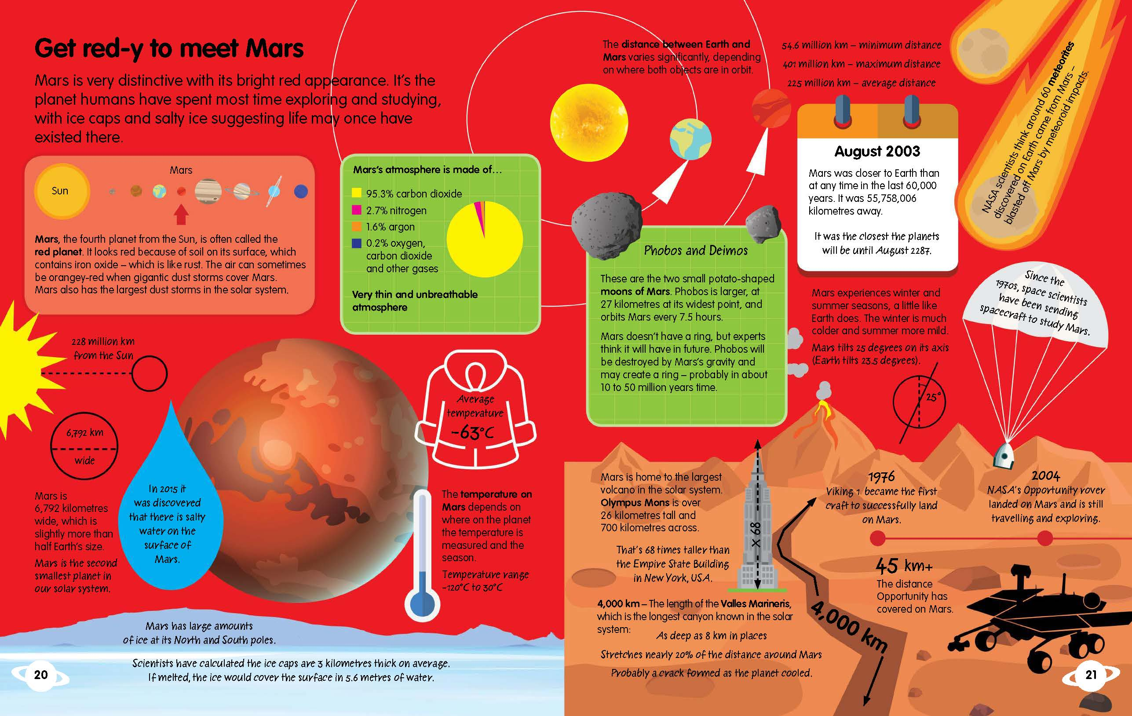
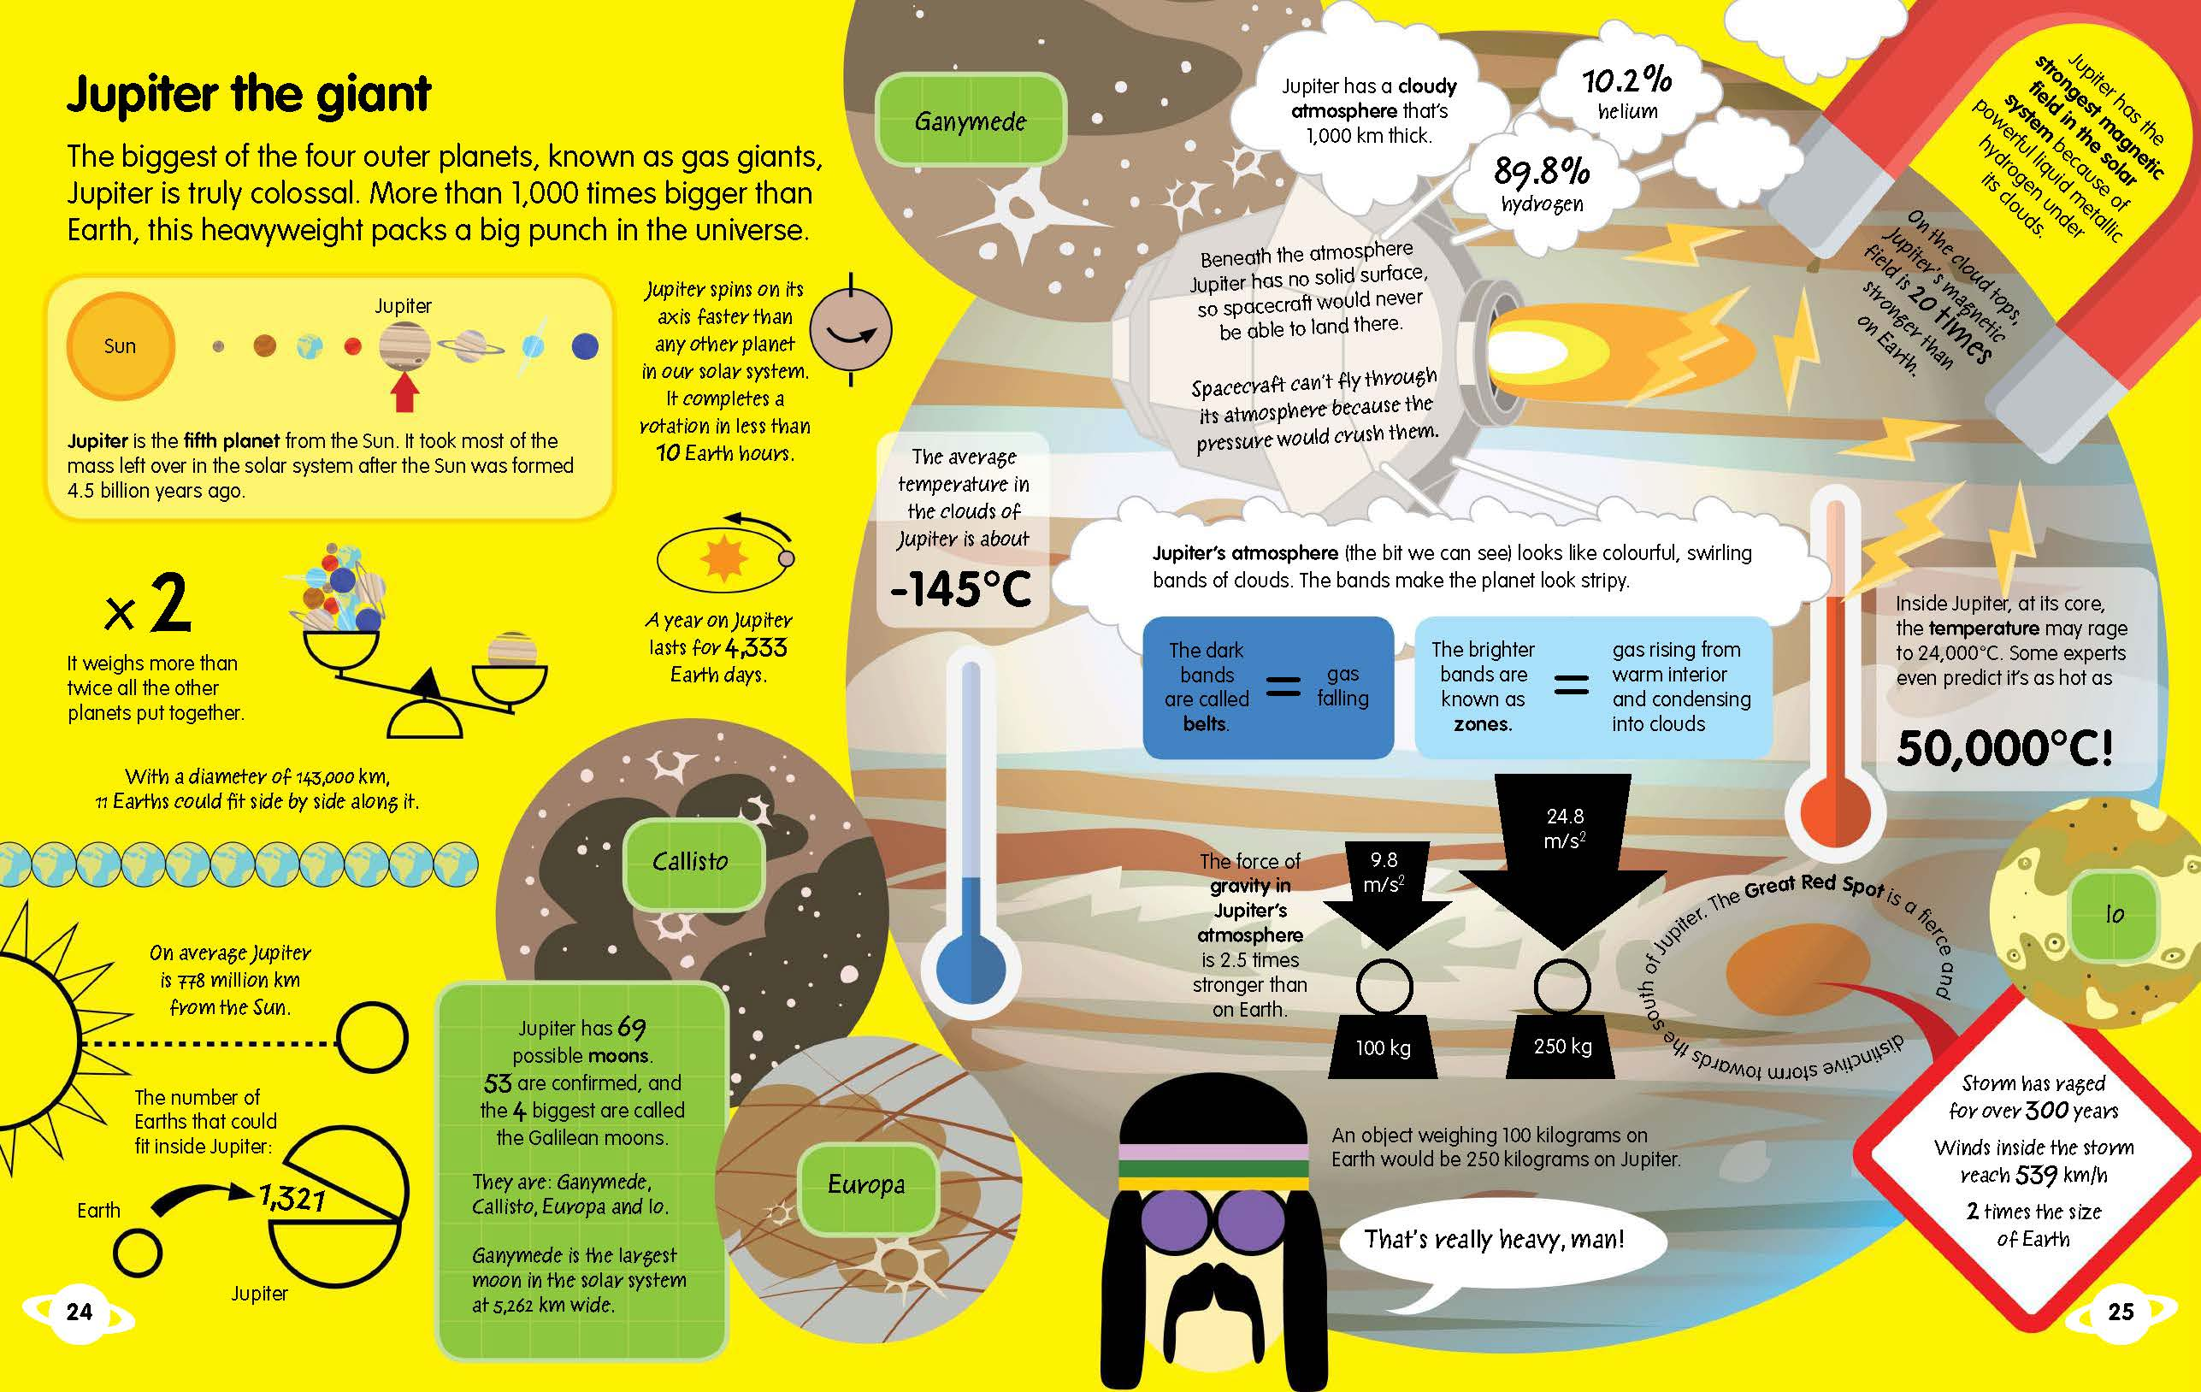
The Big Topic: Space
Planet Wars
Allow pupils to select a favourite planet to research and talk about.
Set up pupils against each other e.g. Mars versus Jupiter.
Pupils should gather as many interesting facts and features of their planet to champion it as the best planet. Encourage them to include facts about size, temperature, distinguishing features, orbits, moons and distance to the sun.
They should then structure this into a speech for the planet battle. Offer different sentence structures to help them:
……………… is the best planet because ………… .
……………… is ………………. , …………….. , and ……………. , therefore is the ultimate planet.
Allow me to introduce you to the most………….. , ……………… , ……………….. planet there is!
It’s clear ……………….. is a truly ……………. planet due to the fact it………………… .
Discuss the use of persuasive devices to win over the audience. Be clear here that the purpose of the speech is to convince the audience that their planet is THE best. The aim is to win!
Give pupils time to practise their speech. They may wish to annotate their writing to show where they will pause for effect, emphasise words or phrases, and actions or looks they may make to the audience.
Set up the stage for the battle at the front of the classroom or in the hall to build some excitement. Time the pupils on their speeches (maybe 1-2mins each). After each pair is complete, allow the audience to vote on the winning planet.

