Slide 1

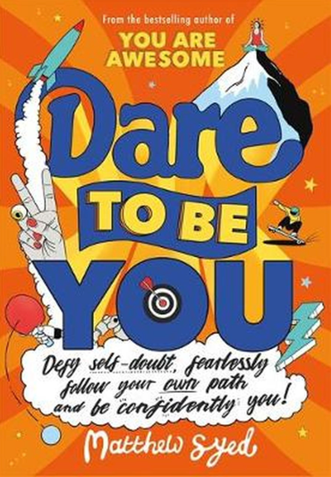
Session 9
Be Decent

Slide 2
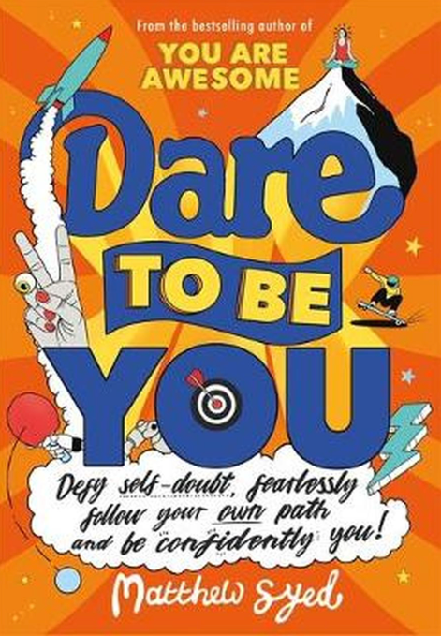
In the last session we looked at:
Why taking action is so important
How you need to turn ‘I wish’ into ‘I could’
How thinking differently is a great thing

Slide 3
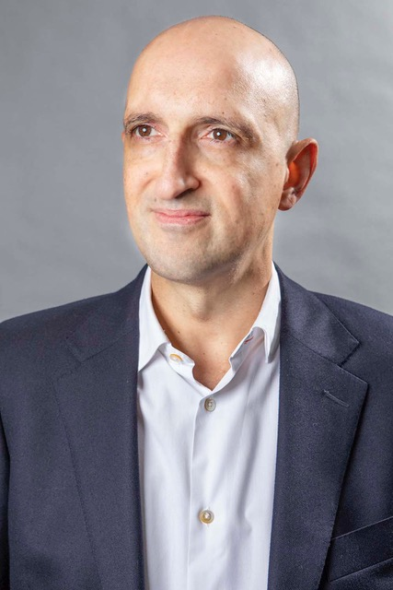
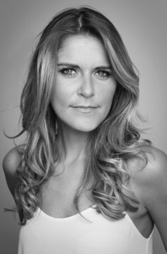
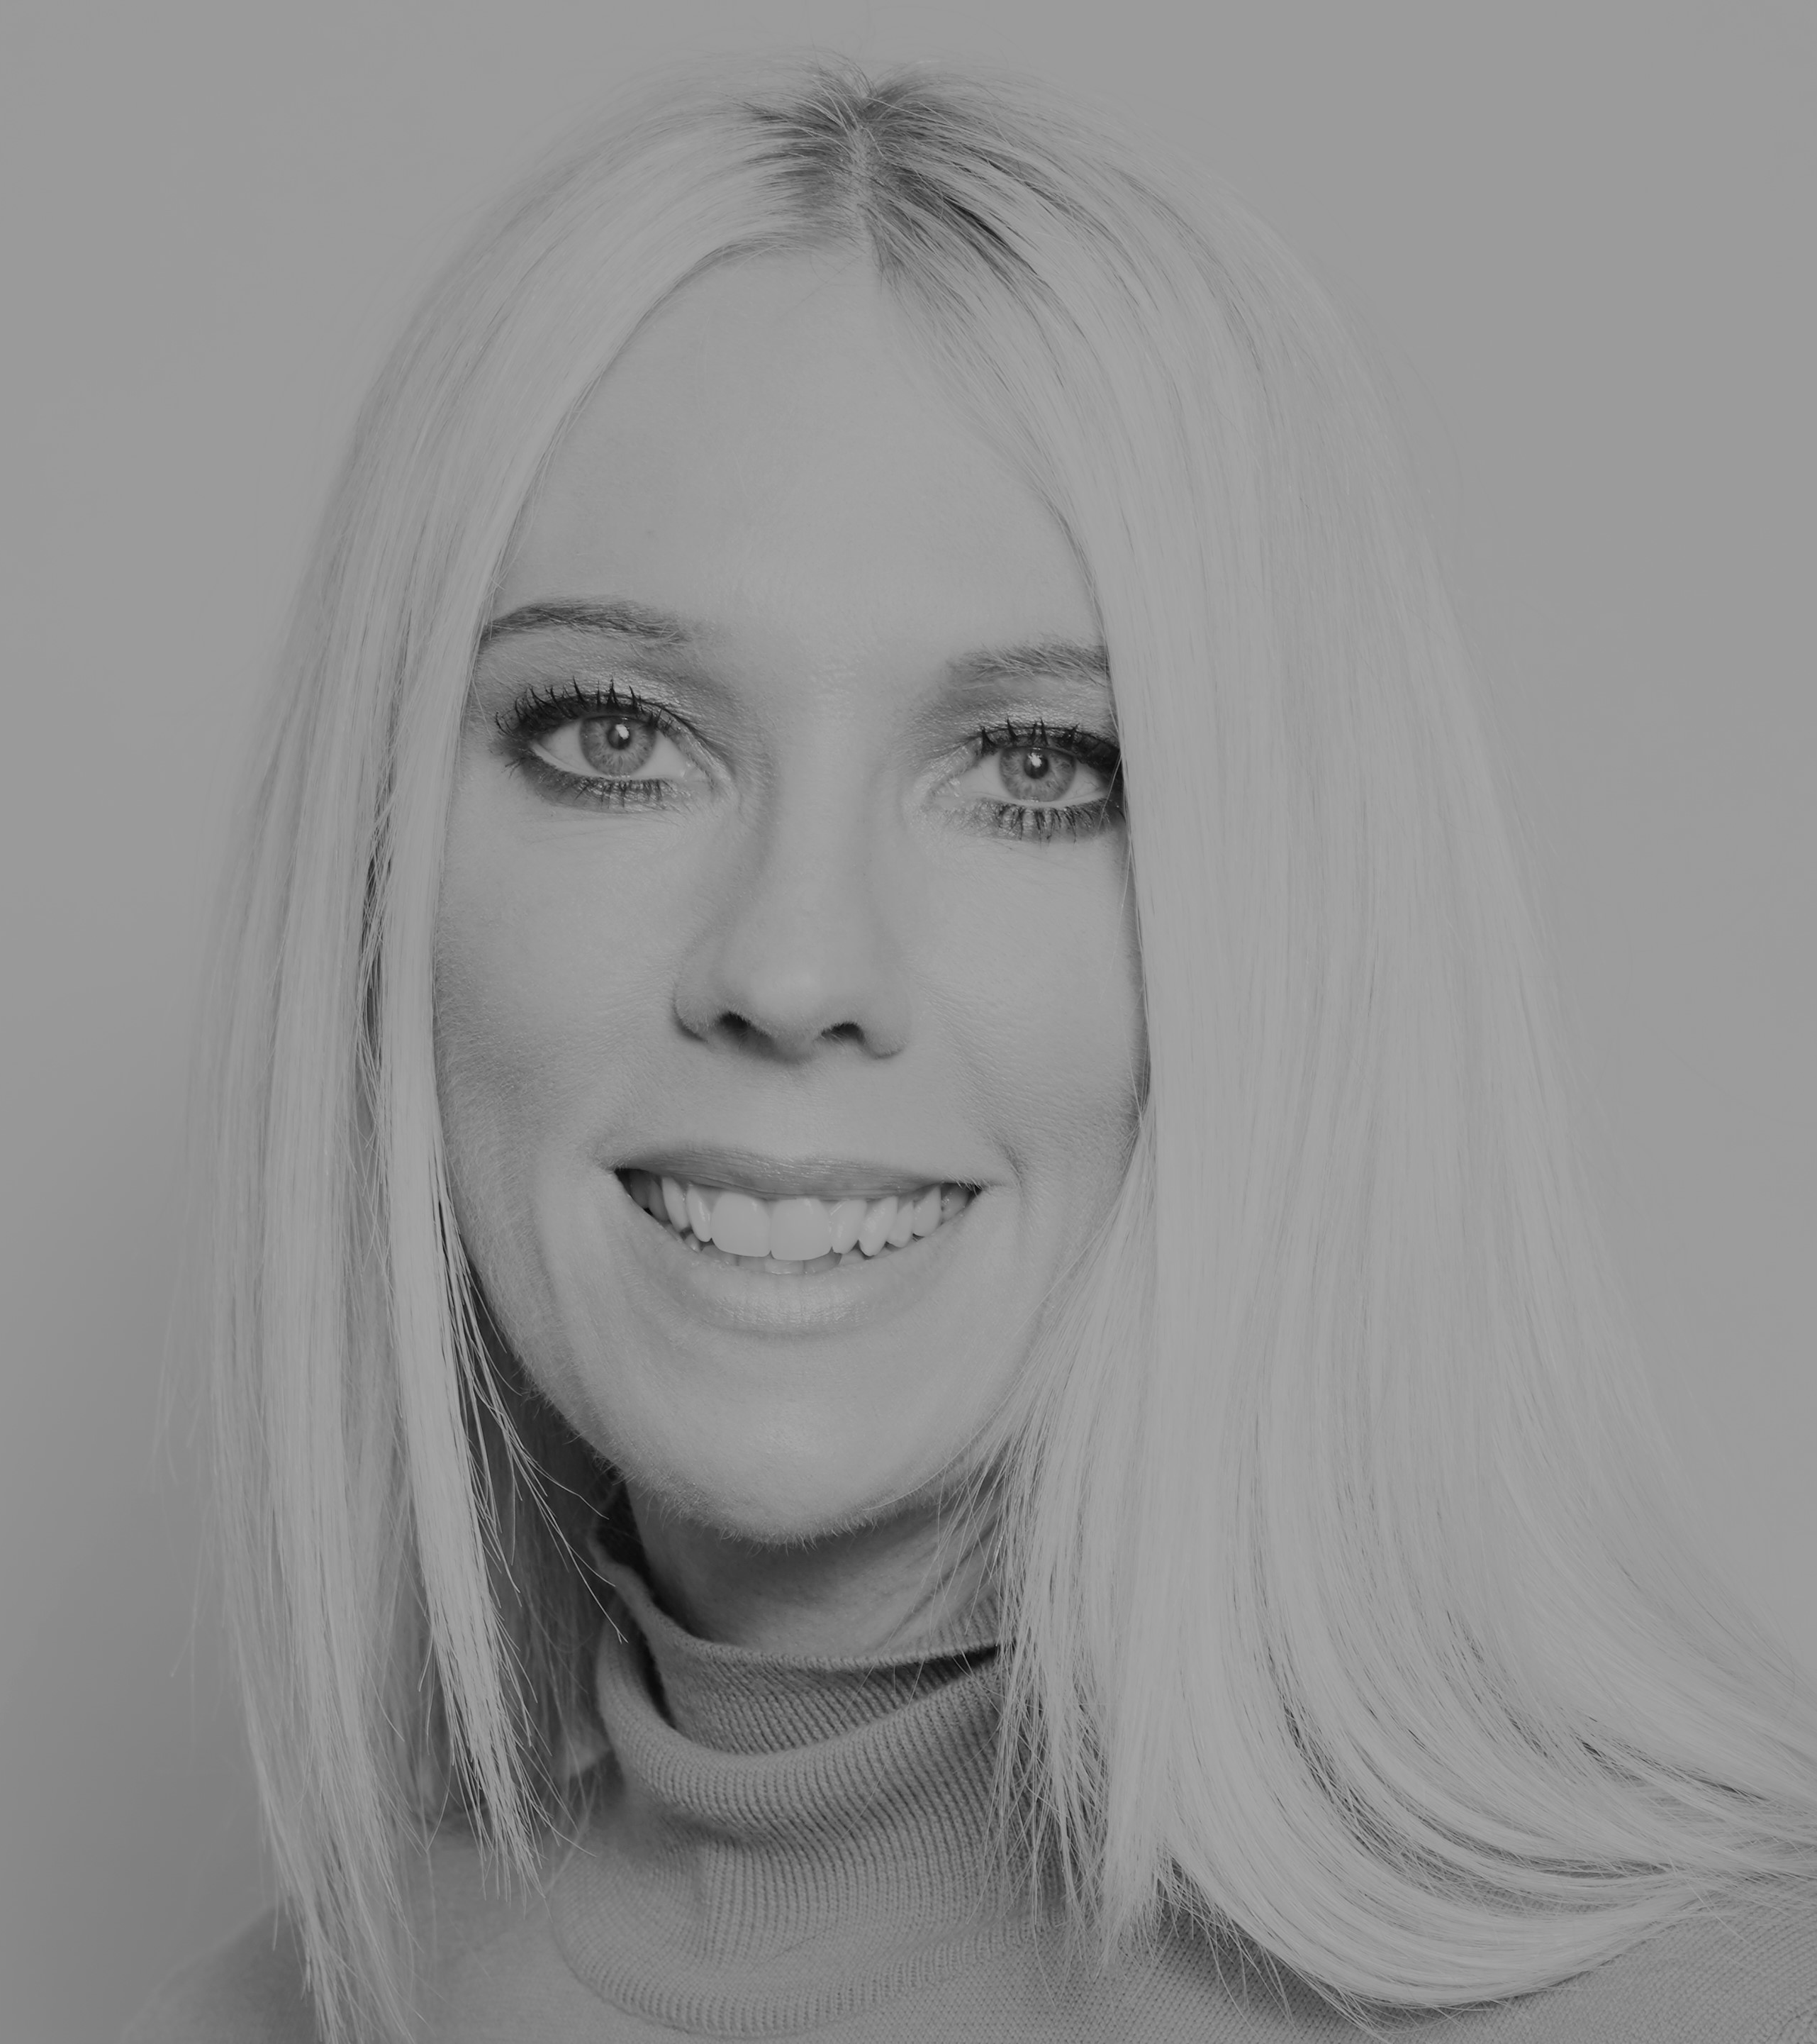
Today we have three people to help us explore ‘Be Decent’.
and…
and…
Matthew Syed Author and Broadcaster, Author of ‘Dare to be You’
Kathy Weeks
‘Dare to Be You’ Team
Gemma Oaten Actress and TV star

Slide 4
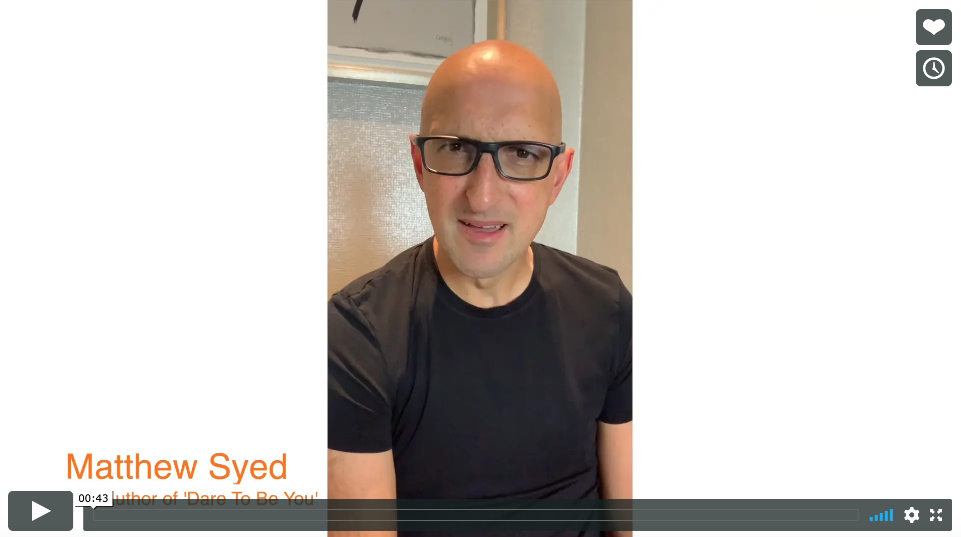


Today we are looking at ‘Be Decent’.
Watch this video of Matthew talking about why being kind is so important.
Be Decent
Matthew Syed
If you are reading along with us, read pages 126–137.

Slide 5
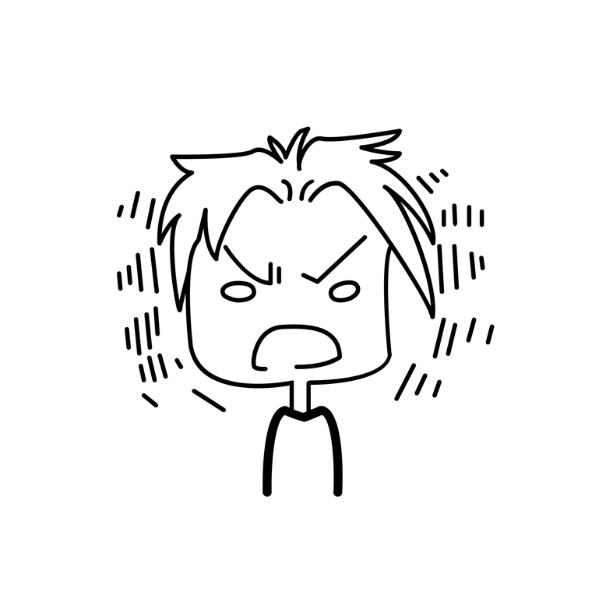
Not everyone is kind.
Not everyone is kind ALL of the time.

Slide 6
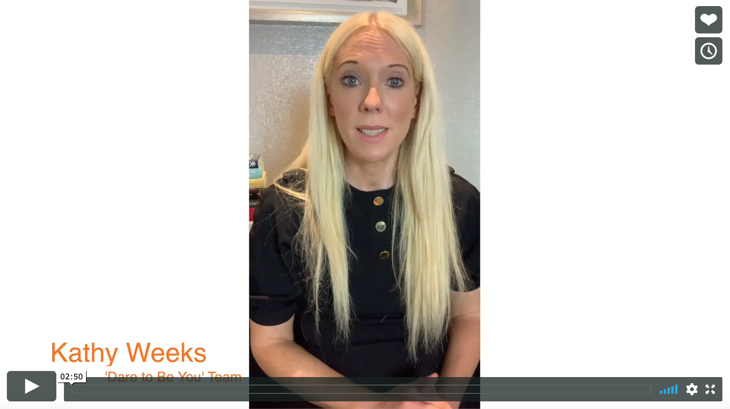
Real life
Kindness
Kathy Weeks

Slide 7
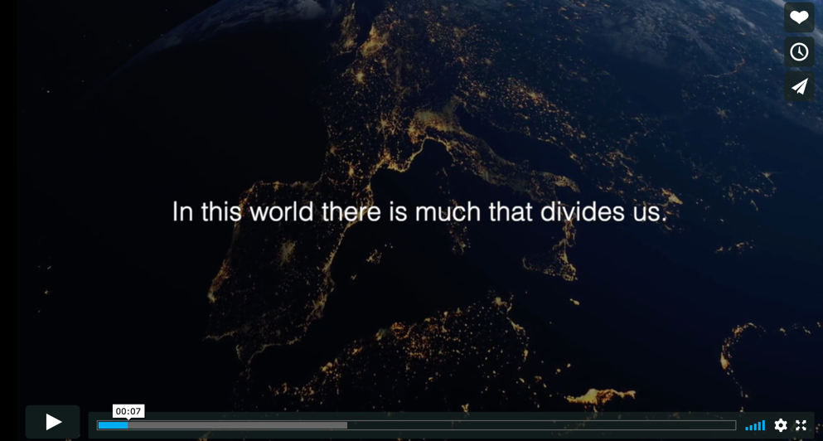
If we were kinder to one another, what a difference that would make.
We have more in common than we think.

Slide 8

People can be unkind in so many strange ways BUT…
MOST people like to be kind and helpful.

Slide 9
I bet you imagine that you are a kind person.
I also bet you haven’t been kind all of the time.
When Kid Doubt is around, sometimes we are made to feel:
Nervous
Unsure
Insecure
Hurt
…and that sometimes means we behave in ways that don’t make us proud of ourselves.

Slide 10

That can start a horrible ‘Kid Doubt Chain Reaction’.
Kid Doubt makes you feel anxious or upset.
So you start behaving in ways that are hurtful or rude to others.
Then the other person has their Kid Doubt making them feel anxious…
So they behave in ways that are hurtful...

Slide 11
In your workbook:
When was the last time someone was unkind to you? How did that feel?
When was the last time you were unkind to someone? What had Kid Doubt been saying to you?

Slide 12

There are lots of reasons why people can be unkind.
They are worried that you are getting ahead of them.
They are feeling bad about themselves and being unkind makes them feel good about themselves – temporarily. Perhaps because making you upset helps them feel a little bit of control over your feelings.
They are hoping that being unkind will make other people think they are cool.
If they can be negative about you maybe they hope that people will forget to be negative about them.
They are not used to people treating them kindly.

Slide 13

Why you need to try and keep your perspective…
Often, when people are unkind, it is to do with them, not you.
You need to focus on YOUR behaviour and attitude being right.
Carry on with your own path, even if others are unkind.
We behave differently when we are stressed or worried.
Try and be kind to others, you don’t know what they are facing.
Being kind can change YOU.

Slide 14
The secret of kindness
What if you being kind could actually make you more successful?
What if going the extra mile for others means you are likely to have more friends?
What if you were able to be kind to yourself, find resilience and be able to manage better when people are unkind to you?

Slide 15
What if we all started being more kind and helpful?
We could stop bullies in their tracks.
We might stop online trolls.
We could create places where people felt safe.
We could help people feel they are valued.
We could change humanity.

Slide 16

What does the research show?
New research from scientists at the University of British Columbia in Canada has shown that being kind can help us to:
feel less nervous
feel less anxious
feel more confident
In small ways, it reduces anxiety
It helps us silence Kid Doubt

Slide 17
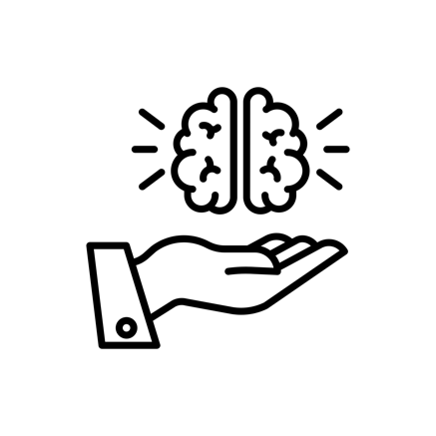
The Kindness Challenge
In your workbook, look at some of the kindness challenges you could have a go at. Answer the following questions.
Can you find some way to help out at home or at school?
Can you make an extra effort to include someone in your plans?
Can you say some positive things to someone who feels down?
Kindness makes us feel more in control of our own anxieties, boosts our good brain chemicals and makes us less afraid of meeting new people. It helps others feel good and helps us feel good about ourselves.

Slide 18
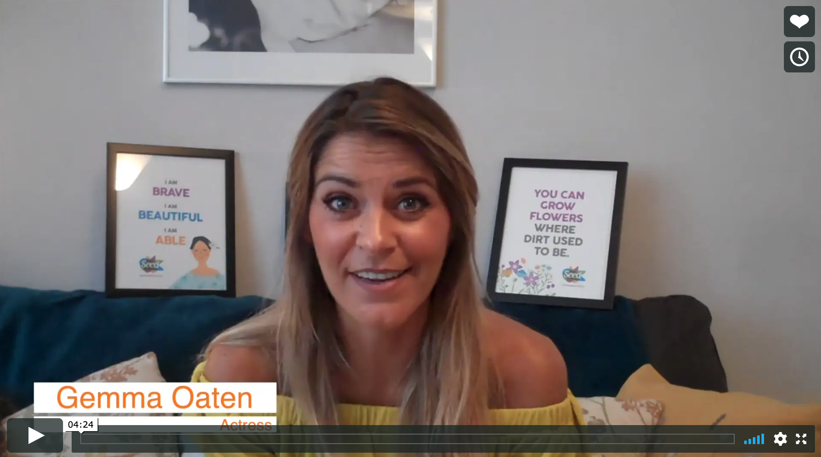

Real life
Be a Decent
Gemma Oaten

Slide 19
© 2020 The PiXL Club Ltd and Hachette UK
This resource may be shared with any school in its current form, and parts thereof, to enhance your work with students. All opinions and contributions are those of the authors. The contents of this resource are not connected with, or endorsed by, any other company, organisation or institution.
If there are any inadvertent omissions or errors in the acknowledgements or usage, this is unintended and we will remedy these on written notification.
Hachette UK own 'Dare to Be You' by Matthew Syed, which may be purchased by individuals and schools, should they wish to do so to enhance these resources for students. Illustrations copyright © Toby Triumph.

