Slide 1

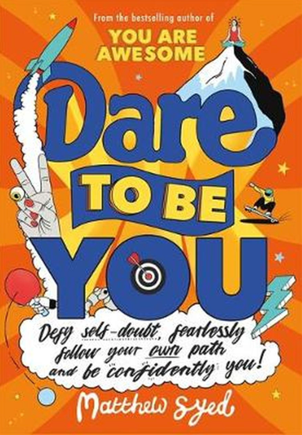
Session 8
Be a Do-er

Slide 2
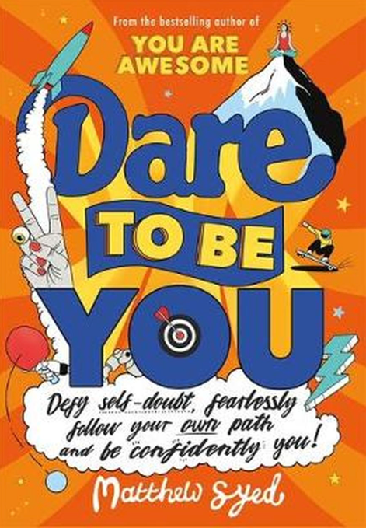
In the last session we looked at:
Why being curious is important
How change is part of all our lives
Why asking questions is so important

Slide 3
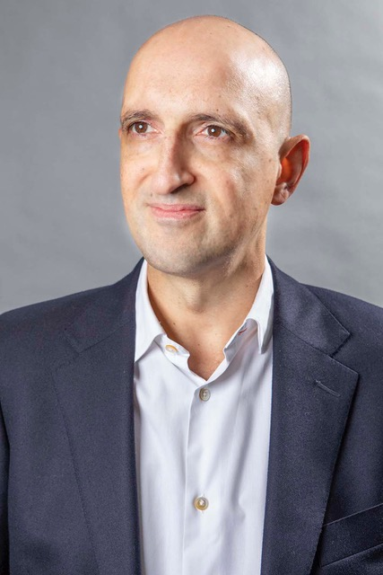
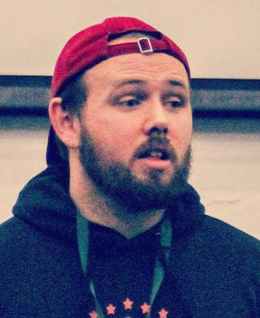
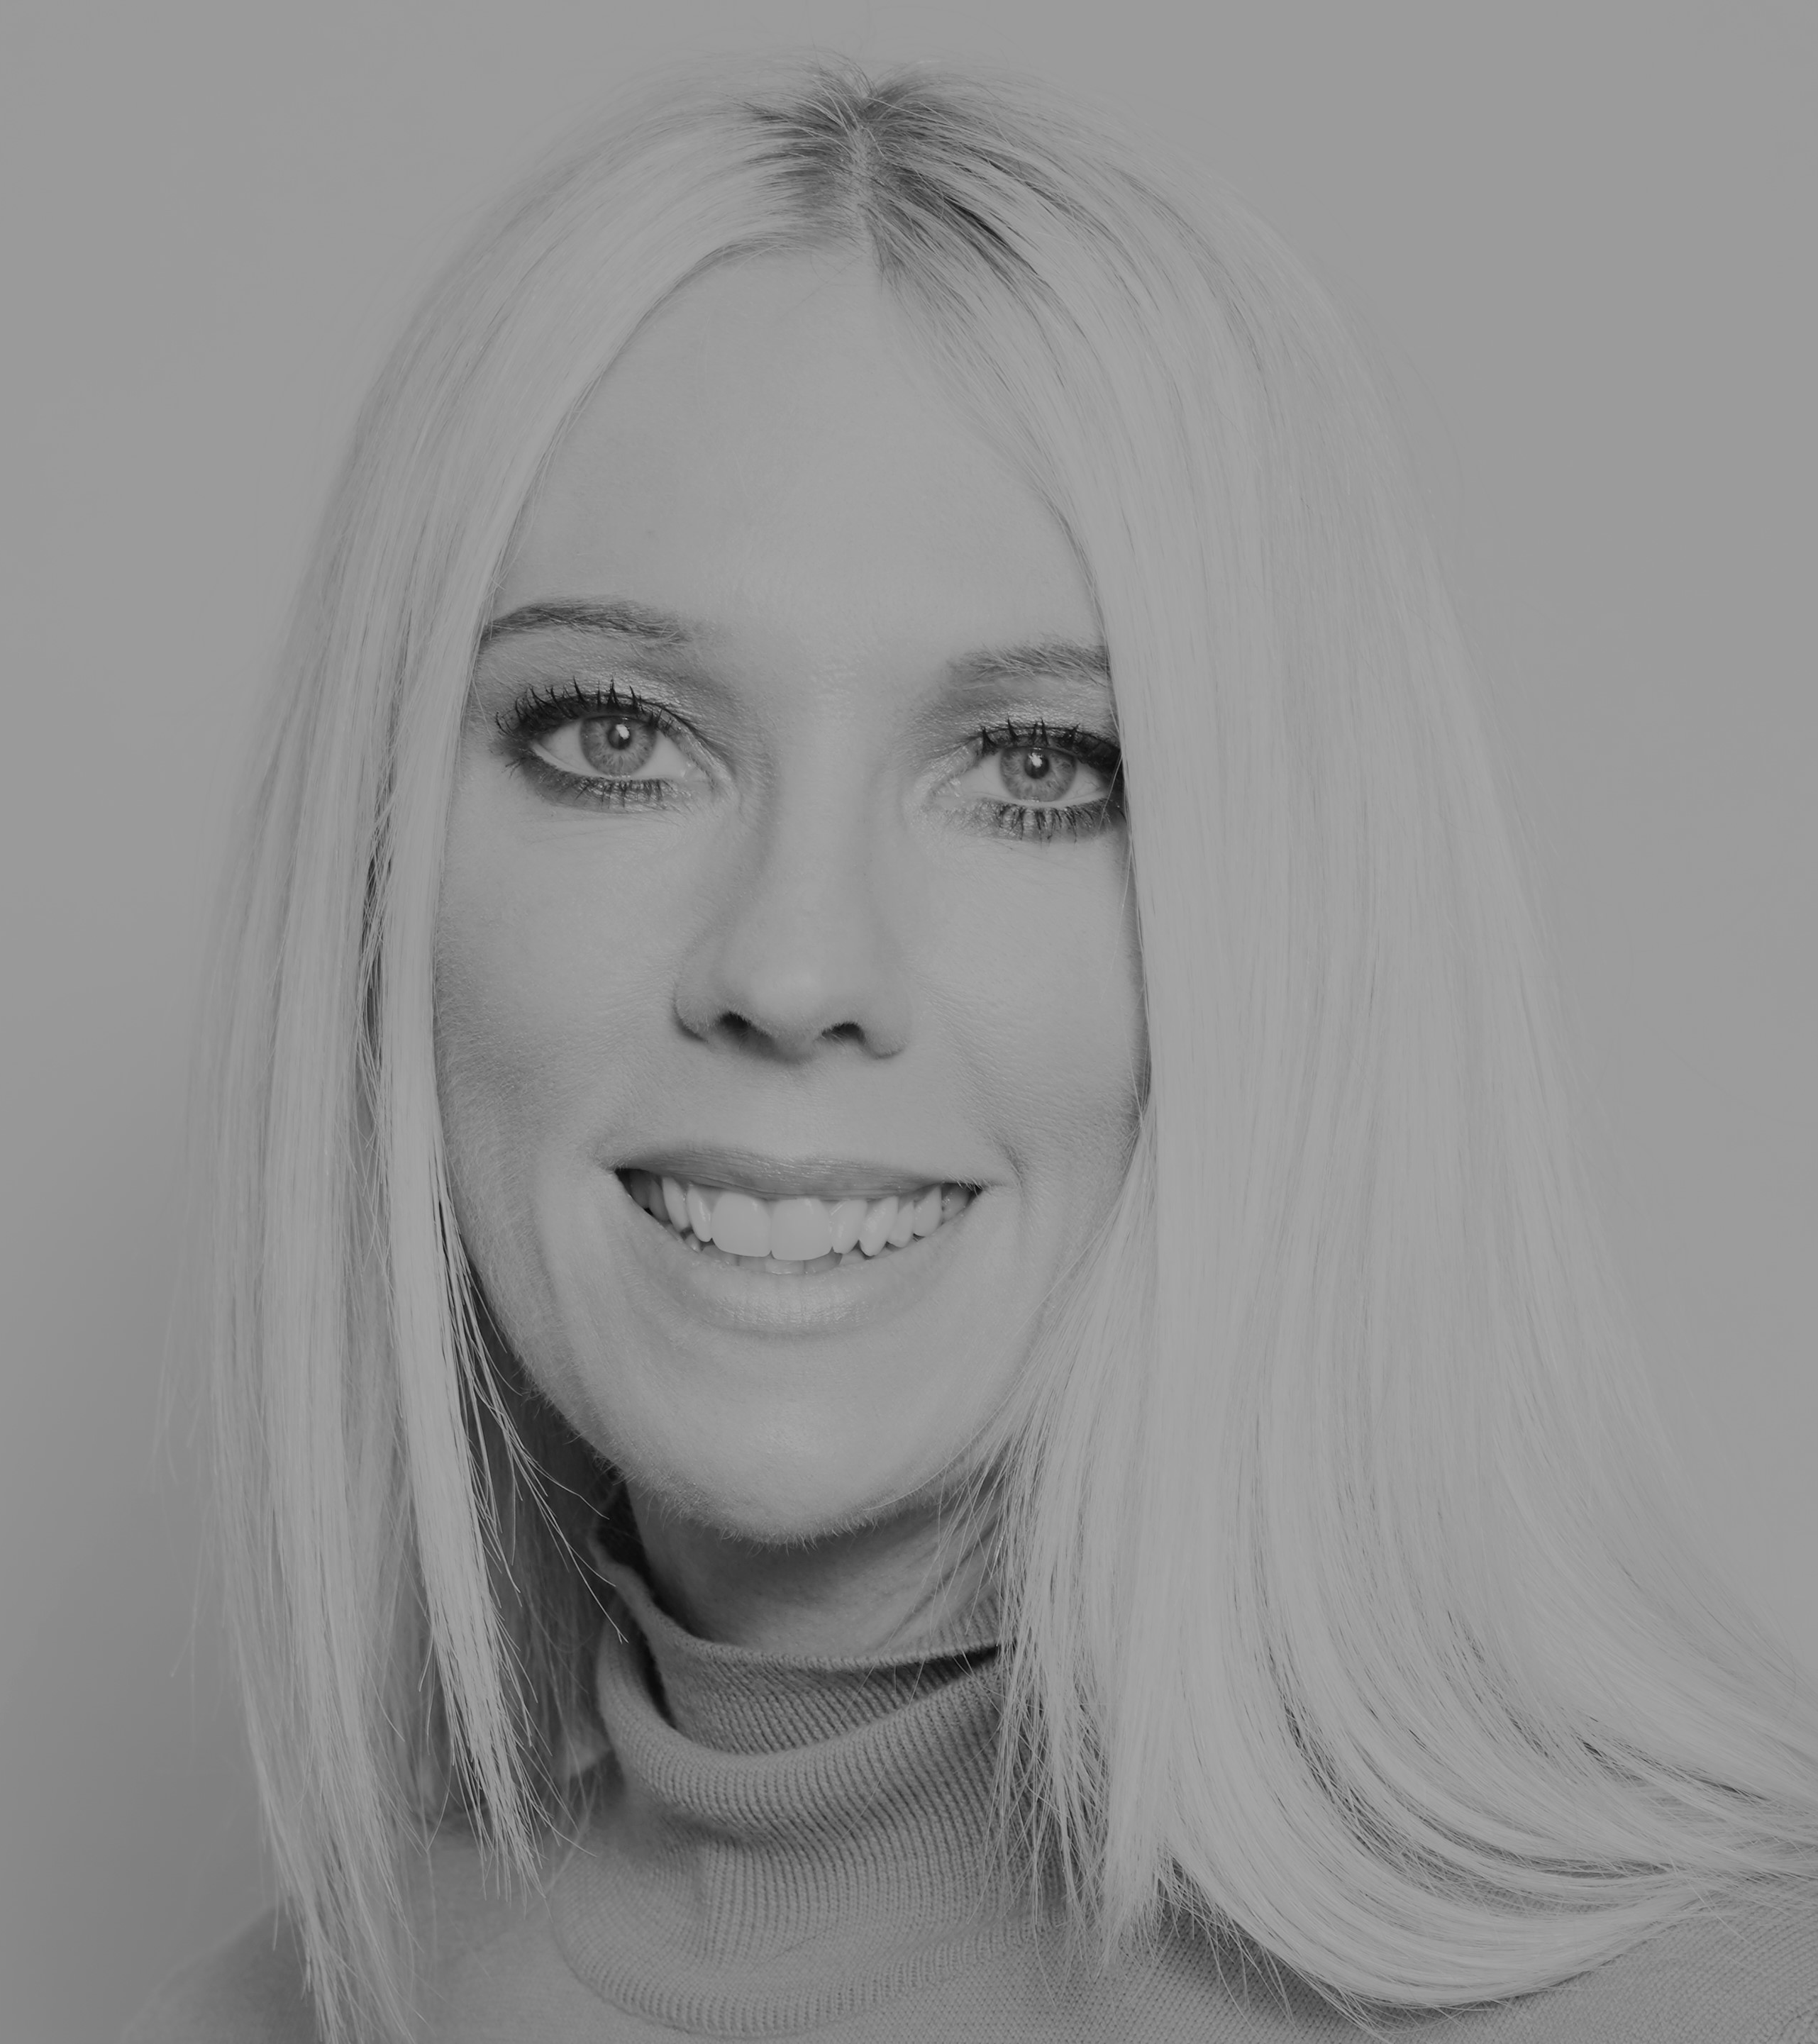
Today we have three people to help us explore ‘Be a Do-er’.
and…
and…
Matthew Syed Author and Broadcaster, Author of ‘Dare to be You’
Kathy Weeks
‘Dare to Be You’ Team
Cameron Parker
Motivational speaker

Slide 4
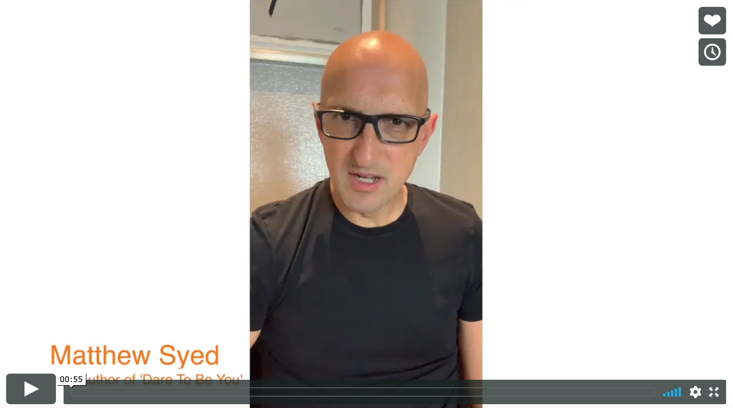


Today we are looking at ‘Be a Do-er’.
Watch this video of Matthew talking about why being someone who takes action and DOES something is important.
Be Do-er!
Matthew Syed
If you are reading along with us, read pages 107–125.

Slide 5
We’ve talked about:
The doubts that Kid Doubt puts in our heads
Celebrating our difference and uniqueness
Daring to be ourselves
Being different and the importance of diversity
The importance of making your own path – owning your own life
Being determined to be curious and question things
All of this is nothing though if you can’t make it HAPPEN.
You have to be a “do-er”, not just a “might do-er”!

Slide 6
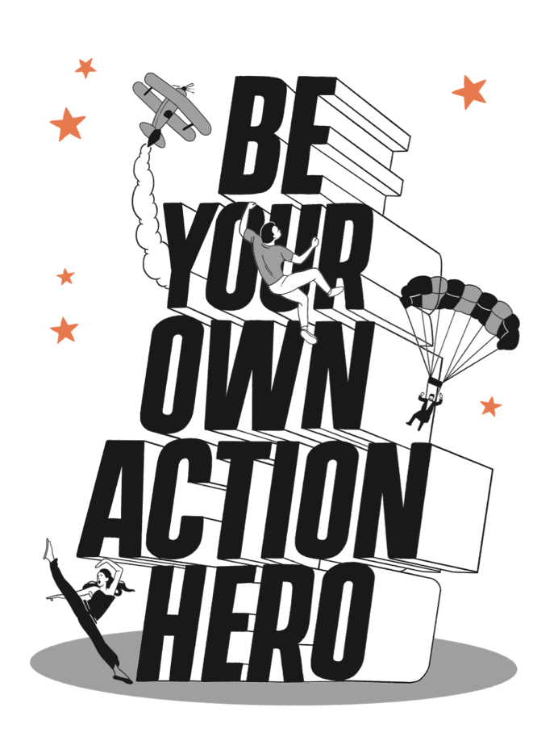
We want you to be able to…

Slide 7
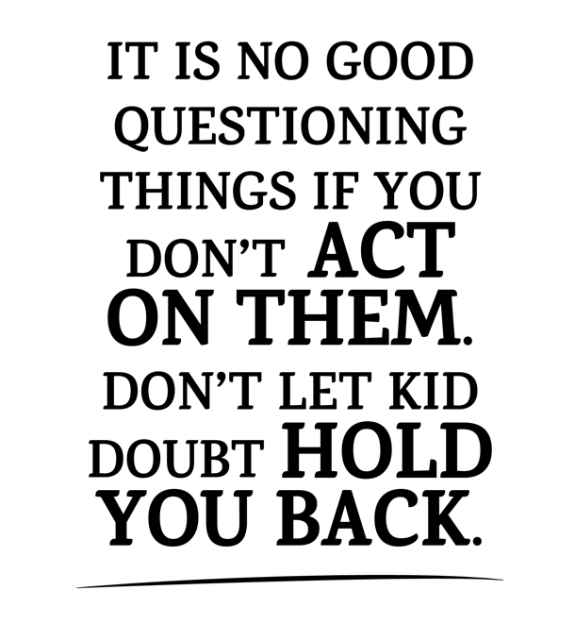
Ultimately, we need to follow these three steps:
ASK THE QUESTION
THINK OF A SOLUTION
ACT ON IT

Slide 8
One of the things Kid Doubt does is make us doubt so much that we do nothing. We know we have to act to make things change.
‘Doubt means DON’T. Don’t move.
Don’t answer.
Don’t rush forward.’
- Oprah Winfrey

Slide 9


People who want to be their own action heroes question the world around them, think of a solution and ACT on it. Here are some people who have done just that.
Richard Branson: When he was 28, Richard’s flight to the British Virgin Islands was cancelled. He was desperate to visit his girlfriend there, so he found a company who hired out planes, got the cost and split it between all the angry passengers. THAT is also how he got the idea for his new airline: Virgin Atlantic.
Melati and Isabel Wijsen: These sisters from Bali were just 10 and 12 when they learned about Rwanda’s ban on plastic bags. They wanted to do the same in Bali. They set up a campaign called ‘Bye Bye Plastic Bags’, aiming to eradicate plastic bags in Bali and beyond. Bali is now plastic free.
Check out the other examples on page 118 if you are reading along.

Slide 10
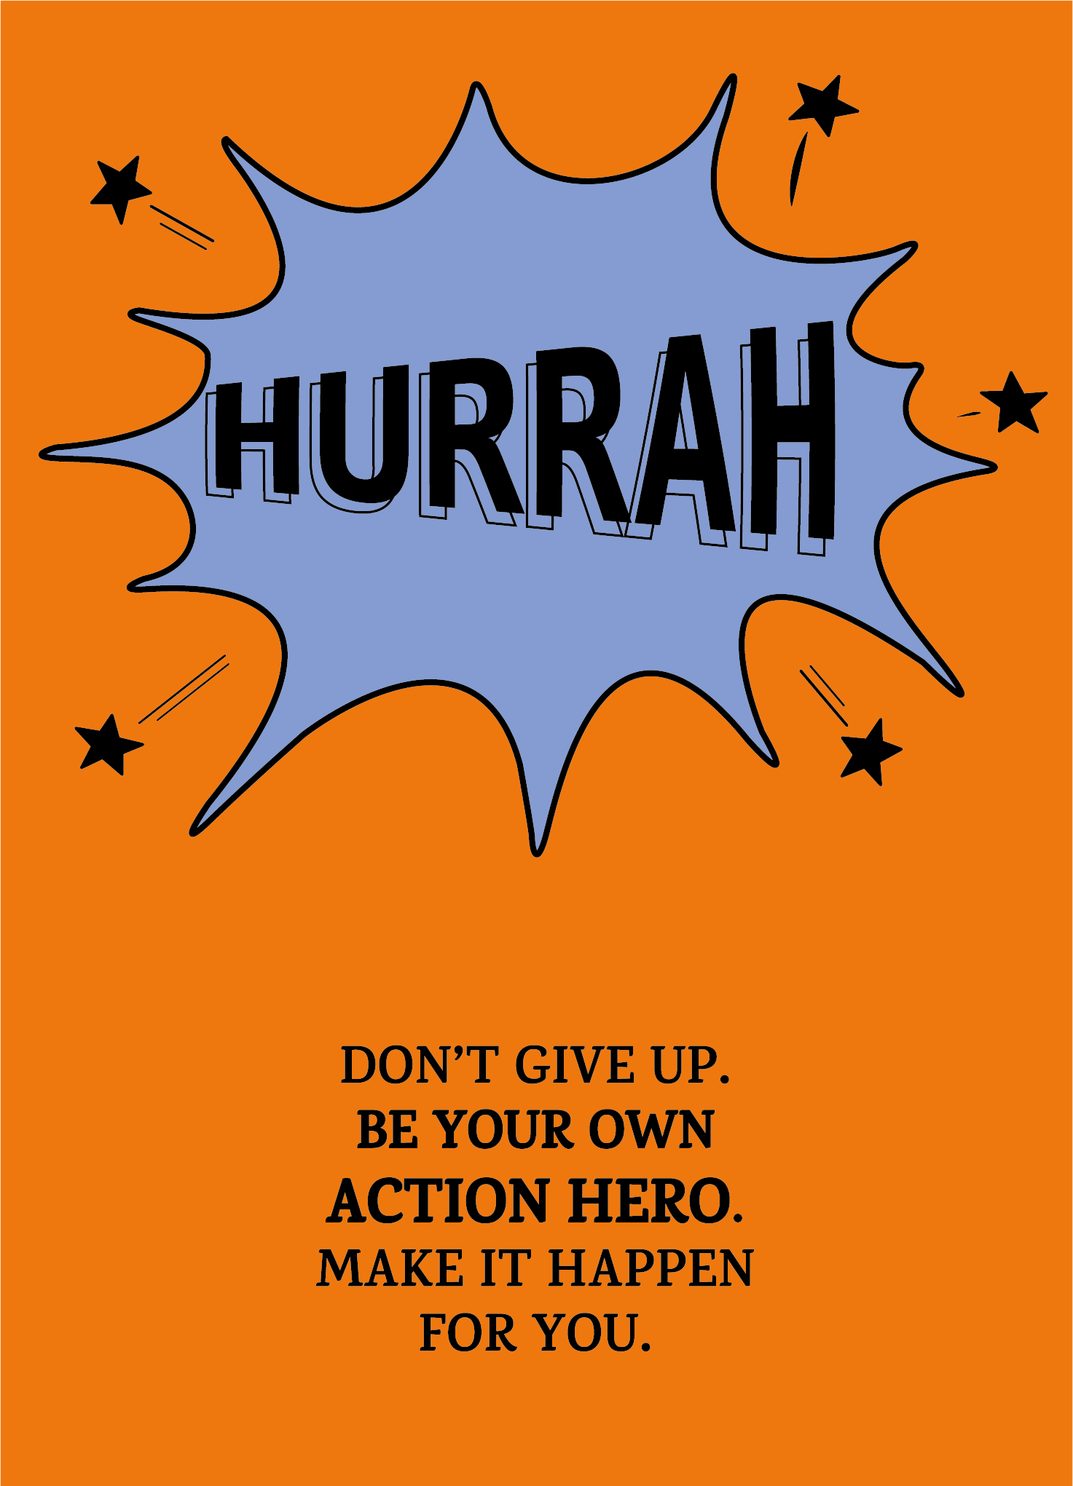
You don’t have to necessarily change the world: you can be your own action hero by questioning, finding solutions and making things happen.

Slide 11
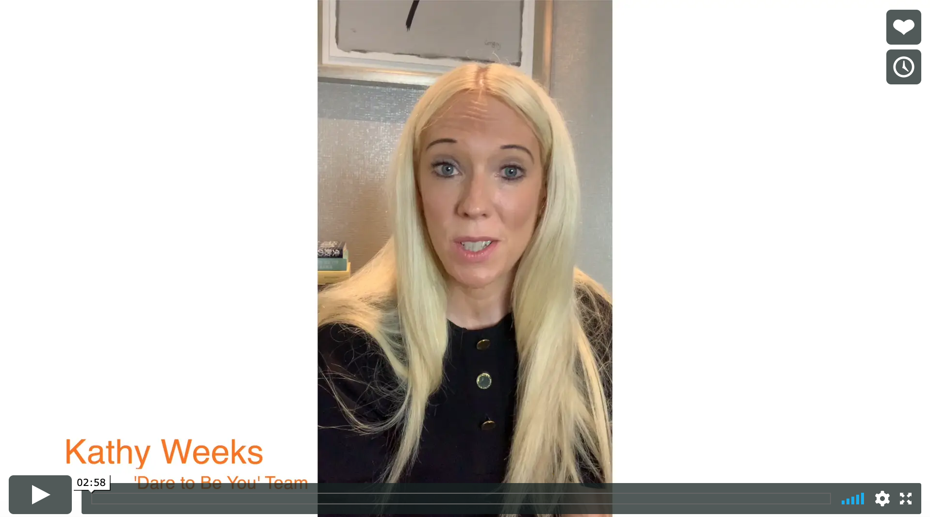
Real life
Be a Do-er!
Kathy Weeks

Slide 12

Sometimes it helps just to write things down. For example:
ASK THE QUESTION:
Why am I struggling to get organised to complete my school
work now I am back at school?
2. THINK OF A SOLUTION:
I could work out a routine so that I start getting back into a pattern,
including finding the one same place to do all my work.
3. ACT ON IT:
Talk to the adults in my house, get everything set up and start going there
to do my work. Create a to-do list each day and tick it off as each task is completed.
Have a look at this example and then complete one of your own in your workbook.

Slide 13
The power of ‘I could…’
When you use the words ‘I wish’ or ‘they need to’ or ‘someone should’, replace them with the words ‘I could’ or ‘I could ask’.
Examples:
‘They need to set up a drama club at school, we don’t have one’.
Instead try: I COULD set up a drama club at school, we don’t have one.
‘I wish I had someone to help me with my homework’.
Instead try: I COULD ASK someone to help me with my homework.
Try writing out some of your list using ‘I could’ instead of ‘I wish’

Slide 14

If you want to be your own action hero then you have to turn your ‘I could’ into ‘I will’. Take those first few steps.
Don’t give up. Be your own action hero.
Make things happen for you!

Slide 15
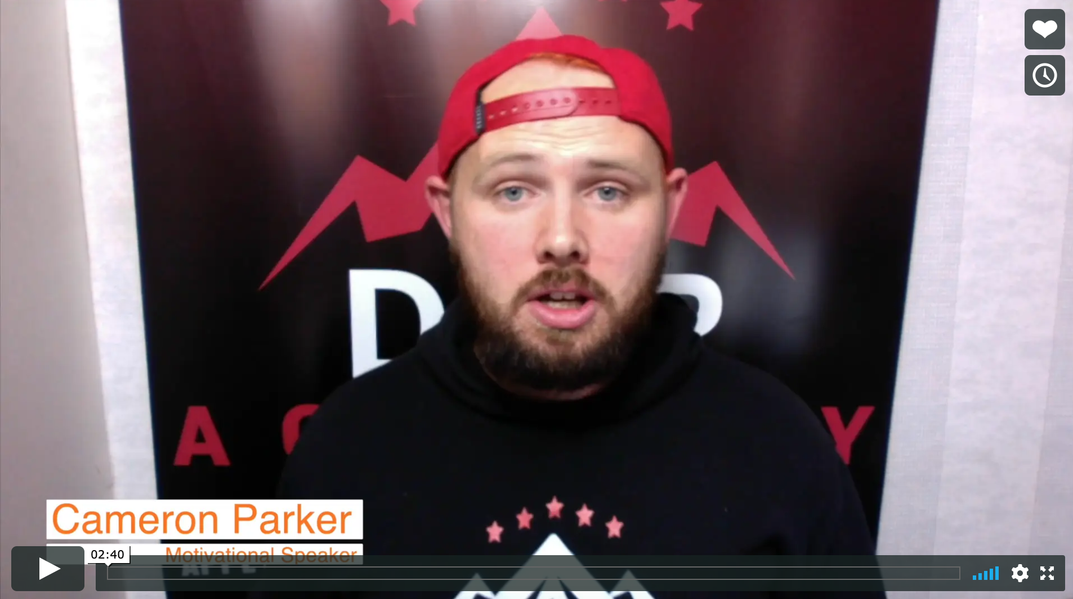
Real life
Be a ‘Do-er’
Cameron Parker

Slide 16
© 2020 The PiXL Club Ltd and Hachette UK
This resource may be shared with any school in its current form, and parts thereof, to enhance your work with students. All opinions and contributions are those of the authors. The contents of this resource are not connected with, or endorsed by, any other company, organisation or institution.
If there are any inadvertent omissions or errors in the acknowledgements or usage, this is unintended and we will remedy these on written notification.
Hachette UK own 'Dare to Be You' by Matthew Syed, which may be purchased by individuals and schools, should they wish to do so to enhance these resources for students. Illustrations copyright © Toby Triumph.

