Slide 1


Session 7
Be Determined

Slide 2

In the last session we looked at:
Why we want to copy people
How we decide what to copy and
what helps us
Who we actually want to be

Slide 3
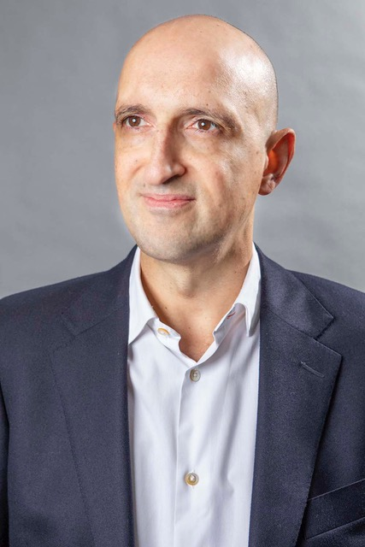
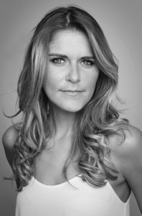
Today we have two people to help us explore ‘Be Determined’.
and…
Matthew Syed Author and Broadcaster, Author of ‘Dare to be You’
Gemma Oaten Actress and TV star

Slide 4
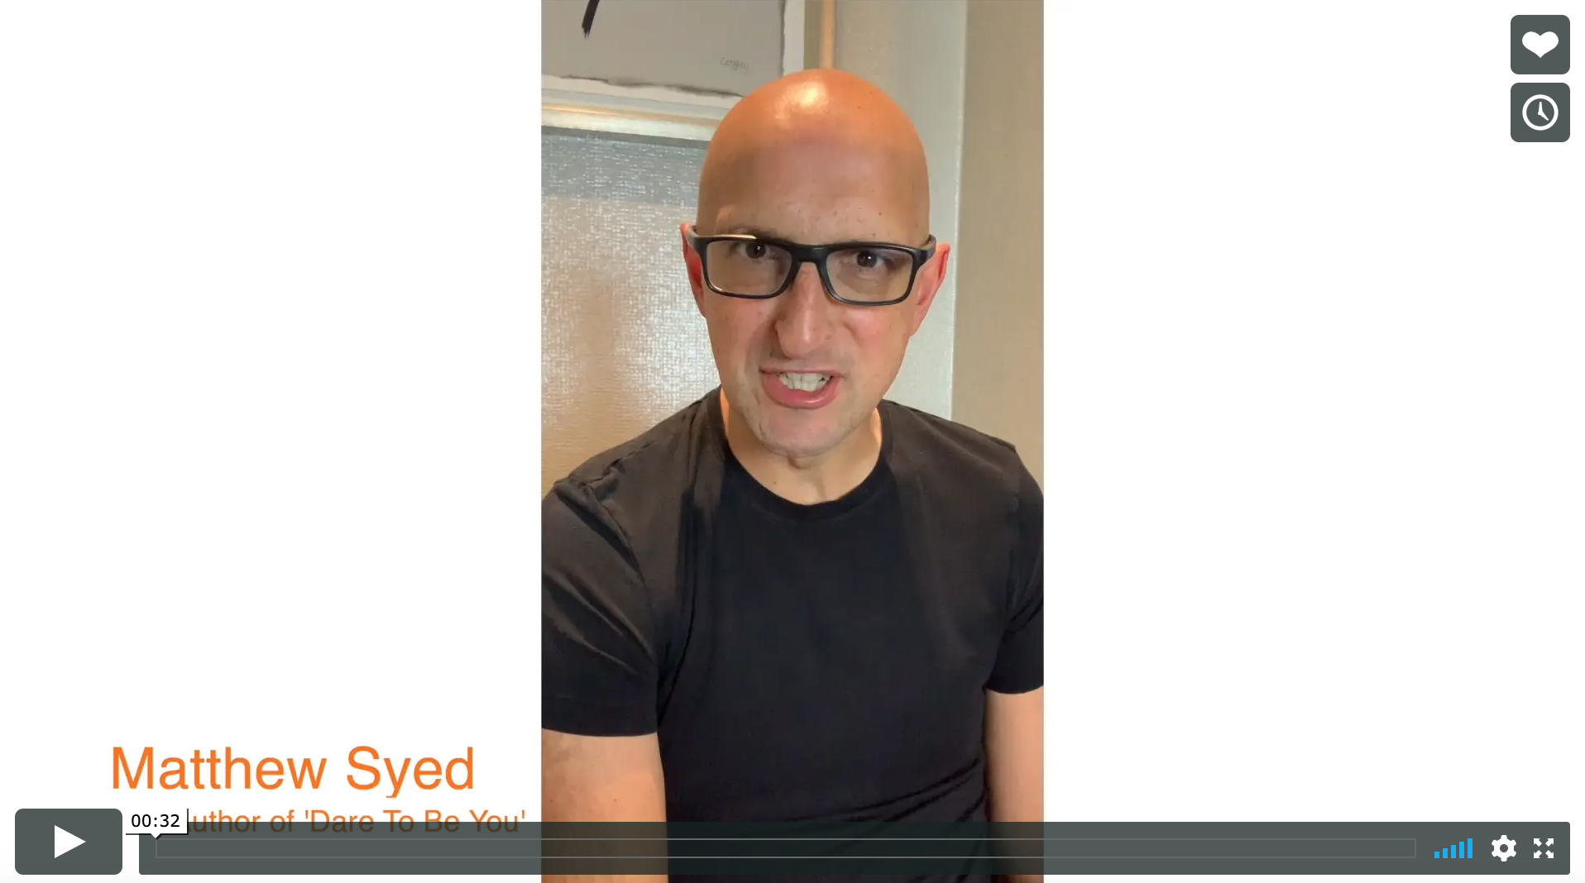


Today we are looking at ‘Be Determined’.
Watch this video of Matthew talking about why being curious matters.
Be Determined
Matthew Syed
If you are reading along with us, read pages 87–107.

Slide 5
Part of daring to be you, is to be curious.

Slide 6
Working out your own path and learning how to be you (and not just copying others), doesn’t always happen straight away. People who have been around much longer than you, still struggle with this.
Matthew Syed said he did the following things when he was in a job that wasn’t making him happy:
I questioned whether the job was RIGHT for ME.
I questioned whether there was something that would be BETTER FOR ME.
I questioned whether I could MAKE A CHANGE.
Having the confidence to question what is happening around you and an ability to be flexible as things change are two of the most important skills you can build for the future.

Slide 7

Navigating change is something we have to get good at.
Think about what we have all just been through, where everything we knew and we were used to changed:
Schools closed
Exams were cancelled
You worked from home with teachers contacting you at home
Your parents may have worked from home too
School looks a little different now
COVID-19 meant the whole world had to change. On a smaller level, throughout our life we have to work out how to manage change. Complete the workbook pages on ‘change’.

Slide 8





The radio took 38 years to reach 50 million listeners after it had been invented.
Some people think that things are changing at the fastest rate we have ever seen in history.
The TV took 13 years to reach 50 million viewers.
It took the internet 4 years to reach 50 million users.
Check out the other examples on page 94 if you are reading along.
It took Facebook less than 2 years.
It took Pokemon Go just 19 days!

Slide 9

If we want to have success in a world that is changing then we need…

Slide 10



We need to be determined that no matter what the change we are facing, we have the means to handle it.
We need to make sure we are happy to:
Question things
Be curious about better ways of doing things
Be adaptable when we need to make changes

Slide 11



The coronavirus pandemic is a recent example where everything has had to change, but there have been lots of
head-spinning changes throughout history.
MONEY BAGS: We haven’t always used money, we used to swap animals or other possessions for items that we needed. As things evolved, people started using coins instead as they didn’t always want the swap on offer!
CENTRE OF THE UNIVERSE: We used to think the Sun revolved around the Earth! We had to do a serious rethink when Copernicus discovered in 1543 that the reality was the exact opposite.
BRIGHT SPARKS: Electricity is a relatively recent thing – the first proper lightbulbs weren’t really used until 1882. Imagine if we hadn’t been adaptable and ready for that change?

Slide 12

According to a piece of research by Dr Sam Wass, young children ask 73 questions every single day. Our curiosity is at its maximum when we are 4 years old. That’s when we ask the most questions.
When we are 4 years old, Kid Doubt does not bother us and we don’t have the worries that Kid Doubt can make us think about.

Slide 13



Be determined
Keep questioning
Keep asking
Stay curious

Slide 14

Have the courage to see if there is a way that things could work better.
Could I change the way I feel about this situation?
Could the way I organise schoolwork, work slightly better?
Does the way I am behaving in that class serve me well?

Slide 15
In your workbook, think about:
What can I definitely change?
What do I think I can’t change (but maybe if I’m brave enough to question it I can)?
What can I definitely not change?
Take charge. Ask the questions. You can do it.

Slide 16
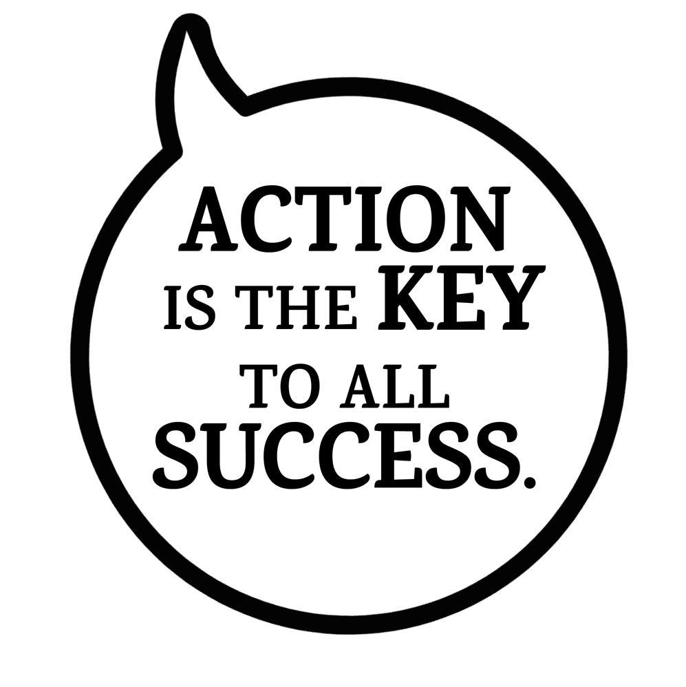

The next session is going to help you take action!

Slide 17
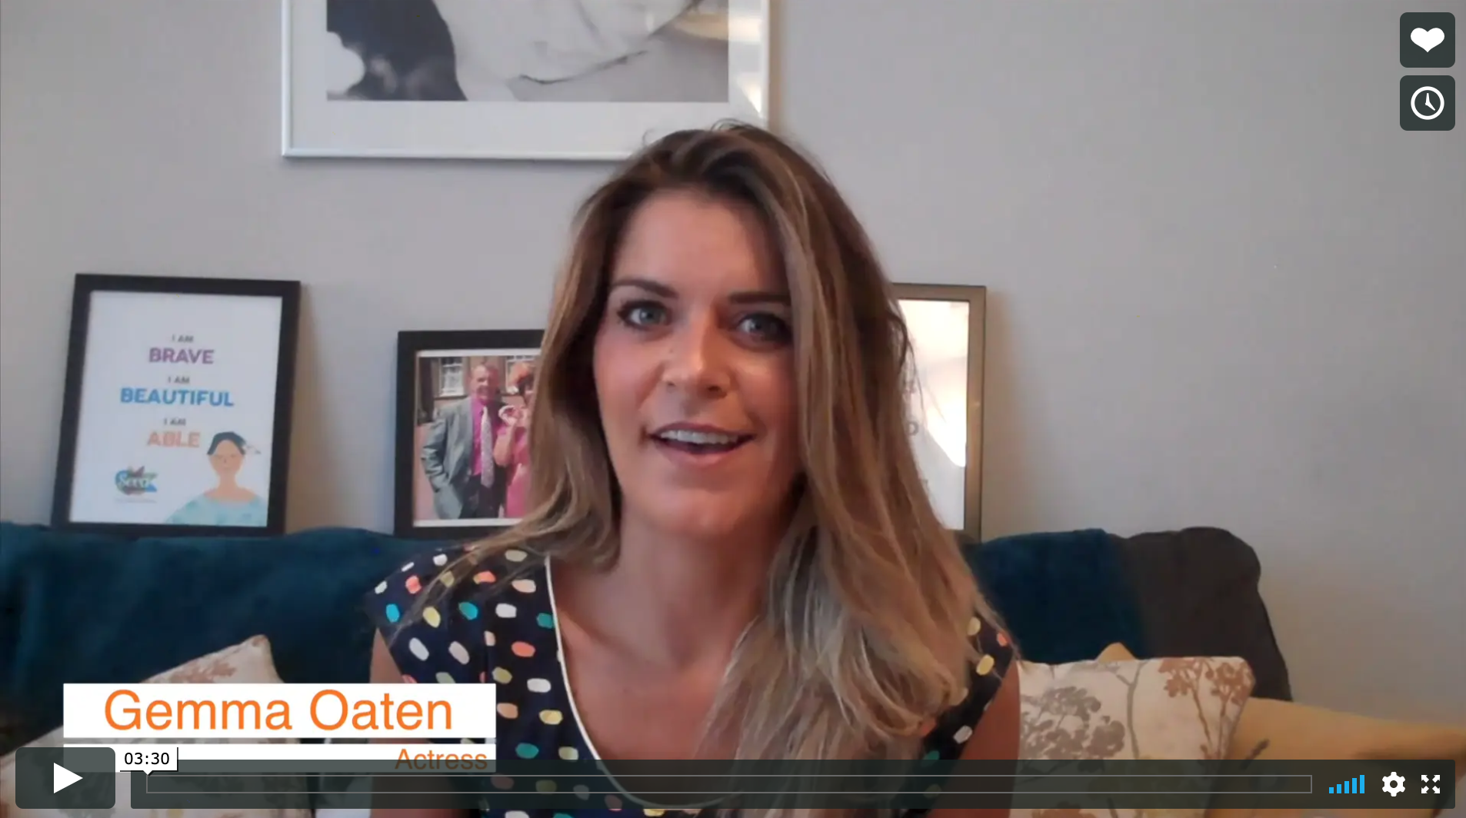
Real life
Be Determined
Gemma Oaten

Slide 18
© 2020 The PiXL Club Ltd and Hachette UK
This resource may be shared with any school in its current form, and parts thereof, to enhance your work with students. All opinions and contributions are those of the authors. The contents of this resource are not connected with, or endorsed by, any other company, organisation or institution.
If there are any inadvertent omissions or errors in the acknowledgements or usage, this is unintended and we will remedy these on written notification.
Hachette UK own 'Dare to Be You' by Matthew Syed, which may be purchased by individuals and schools, should they wish to do so to enhance these resources for students. Illustrations copyright © Toby Triumph.

