Slide 1


Session 6
Be Decisive

Slide 2

In the last session we looked at:
How diverse teams are better teams
What you can do to be distinctive
How we need to find our own voice and opinions

Slide 3
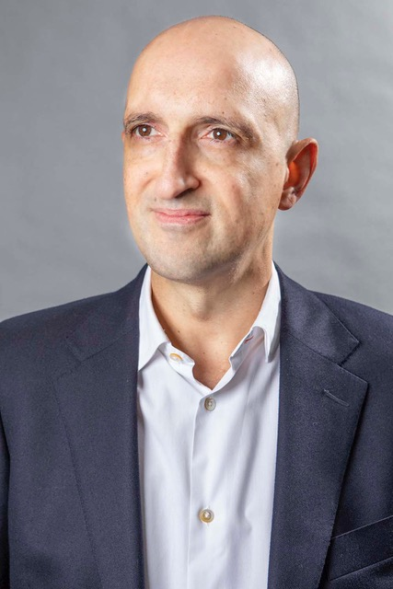
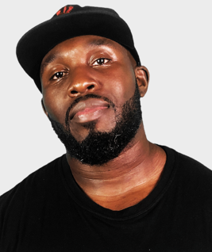
Today we have two people to help us explore ‘Be Decisive’.
and…
Matthew Syed Author and Broadcaster, Author of ‘Dare to be You’
Mr Beezy
Motivational speaker

Slide 4
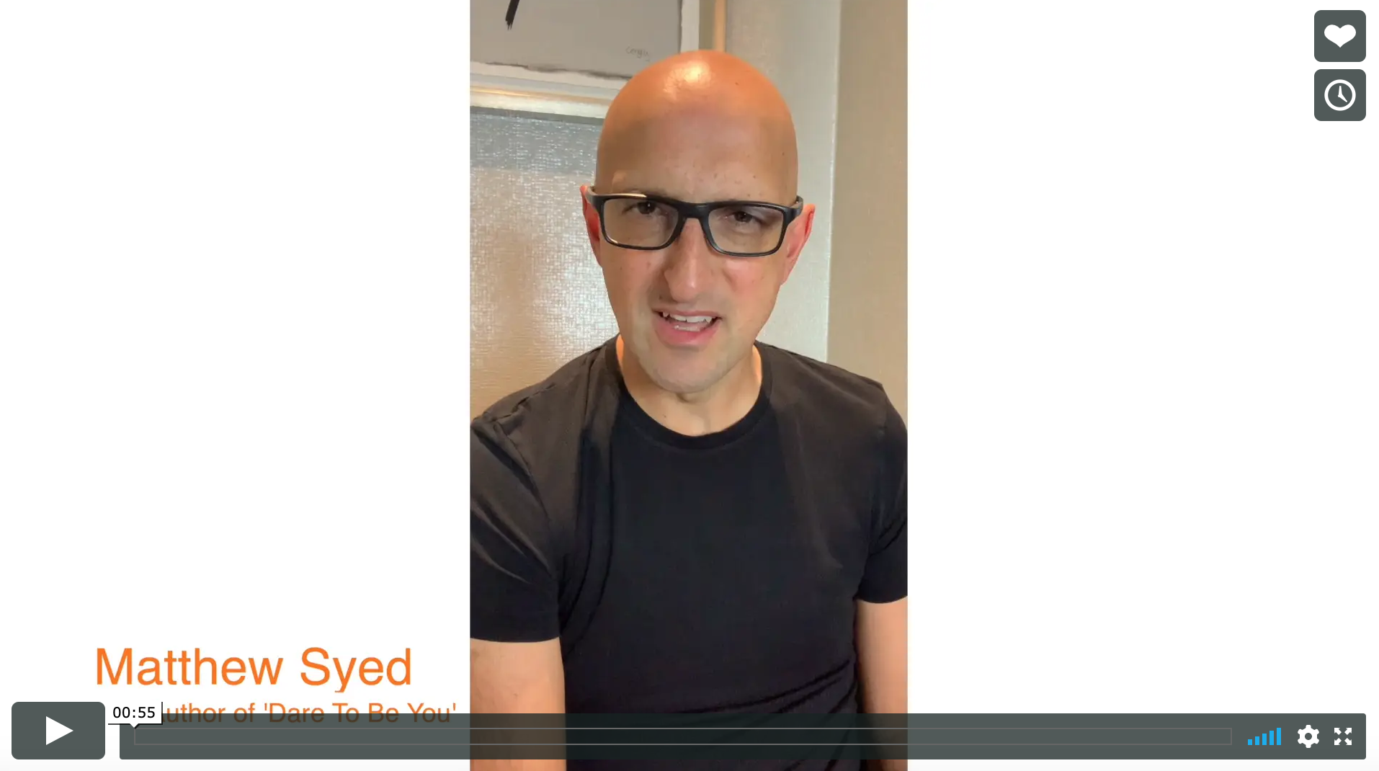

Today we are looking at ‘Be Decisive’.
Watch this video of Matthew explaining why we need to not become clones.
Be Decisive
Matthew Syed
If you are reading along with us, read pages 71–87.

Slide 5
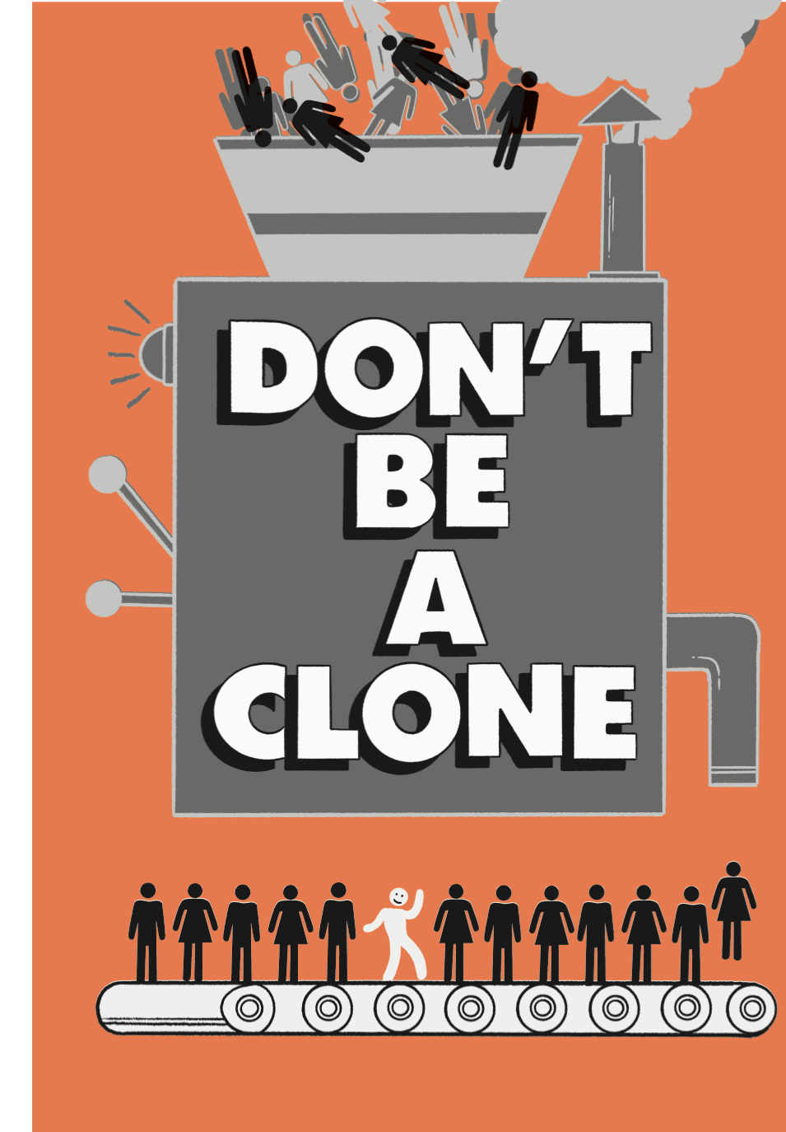
It’s great to admire people BUT sometimes we can try too hard to be just like them:
We become like clones
We dress like them
Talk like them
Behave like them
Make choices that they would make
Believe what they believe

Slide 6

Why do we behave like clones?
Joseph Henrich, a professor at Harvard University, has a theory that human beings have a tendency to OVER-COPY or to OVER-IMITATE people who we think are successful.
When we were babies, we copied everything, and we have never really stopped!

Slide 7

When you are a baby, you learn how to use a spoon by watching adults. You copy them. But the decision to copy everything means that you start copying lots of things that have NOTHING to do with using a spoon.
You copy the adult’s:
smile (nothing to do with the spoon)
tone of voice (nothing to do with the spoon)
additional actions they are doing at the time, like being on social media (nothing to do with the spoon)
In the end, you might copy the way they turn the spoon towards their mouth (useful and definitely to do with the spoon!)
Eventually you get to the relevant spoon part but you have copied a lot of unhelpful un-spoon related stuff in the process.

Slide 8
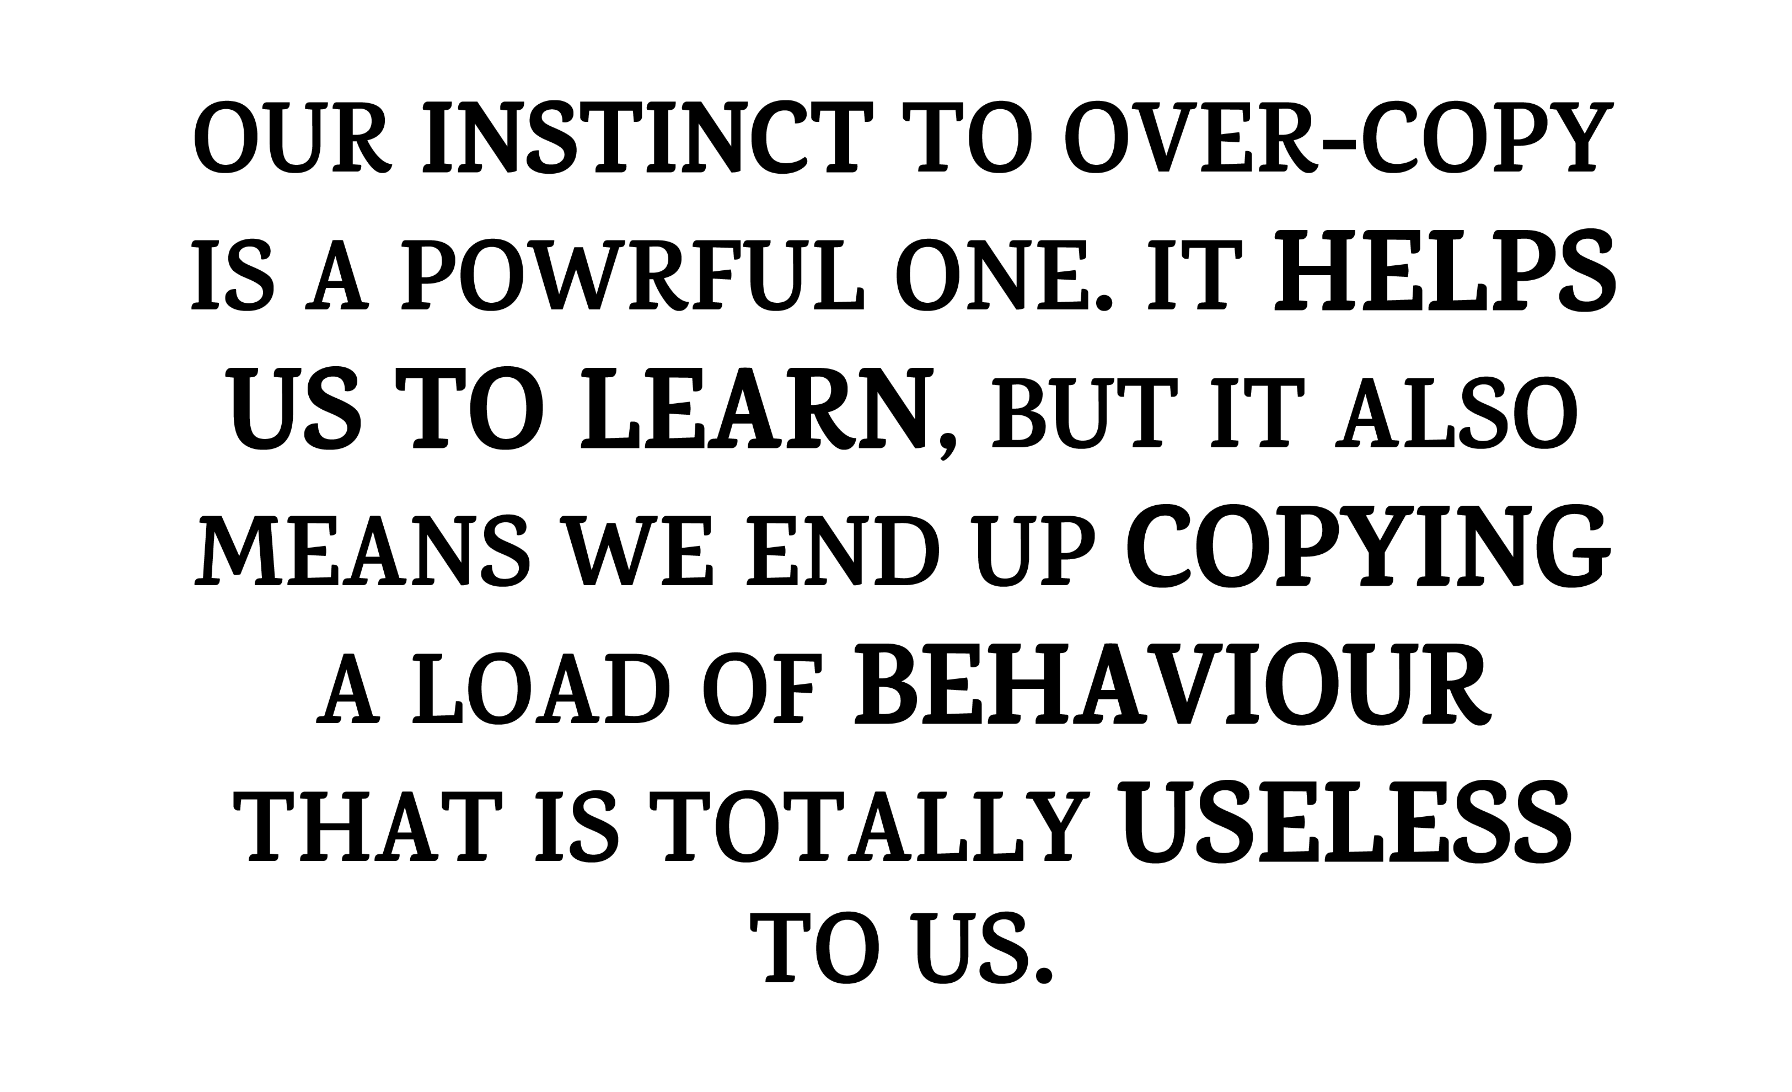

Slide 9


Why are we obsessed with copying people?
What are we copying?
People like Beyoncé Knowles are paid millions to advertise products like Pepsi. The hope is that if people want to be like her, they will copy what she does, including buying Pepsi. Some might try singing and dancing lessons, others buy Pepsi. Drinking any drink isn’t going to make us perform like her, but we copy anyway. Companies make billions on the back of it.
It is logical to try and copy things about people you truly admire. If you copy Malala Yousafzai’s bravery this would be a sensible thing to do. Copying her gym schedule or what she likes to eat isn’t going to make you an international ambassador for peace though.

Slide 10


What is it about people that we are copying? Are you even aware of it?
Things about people you might copy
and would be helpful:
Determination
Practising the guitar
Dance/singing lessons
Bravery and courage
Kindness and empathy
Hard work
Things about people you might copy
and you need to ask why:
Buying the same clothes they have
Their bad behaviour
Their negative attitude
The way they treat others badly
The way they avoid work
Be yourself! Copy the traits you admire that are likely to be good for you, such as kindness, hard work and courage.

Slide 11

It is time to BE DECISIVE and decide who YOU actually are and who you want to be.
In your workbook:
Think about someone who you have been copying but some of the things you have been copying are not helpful.
Write down what you have been copying that wasn’t really ‘you’. E.g. being unkind to people or wearing clothes that you don’t really like.
What is the one thing you want to change?
Think about someone you admire. It could be someone you know or someone famous.
Write down all the things that made you want to copy that person.
Now underline the ones that are going to help you achieve YOUR goals.

Slide 12


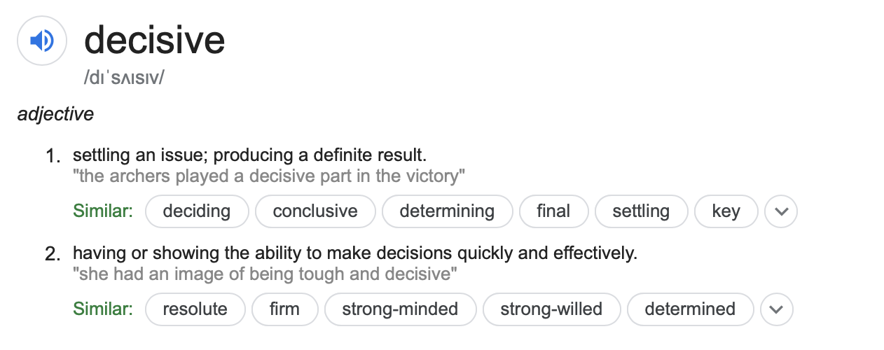
Decisive
Setting an issue; producing a definite result.
Having or showing the ability to make decisions quickly and effectively.
We must make the decision to embrace our differences and to find our own opinions and ideas. We need to be aware of what we are copying and why. Is it helping us become who we want to be?

Slide 13


If we are going to make a change, we must have an idea about who we want to be. Look at the list below: which ones describe who you want to be? Write them in the person outline in your workbook.
Kind
Compassionate
Empathetic
Determined
Courageous
Decisive
Encouraging
Thoughtful
Friendly
Creative
Hard working
Caring
Organised
Efficient
Brave
Patient
Optimistic
Honest
Sincere
Spiritual
Daring
Accepting
Truthful
Trusting
Look up these words online or in a dictionary for more explanation

Slide 14
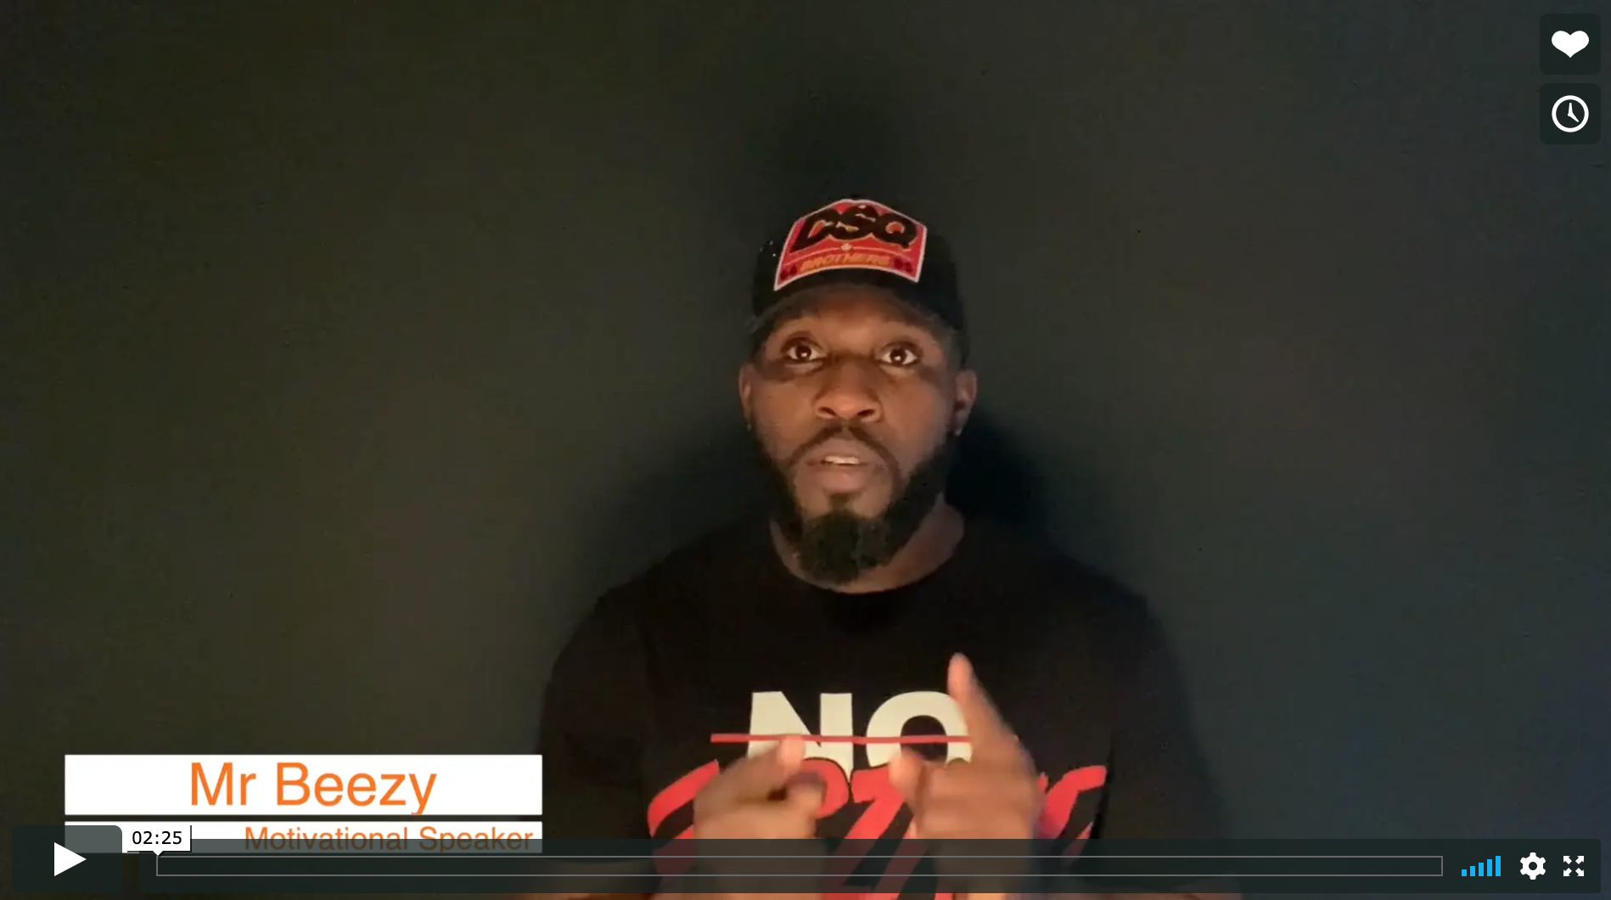
Real life
Be Decisive
Mr Beezy

Slide 15
© 2020 The PiXL Club Ltd and Hachette UK
This resource may be shared with any school in its current form, and parts thereof, to enhance your work with students. All opinions and contributions are those of the authors. The contents of this resource are not connected with, or endorsed by, any other company, organisation or institution.
If there are any inadvertent omissions or errors in the acknowledgements or usage, this is unintended and we will remedy these on written notification.
Hachette UK own 'Dare to Be You' by Matthew Syed, which may be purchased by individuals and schools, should they wish to do so to enhance these resources for students. Illustrations copyright © Toby Triumph.

