Slide 1
Session 5
Be Distinctive

Slide 2
In the last session we looked at:
How important being different is
Why all of us have different things to contribute
Refusing to hide the things that are different about us

Slide 3
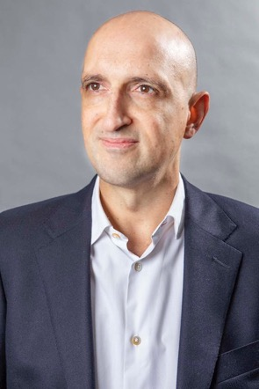
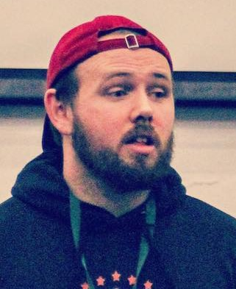
Today we have two people to help us explore ‘Be Distinctive’.
and…
Matthew Syed Author and Broadcaster, Author of ‘Dare to be You’
Cameron Parker
Motivational speaker

Slide 4
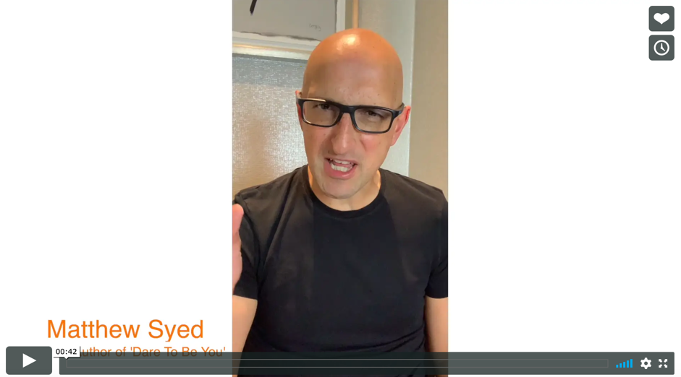
Today we are looking at ‘Be Distinctive’.
Watch this video of Matthew explaining why we need to embrace having different opinions.
Be Distinctive
Matthew Syed
If you are reading along with us, read pages 59–71.

Slide 5
We have talked about lots of differences: our appearance, our background, our body type and our experience of life.
But what about differences of opinion?
In your workbook, answer the questions about how comfortable you are expressing your own opinion:
a) at home b) at school c) with your friends.
What stops you expressing your own view?

Slide 6
This is YOU.
This circle represents how much you know now.
As you gain knowledge and skills, this circle will grow.
YOU in a few years time.
You know more.
You can do more

Slide 7
Imagine this diagram represents the ‘cool kids’ at your school.
Student A
Student D – She doesn’t know anything that Student A doesn’t already know. She sits next to Student A, they talk all the time and she wants to be just like her. She has been copying Student C too. Her circle is completely inside Student A’s.
Student B
Student D
Student A – Knows a lot.
Student B – Knows quite a bit but a lot of what he knows is the same as what Student A knows. He has been copying her for ages now.
Student C
Student C – She knows quite a bit, but a lot of what she knows is the same as Student A and Student D. She has been copying both of them.

Slide 8
The problem with this model:
Everyone knows the same things
Everyone is trying to think like someone else
Everyone probably believes the same things
There is no difference of opinion

Slide 9
Imagine that the circle represents where all of the great ideas, inventions and brilliant breakthroughs could possibly come from. Let’s call it:

Slide 10
If we put the ‘cool kids’ in ’The World of Good Ideas’, what happens?
They have some good ideas between them.
They have spent so long trying to copy each other and making sure they fit in they have become clones of each other.
There is a lot they don’t know, and a lot they won’t find out!
Student B
Student A
Student D
Student C

Slide 11
Do you want to be distinctive? Do you want to be different?
OPTION 1
OPTION 2
YOU
YOU
Where do YOU want to be?
OPTION 1: In with the cool kids but not many ideas of your own?
OPTION 2: Proud of thinking differently and bringing new and interesting ideas?

Slide 12
If you were asked to create a team for a class project, who would you choose from Option 2 to work with you?
YOU
You would choose the biggest circle wouldn’t you? Student A? All the others think the same as Student A so they aren’t needed in the team.

Slide 13
The best and most creative team might look like this:
Different people with different views
They will be great at problem solving
They will come up with the greatest number of possible solutions
They are not clones
They may have different backgrounds, different ideas, people with neurodiversity
They are proud of their differences
They understand why thinking differently is so important
YOU

Slide 14
There are LOADS of things that may make you feel different.
Whatever it is, embrace it and own it.
BE Distinctive!
Complete the reflection in the workbook:
The difference I can bring is…
The following things give me a different perspective from my friends…
I haven’t always embraced my difference because…

Slide 15
“I have Asperger’s and that means I’m sometimes a bit different from the norm. And – given the right circumstances – being different is a superpower.”
- Greta Thunberg, teenager and eco-activist

Slide 16
If you are going to embrace being different and being distinctive then you will need to do the following:
Start to think for yourself
Practise thinking your own thoughts when with your friends
Express an opinion, even though it may be different
Treat people with kindness, recognising that we NEED difference
Choose people who are different to you to talk to and work with
Learn from each other by listening
Expose your mind to ideas that are not the same as yours
Forge your own path

Slide 17
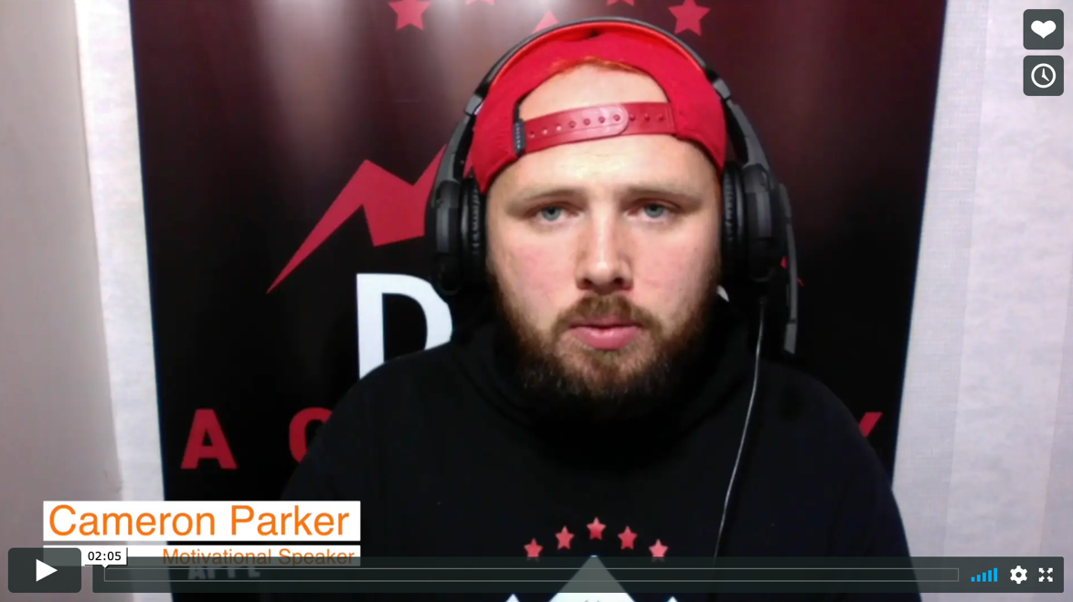
Real life
Be Distinctive
Cameron Parker

Slide 18
© 2020 The PiXL Club Ltd and Hachette UK
This resource may be shared with any school in its current form, and parts thereof, to enhance your work with students. All opinions and contributions are those of the authors. The contents of this resource are not connected with, or endorsed by, any other company, organisation or institution.
If there are any inadvertent omissions or errors in the acknowledgements or usage, this is unintended and we will remedy these on written notification.
Hachette UK own 'Dare to Be You' by Matthew Syed, which may be purchased by individuals and schools, should they wish to do so to enhance these resources for students. Illustrations copyright © Toby Triumph.

