Slide 1

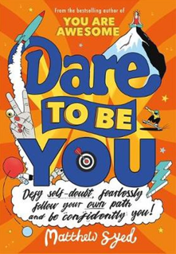
Session 4
Be Daring

Slide 2
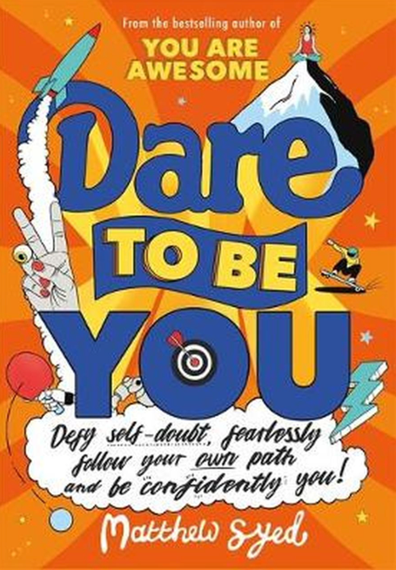
In the last session we looked at:
Where the idea of ‘normal’ came from
The problem with comparing ourselves to data-driven averages
Starting to explore what is unique about you!

Slide 3
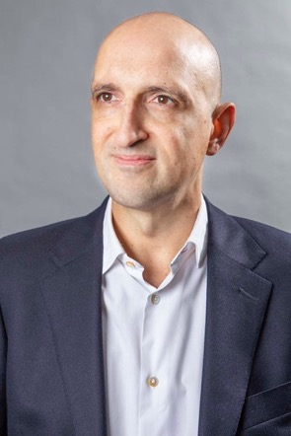
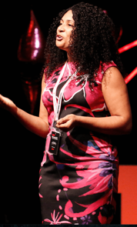
Today we have two people to help us explore ‘Be Daring’.
and…
Matthew Syed Author and Broadcaster, Author of ‘Dare to be You’
Jaz Ampaw-Farr
Resilience ninja!

Slide 4
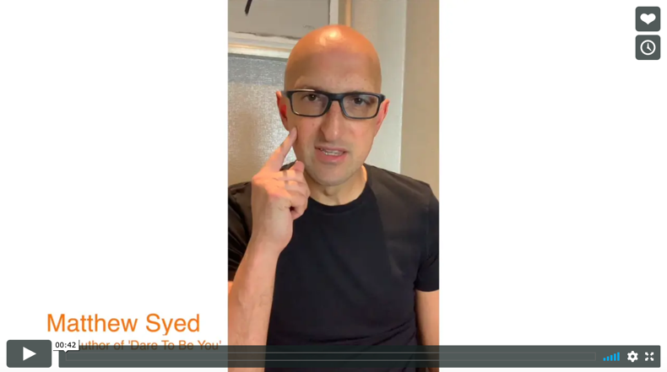

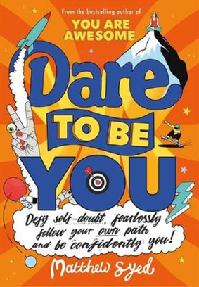
Today we are looking at ‘Be Daring’.
Watch this video of Matthew explaining why we need to dare to be the real version of us.
Be Daring
Matthew Syed
If you are reading along with us, read pages 42–58.

Slide 5



In recent years, we have started to embrace the idea of individuality and being different.
We have personal playlists and streaming services that make suggestions based on your preferences.
Even medicine has to be right for you – everyone has different hormones, fat levels, blood cells and so on.
Social media companies track your data and give you more of what you like (although this can have big problems attached too!)

Slide 6
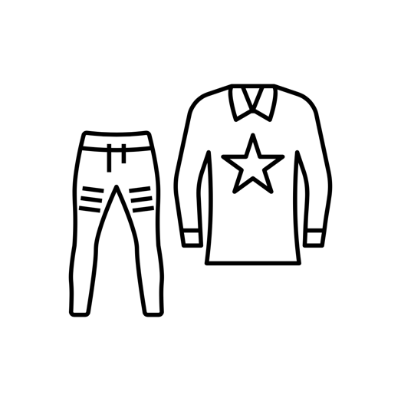

Although in other ways, we still assume everyone is the same!
Clothes don’t always fit us all perfectly even if we are all the same size in terms of the label – we may have longer or shorter arms, longer or shorter legs!
In primary school, do you remember the little chairs? For some they were too small and for others they were just right!
Can you think of any ‘normal nonsense’?

Slide 7
Kid Doubt can spring into action when we feel like we are different.
Sometimes we feel like we are different and we are upset by other people’s reactions to that. We can feel like:
We don’t belong
We don’t fit in
We feel shut out
We are being marginalised
We are ‘too different’
When did you last feel that you were different and Kid Doubt had something to say? Write your answer in your workbook.

Slide 8

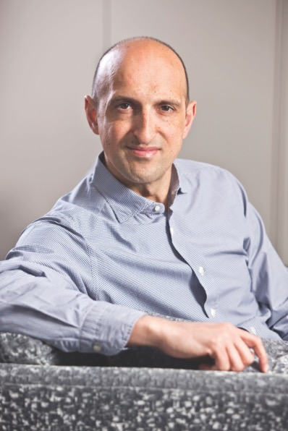
This is what Matthew Syed says about his experience of feeling different:
“It doesn’t matter what makes you feel different. It might be your skin colour, like me. Or your hair colour. Or that you like boys better than girls or girls better than boys. Or that you like chess not dance. Or that you prefer maths to nail varnish. Or that you have ADHD. Or that your mum needs you to look after her. Or that you don’t see your dad. I could go on for ever with this list. Seriously, I could.”
Matthew Syed page 52

Slide 9
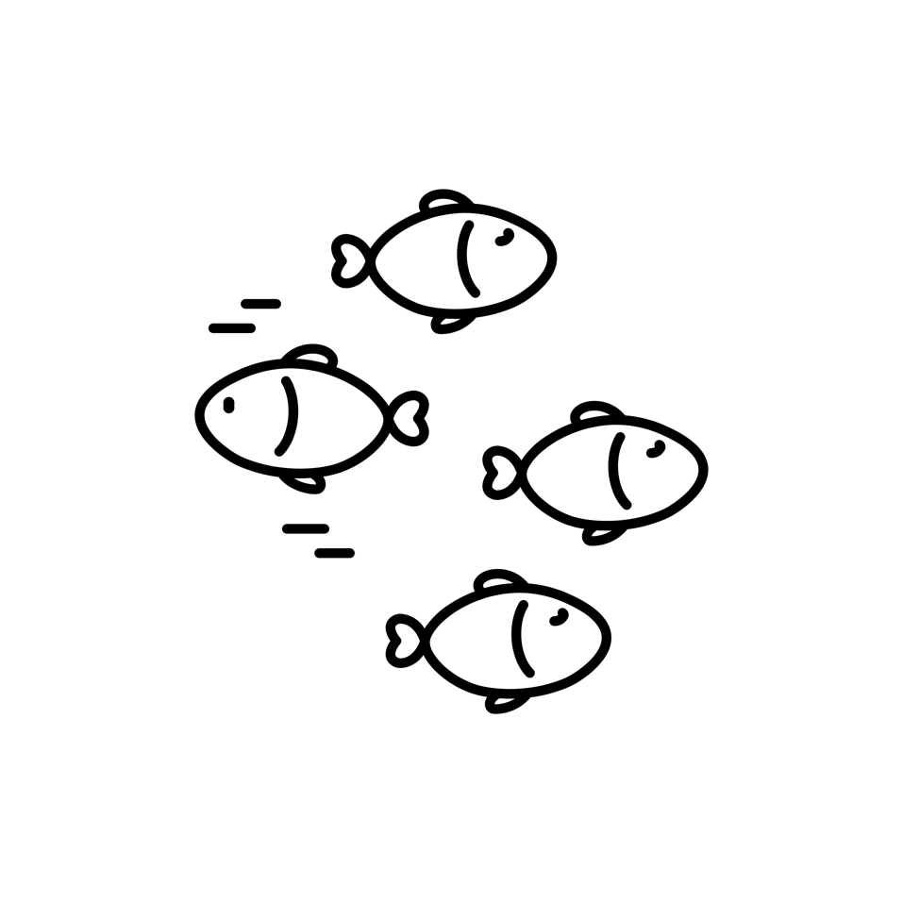
BUT it is important to be DIFFERENT. What if we could show you that the BEST IDEAS come from people who are different? What if we could show you that being different might make you MORE SUCCESSFUL?
Would you dare to embrace your differences then?

Slide 10

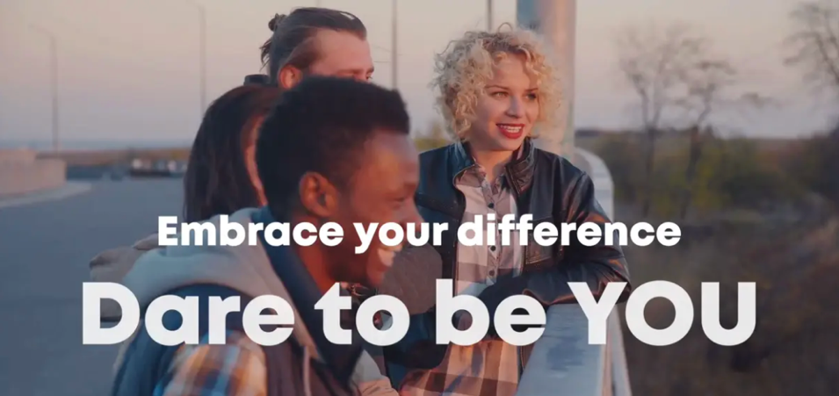
Here are 3 people who embraced what other people called ‘different’ – and look what they achieved:
Google – Sergey Brin
Pepsi – Indra Nooyi
Yahoo! – Jerry Yang
Watch this video and see what they achieved.
How did their difference give them the edge?

Slide 11

What do these three people have in common?
“None of these highly successful business people were born in the USA. They were immigrants, and came to America after having lived in other countries. Research by the Kauffman Foundation has shown that you are TWICE as likely to start a new business if you are an immigrant.”
Matthew Syed, ‘Dare to Be You’ page 54
Here’s why!
These people:
know about changing things up
have lived and worked in different cultures
understand different beliefs and languages
gather different ideas from different places
can challenge thinking because they’ve seen different things

Slide 12

By bringing a different view, they are able to think in different ways!
Did you know that…
More than HALF of the top 35 companies in the USA were founded by immigrants or by the children of immigrants?
If you include the top 500 companies, the figure is 43%
That is HUGE when you consider that immigrants account for only about 14% of the population of the USA overall

Slide 13

That’s not all … you are more likely to be an entrepreneur if you are dyslexic.
This difference meant that they developed other skills like being brilliant at oral communication, thinking creatively and trusting others to do things for you.
Richard Branson
Lord Sugar
Ingvar Kamprad (IKEA)
Jamie Oliver
They are all dyslexic.

Slide 14


You are actually a different person to the one you were three weeks ago!
Each of us literally lives in a different skin every few weeks.
Apparently, humans shed 600,000 particles of skin every hour!
Our skin cells renew themselves roughly every 2-3 weeks.
Did you know that we all have a totally different TONGUE print as well as a unique fingerprint?

Slide 15

Different really is the new AWESOME!

Slide 16

So, what is stopping you from embracing your difference and accepting that being different is a good thing?
In your workbook, have a go at answering these questions:
What is the difference that you bring to the world?
What is the thing about you that Kid Doubt has made
you anxious about, but that you should celebrate?
What are you going to stop trying to hide?

Slide 17
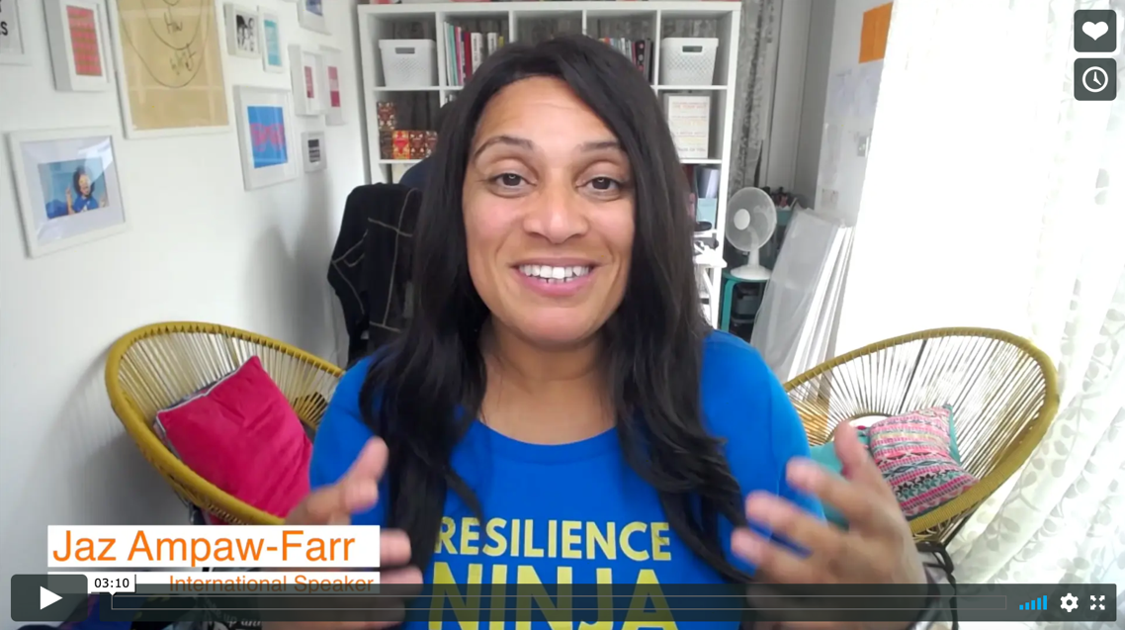

Real life
Be Daring
Jaz Ampaw-Farr

Slide 18
© 2020 The PiXL Club Ltd and Hachette UK
This resource may be shared with any school in its current form, and parts thereof, to enhance your work with students. All opinions and contributions are those of the authors. The contents of this resource are not connected with, or endorsed by, any other company, organisation or institution.
If there are any inadvertent omissions or errors in the acknowledgements or usage, this is unintended and we will remedy these on written notification.
Hachette UK own 'Dare to Be You' by Matthew Syed, which may be purchased by individuals and schools, should they wish to do so to enhance these resources for students. Illustrations copyright © Toby Triumph.

