Slide 1

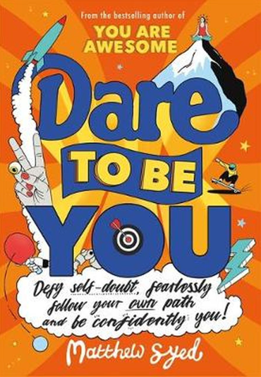
Session 3
The Difference

Slide 2
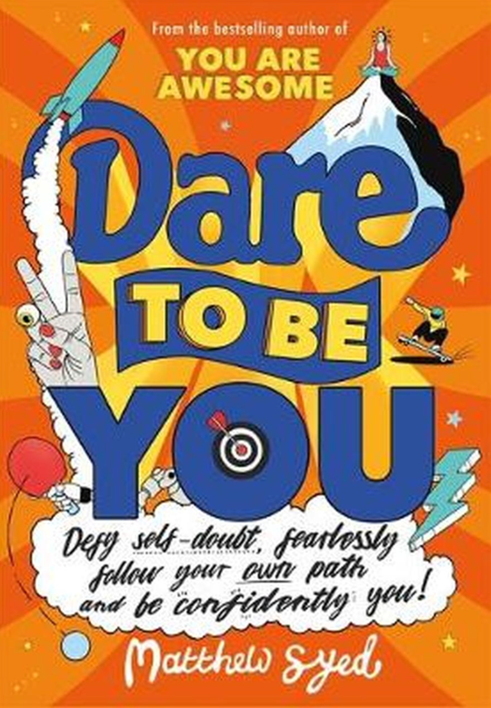
In the last session we looked at:
Why Kid Doubt is not good to have around
The way Kid Doubt sometimes makes you feel you are not ‘normal'
How we need a plan to ‘dare to be you’

Slide 3
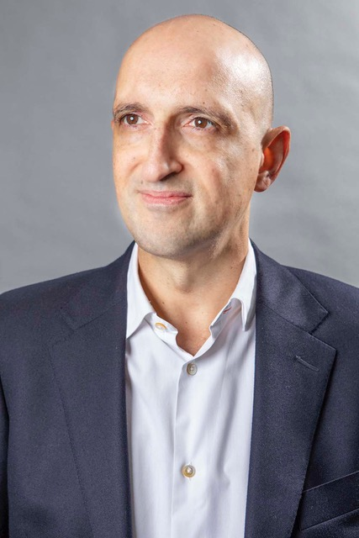
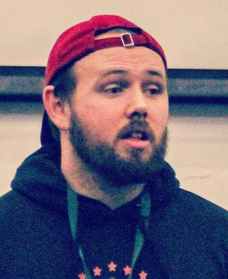
Today we have two people to help us explore ‘The Difference’.
and…
Matthew Syed Author and Broadcaster, Author of ‘Dare to be You’
Cameron Parker
Motivational speaker

Slide 4

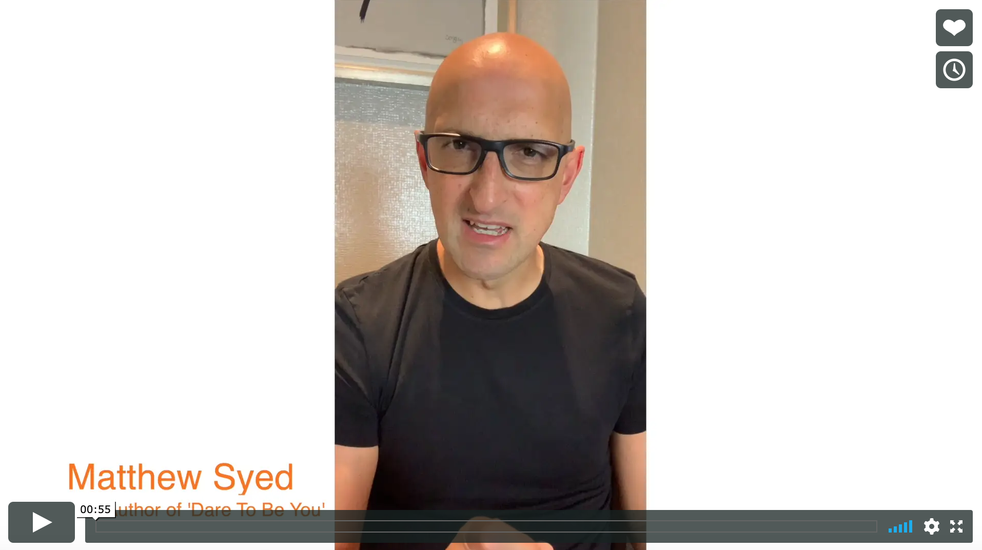

Today we are looking at ‘The Difference’.
Watch this video of Matthew explaining why we need to stop thinking that ‘one size fits all’.
The Difference
Matthew Syed
If you are reading along with us, read pages 26–41.

Slide 5
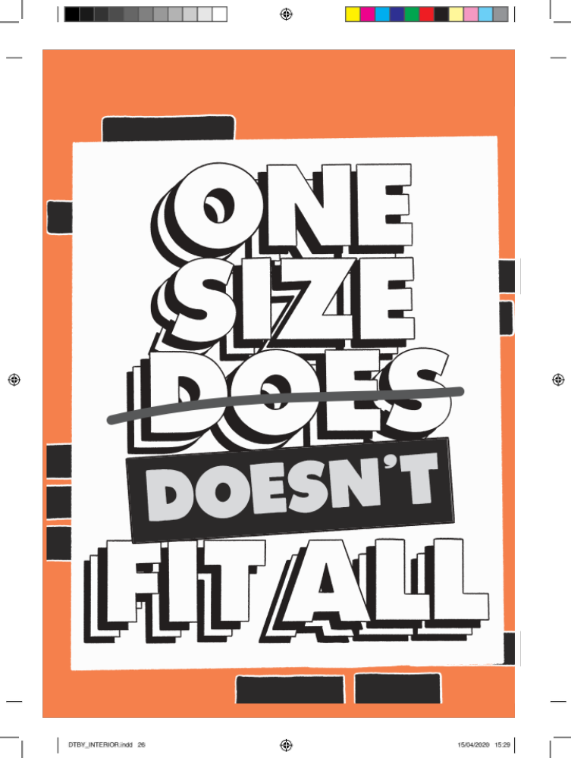
So many of us spend SO long trying to be as similar to those around us as we possibly can. It can even mean we do things we don’t like, don’t enjoy and don’t even believe in! WHY do we do this?
In your workbook, answer this question: When have you tried so hard to fit in that you’ve done something that you don’t even like doing?

Slide 6

Often, it all comes down to this…
I want to be normal!

Slide 7
Here is where we have to put some things right!
One size does not fit all.
‘Normal’ does NOT exist.
‘Normal’ is an idea that we’ve accepted without questioning it!

Slide 8


A real-life example:
It was 1926, the US military decided to use the idea of One Size Fits All to design the perfect cockpit for their fighter planes.
They collected measurements on hundreds of their male* pilots: they calculated ‘normal’ height, arm length, leg length and ‘normal’ reach amongst other metrics.
* Women were not really given the opportunity to be pilots in 1926
Using this data, they created the ‘perfect’ cockpit – all perfectly sized for the ‘perfect pilot’.

Slide 9

25 years after these cockpits were designed, the air force were puzzled about why their pilots kept crashing. 17 pilots crashed in one single day once.
Maybe it was to do with the cockpit design?

Slide 10
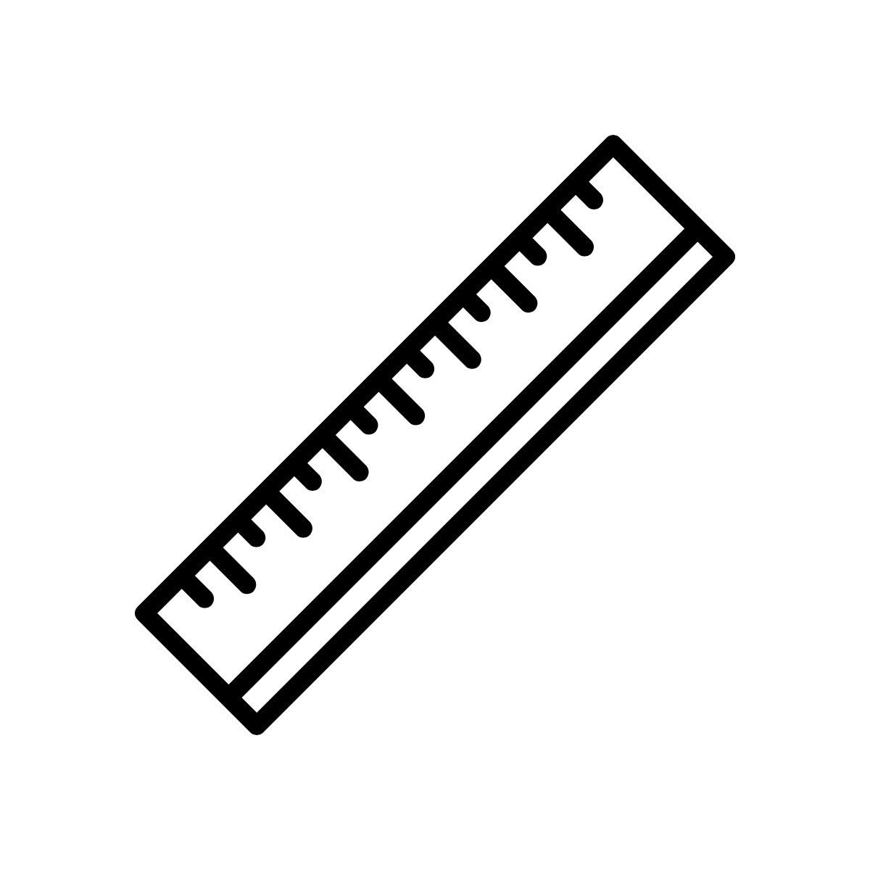
Gilbert S Daniels was working for the US military and decided to investigate. He took 10 of the most relevant measurements from just over 4,000 currently enlisted pilots. From this, he calculated the 10 dimensions of the so-called ‘average’ pilot. The perfect arm length etc.
Then he decided to see how many of his 4,000 pilots were actually ‘normal’.
How many of the 4,000 pilots were ‘normal’?
How many had the ‘perfect’ measurements
for the ‘perfect’ cockpit?

Slide 11

NONE OF THEM!
Not one of them had the measurements that the cockpit had been designed for. None of the pilots were ‘normal’.
That is why they kept crashing!
There is another example linked to food on pages 36-37 in ‘Dare to Be You’.

Slide 12

Where did the idea of ‘normal’ even come from?
A scientist called Quetelet was working in Belgium. Officials were collecting information for the census, such as how many people were getting married, or dying each year.
He watched what other countries were collecting and then started to work out a whole range of averages.

Slide 13
He was one of the first people to try to use maths and averages to define what ‘normal’ looks like for a group of people. This can be helpful in some contexts but…
Quetelet almost started to worship this ‘normal’ person he had come up with. He thought this ‘normal’ person he had created from the data was the closest thing to perfection anyone might hope to be.
In your workbook, what do you think are the problems around creating a version of ‘normal’ from data averages?

Slide 14
In your workbook, what do you think ‘normal’ or ‘perfect’ looks like? Do you know anyone who meets all of those criteria?

Slide 15

We are all different.
Each of us is unique.
Normal is not a thing.
“If you are always trying to be normal, you will never know how amazing you are.”
- Maya Angelou, author

Slide 16
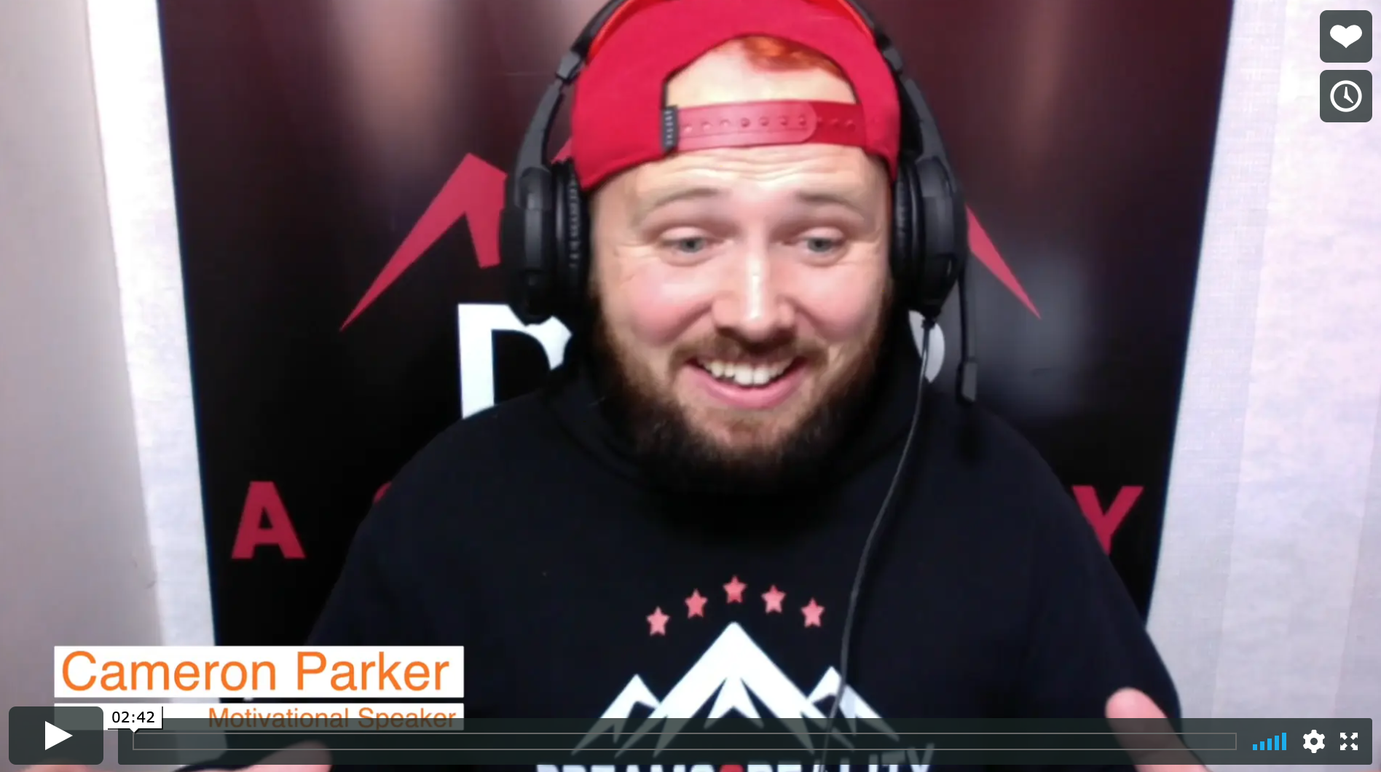
Real life
The Difference
Cameron Parker

Slide 17
© 2020 The PiXL Club Ltd and Hachette UK
This resource may be shared with any school in its current form, and parts thereof, to enhance your work with students. All opinions and contributions are those of the authors. The contents of this resource are not connected with, or endorsed by, any other company, organisation or institution.
If there are any inadvertent omissions or errors in the acknowledgements or usage, this is unintended and we will remedy these on written notification.
Hachette UK own 'Dare to Be You' by Matthew Syed, which may be purchased by individuals and schools, should they wish to do so to enhance these resources for students. Illustrations copyright © Toby Triumph.

