Slide 1


Session 2
The Doubts

Slide 2

In the last session we looked at:
Change being part of life
Working on our own transformation
Understanding what we might want
to change about ourselves
Are you ready to DARE TO BE YOU?

Slide 3
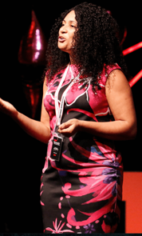
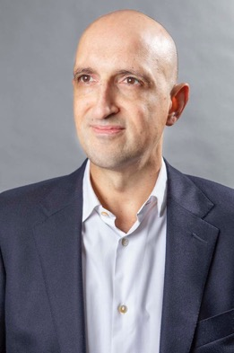
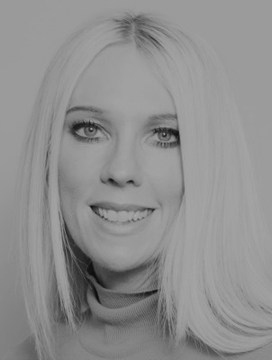
Today we have three people to help us explore ‘The Doubts’.
and…
and…
Matthew Syed Author and Broadcaster, Author of ‘Dare to be You’
Kathy Weeks
‘Dare to Be You’ Team
Jaz Ampaw-Farr
Resilience ninja!

Slide 4

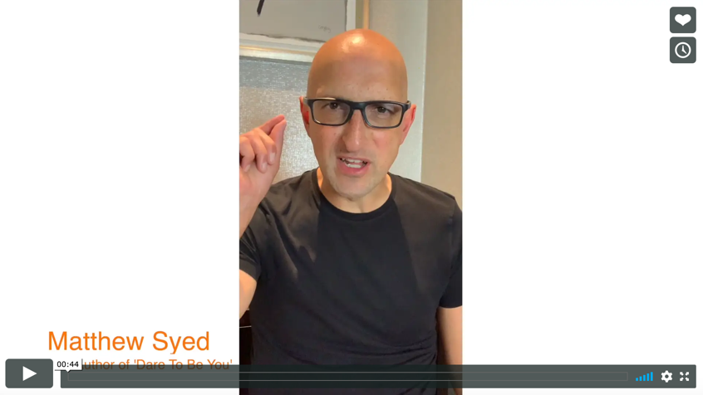

Today we are looking at ‘The Doubts’.
Watch this video of Matthew explaining
why we need to deal with ‘Kid Doubt’.
The Doubts
Matthew Syed
If you are reading along with us, read pages 1–25.

Slide 5
Each of us has our own Kid Doubt to manage! So, who is Kid Doubt?
Kid Doubt is the voice inside your head that makes you change your behaviour to fit in with other people. ‘Kid Doubt’ can make you feel uneasy, anxious, unsure of yourself, or that you don’t fit in.
Kid Doubt isn’t a real person but it is a way of explaining some of the thoughts that we wrestle with every single day. It isn’t just a young person’s thing either, adults can struggle with the same voice too.

Slide 6
What kind of things does Kid Doubt say?
‘Your friends don’t really like you’
‘You’re not cool enough’
‘Everyone will stare at you’
‘Your clothes aren’t the right ones’
‘You don’t fit in’
‘Everyone will laugh at you’
‘Just pretend’
Kid Doubt
‘You will make a fool out of yourself’

Slide 7
What does Kid Doubt do?
Sometimes Kid Doubt:
encourages you to get attention in a negative way
persuades you to play for the laughs even if it is unkind
tells you that you have to change to be good enough
makes you behave in ways that you know aren’t you
makes you feel anxious and nervous
gets you feeling like you’re not good enough
Kid Doubt does not make you feel positive or happy.

Slide 8
Kid Doubt is not your friend.
What kind of friend makes you:
doubt yourself all of the time?
feel rubbish?
act differently in order to fit in?
feel anxious and nervous?
hold yourself back?
In your workbook, write how your Kid Doubt makes you feel.

Slide 9

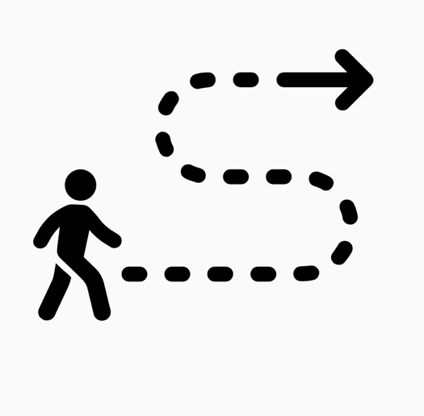
When you get rid of Kid Doubt you decide to:
Follow your own path
Get your own brand of ‘cool’
You also then have confidence to:
Make friends with people who like you for YOU rather than try and be what they want you to be
Make choices that feel right for you not choices that are made to impress others

Slide 10





Deciding to ignore what Kid Doubt is saying is the first step –
but that doesn't mean he/she won’t try again!
“Kid Doubt is a ‘hanger on’. I had vowed to ignore that grey and miserable face if I ever saw him again. But of course, I did see him again. Often. You name it, if there is a party, an exam, a competition, a play rehearsal or a school trip, he’ll be there trying to get an invite”.
Page 17 ‘Dare to Be You’

Slide 11
‘I needed to develop strategies to help build my confidence. To figure out how to refill my tank of resilience when Kid Doubt left it empty.’
Page 17 ‘Dare to Be You’
How can we find strategies to help us overcome Kid Doubt and make a plan we can stick to?

Slide 12
In your workbook, circle or highlight which 2 of these 8 things you find the most difficult to do.
What would you add to your own plan?
How does Kid Doubt stop you from being YOU?
There is room for you to write your own plan if you want to.
(We will also come back to this!)

Slide 13
“Any moment, someone’s going to find out that I’m a complete fraud, and that I don’t deserve any of what I’ve achieved. I can’t possibly live up to what everyone thinks I am and what everyone’s expectations of me are.”
– Emma Watson, Actress
“I had to overcome the question, ‘am I good enough?’”
– Michelle Obama,
Former First Lady of the USA
“Kid Doubt has about 7,700,000,000 brothers and sisters. Every single person on the planet has their very own Kid Doubt. Even really famous and successful people”.
Page 20 ‘Dare to Be You’

Slide 14
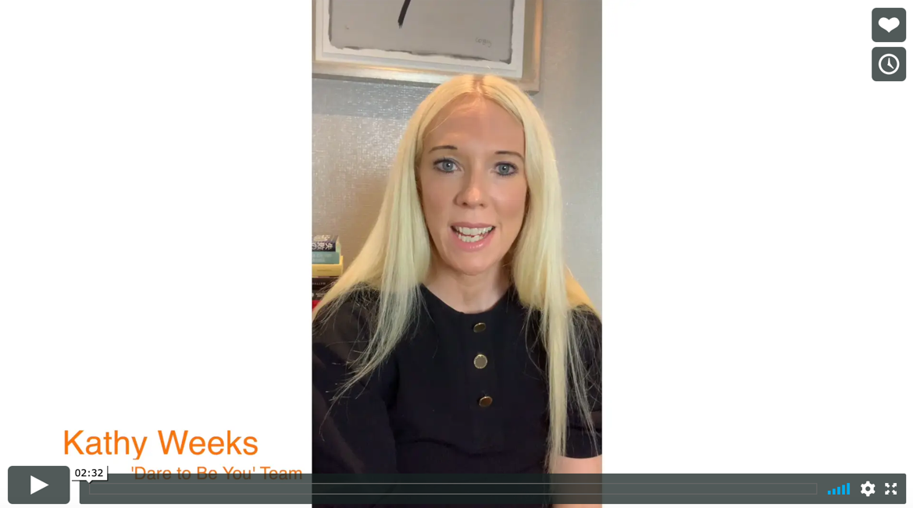
Real life
The Doubts
Kathy Weeks

Slide 15
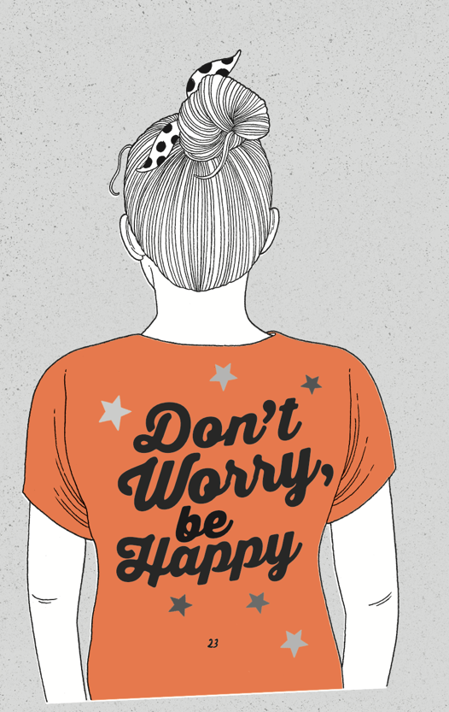
Everyone’s Kid Doubt looks different and says different things to get you down, but what they all have in common is that they hold us back.
Did you know?
A piece of research by 72 Point suggests that people spend nearly 2 hours worrying, EVERY SINGLE DAY. That’s 28 days a year!
What are the kind of things you worry about?
Write them in your workbook.

Slide 16

One of the main things Kid Doubt shouts is:
‘You’re not normal!’
There is good news though – ‘normal’ doesn’t even exist. The best ideas come from those who think differently.
More of this in the next session!

Slide 17
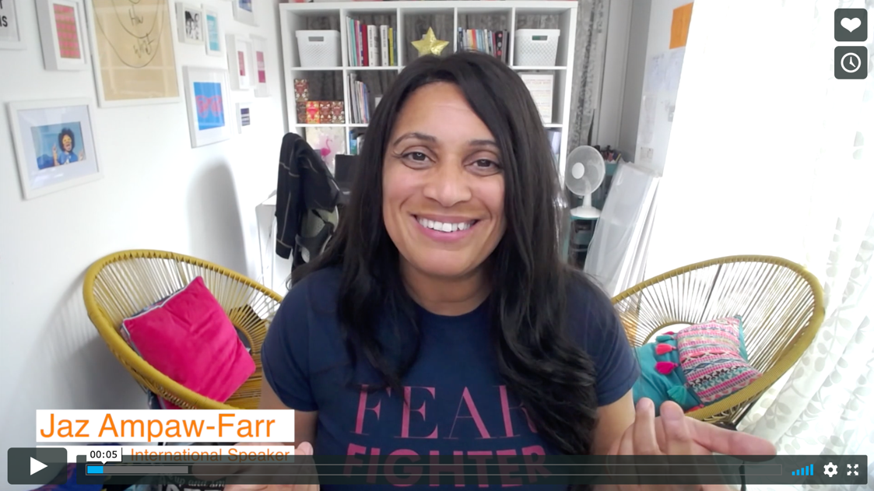
Real life
The Doubts
Jaz Ampaw-Farr

Slide 18
© 2020 The PiXL Club Ltd and Hachette UK
This resource may be shared with any school in its current form, and parts thereof, to enhance your work with students. All opinions and contributions are those of the authors. The contents of this resource are not connected with, or endorsed by, any other company, organisation or institution.
If there are any inadvertent omissions or errors in the acknowledgements or usage, this is unintended and we will remedy these on written notification.
Hachette UK own 'Dare to Be You' by Matthew Syed, which may be purchased by individuals and schools, should they wish to do so to enhance these resources for students. Illustrations copyright © Toby Triumph.

