Slide 1


Session 12
BE Change Makers

Slide 2

After 11 sessions, we have reached the final stage of ‘PiXL Change Makers’.
We hope that you have started to think about who you are going to be and the changes you are going to make.

Slide 3
We have covered A LOT:
Be Determined
Be a Do-er
Be Decent
Be Deliberate
Be Dedicated
Be Change Makers
Why Change Makers?
The Doubts
The Difference
Be Daring
Be Distinctive
Be Decisive

Slide 4
We have said goodbye to Kid Doubt.
You have started to think about what it means to be ‘YOU’.

Slide 5
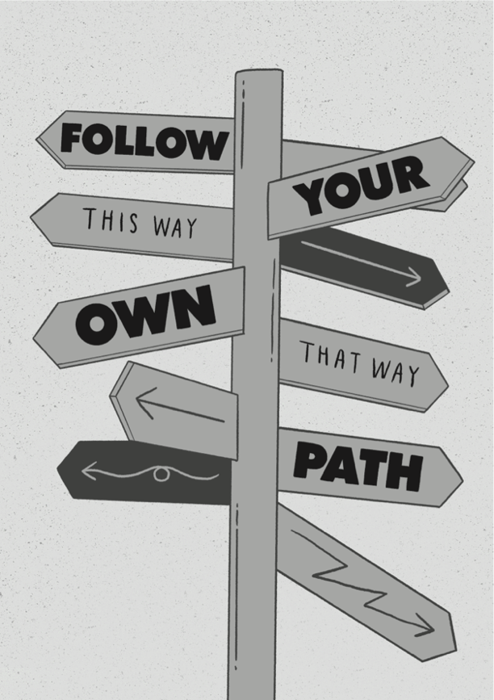
If you want to see change in your own life, then you need to dare to be you.
This world needs people who are:
Determined
Kind-hearted
Motivated
Compassionate to others
Kind to themselves
Kind to others
Comfortable embracing difference
The world NEEDS people like that!

Slide 6
Change makers SEE the change that needs to happen.
Change makers MAKE it happen.
And it starts with YOU.

Slide 7
NORMAL does NOT exist.
You are unique.

Slide 8
There will be times when people don’t understand you.
When Kid Doubt starts
to speak.
If you know who YOU want to be,
then you can walk that path.

Slide 9

WHO do you want to BE?
It’s time to commit and dare to be you.
Have a go at writing your thoughts in your workbook:
What 3 words do you hope people will use to describe you?
When people are around you, how do you want them to feel?
How kind are you to those who are different to you?

Slide 10

If we all play our part, then THIS generation can be a force for change. You can be:
Kind
Resilient
Determined
Compassionate
Deliberate
Confident
Understanding

Slide 11



Remember,
YOU can change the world.
Your world.
The worlds of others.
If you dare to be you and commit to starting your journey as a Change Maker.
PRACTICE MAKES AWESOME!

Slide 12
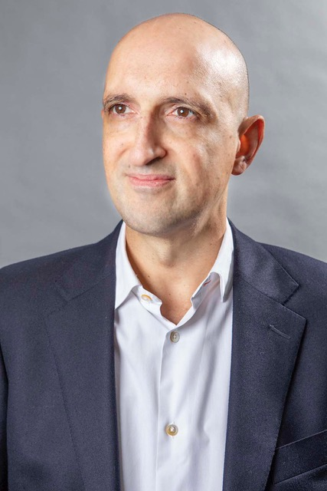
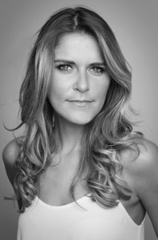
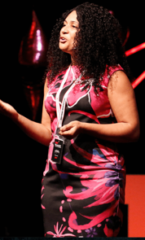
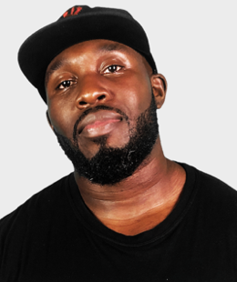
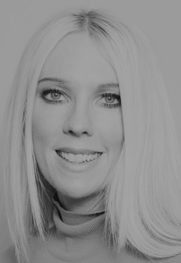
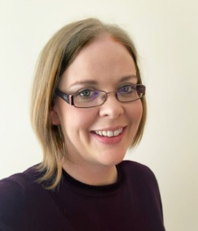
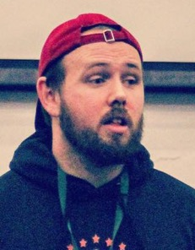


Good luck from us, as you dare to be YOU.
Matthew Syed Author and Broadcaster, Author of ‘Dare to Be You’
Gemma Oaten Actress and TV star
Jaz Ampaw-Farr
Resilience ninja!
Mr Beezy
Motivational speaker
Real life
YOU
Kathy Weeks
‘Dare to Be You’ Team
Rachel Johnson
Writer of Change Makers
Cameron Parker
Motivational speaker
And YOU?

Slide 13
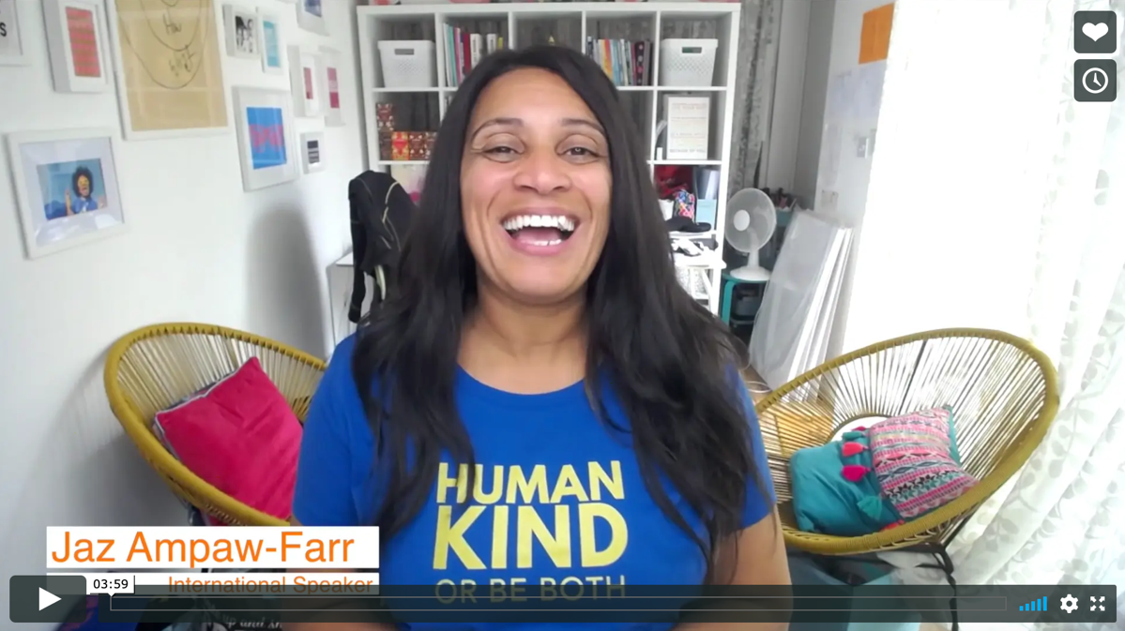
Real life
Be Change Makers
Jaz Ampaw-Farr

Slide 14
© 2020 The PiXL Club Ltd and Hachette UK
This resource may be shared with any school in its current form, and parts thereof, to enhance your work with students. All opinions and contributions are those of the authors. The contents of this resource are not connected with, or endorsed by, any other company, organisation or institution.
If there are any inadvertent omissions or errors in the acknowledgements or usage, this is unintended and we will remedy these on written notification.
Hachette UK own 'Dare to Be You' by Matthew Syed, which may be purchased by individuals and schools, should they wish to do so to enhance these resources for students. Illustrations copyright © Toby Triumph.

