Slide 1


Session 11
Be Dedicated

Slide 2

In the last session we looked at:
Why we need to be deliberate about our intentions
How kindness benefits all of us
How we need to be kind to ourselves too

Slide 3
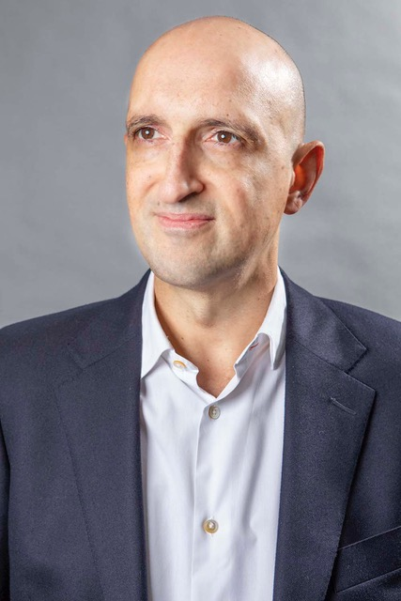
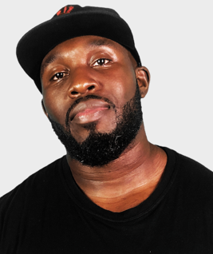
Today we have two people to help us explore ‘Be Dedicated’.
and…
Matthew Syed Author and Broadcaster, Author of ‘Dare to be You’
Mr Beezy
Motivational speaker

Slide 4
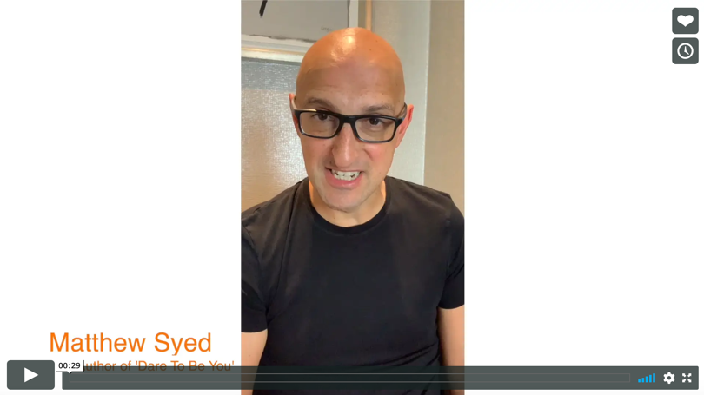


Today we are looking at ‘Be Dedicated’.
Watch this video of Matthew talking about why we need to continue being resilient in our ‘Dare to Be You’ journey.
Be Dedicated
Matthew Syed
If you are reading along with us, read pages 150–183.

Slide 5

So far on your ’Change Maker’ journey, we have talked about all the things we can do to make the changes we need in order to: be kinder, listen less to Kid Doubt and to dare to be us.
BUT what happens when it all feels like it is going wrong?
How do we handle the bumps in the road’?

Slide 6

We need RESILIENCE.
‘The ability to be happy or successful again after something difficult or bad has happened’
If you re-arrange the letters of RESILIENCE, you can spell ‘SINCERE’ or ‘I RE-SILENCE’. Having resilience is about keeping going and re-silencing Kid Doubt’s unhelpful comments.

Slide 7
If you could be made of any type of material, what would you want to be made of?

Slide 8
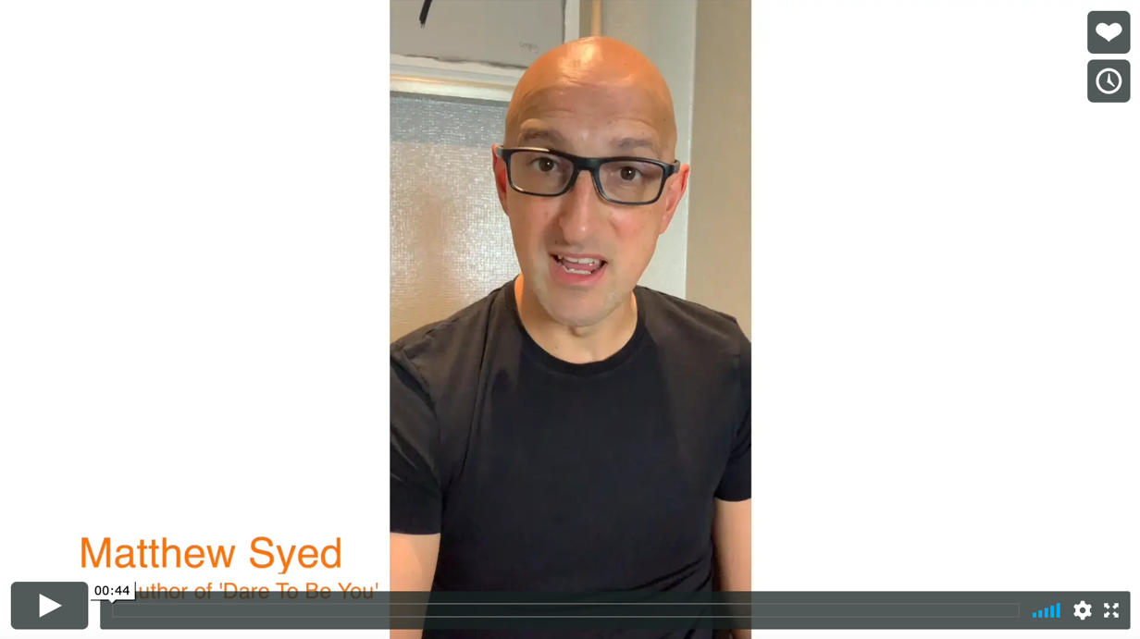

Watch this second clip of Matthew talking about what he would choose!
Be Dedicated
Matthew Syed

Slide 9
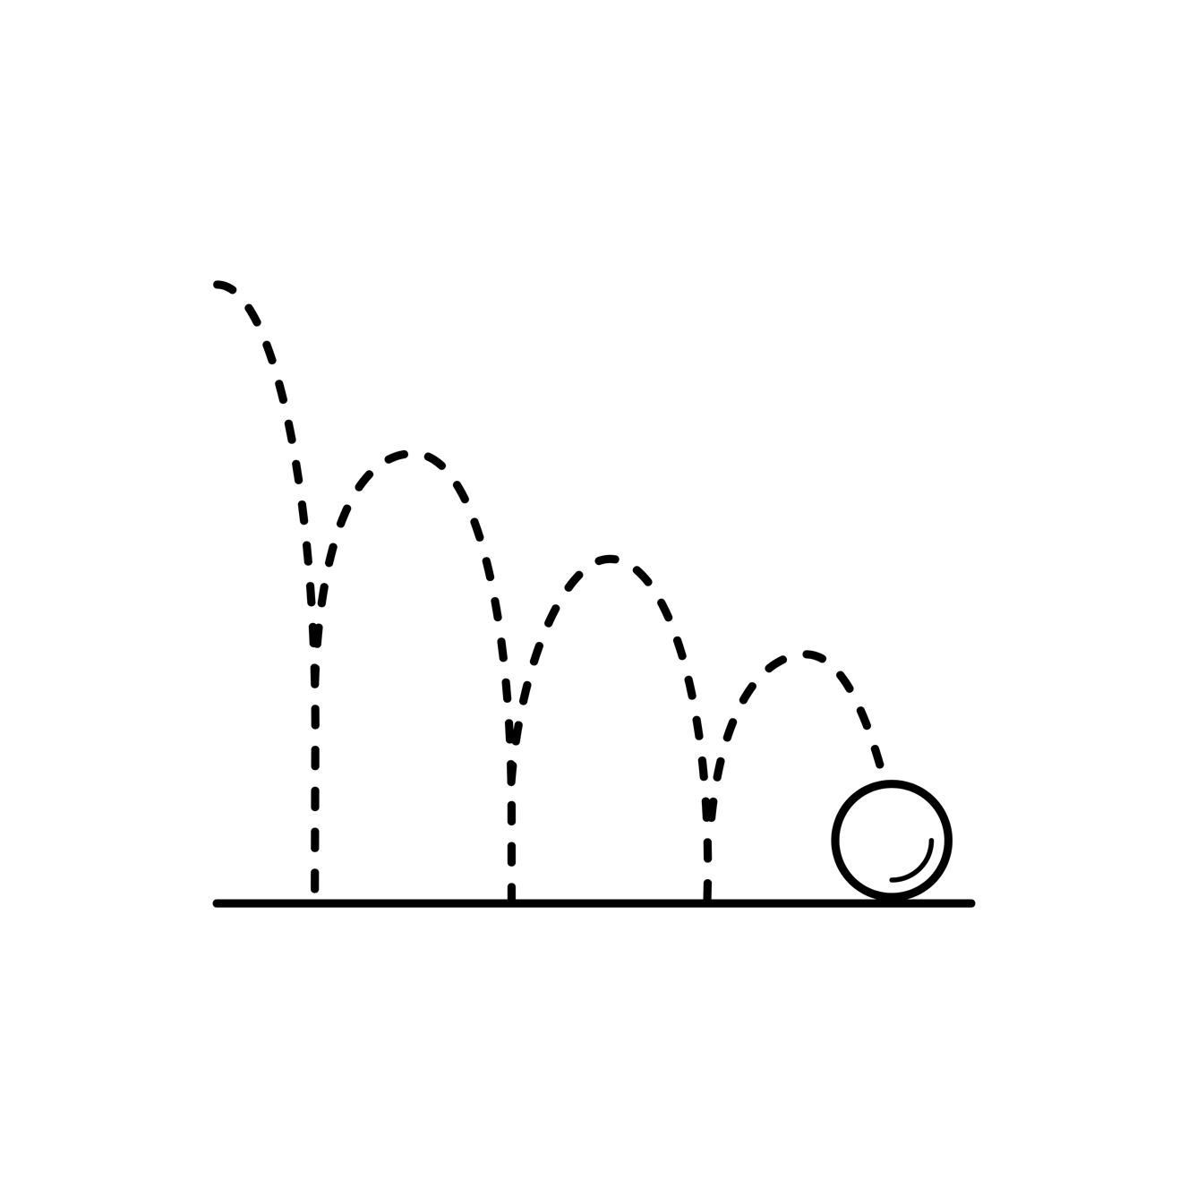
The great rubber revelation!
This brilliantly bendy, super-stretchy substance can tell us something about how to deal with:
Things that go wrong
Things that don’t go to plan
Times when we fail at something
Times when we make mistakes
We can learn how to absorb the shocks and deal with the bumps in the road that happen every day.

Slide 10

Bouncing Back from Bumps
If we hit bumps, we know we can bounce back.
Why?
We are not worried about being different.
We have chosen our own path.
We know we can change things.
We know we can take control.
We know we can be kind through it all.
How?
Be kind to yourself.
Adjust your goals.
Ask for help.
Don’t panic.
Make a plan.

Slide 11

In your workbook, write down the bumps in the road you have faced.
What caused it?
How did you feel about it?
What did you do about it?
How did you get back up and keep going?
How kind were you to yourself and others during this?
After these lessons, what would you do differently now?

Slide 12

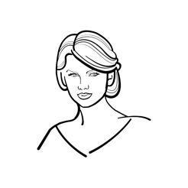

You are not alone. If you are dedicated to something, you should find your own path and dare to follow it.
Coldplay have sold 100 million records! Right at the start, the band were offered a record deal but 3 out of the 4 band members wanted to finish their degrees in history, maths and astronomy. They followed their own path.
To date, Taylor Swift has won a total of 10 Grammy Awards. When she was younger, she was called ‘weird’ by kids her age because she liked country music. She went home and wrote songs anyway. They were unkind to her but she continued on her own path.
Vincent Kompany played 265 matches for Manchester City and was captain for 8 seasons. Kompany wanted to study for an MBA (a high level business degree) at the same time as leading his team out in front of 50,000 fans. He graduated from business school in 2017. He felt that his team mates laughed at him but he followed his own path.

Slide 13
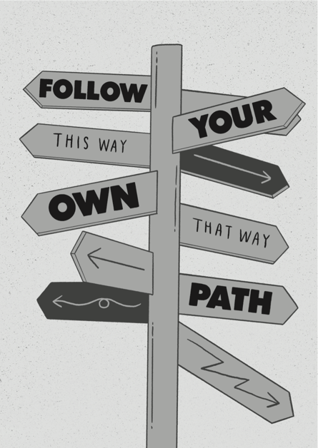
Follow your own path – what does that mean?
Make friends with people who like you for YOU.
Make choices based on what you feel is right for YOU.
Don’t blindly copy other people. Be YOU.
Ask questions. Keep asking questions. Make things work for YOU.
Don’t be afraid of doing things at YOUR own pace.
YOU should be prepared to be flexible.
Be kind. And don’t listen to anyone who isn’t kind towards YOU.
Make it happen. Don’t wait. Get out there. It is down to YOU.
In your workbook, look at Matthew Syed’s Manifesto for Change – is this the same as yours or would you change something? Write your own in the space provided.

Slide 14

Choose your own path.
Ignore Kid Doubt.
Be your OWN change maker.

Slide 15
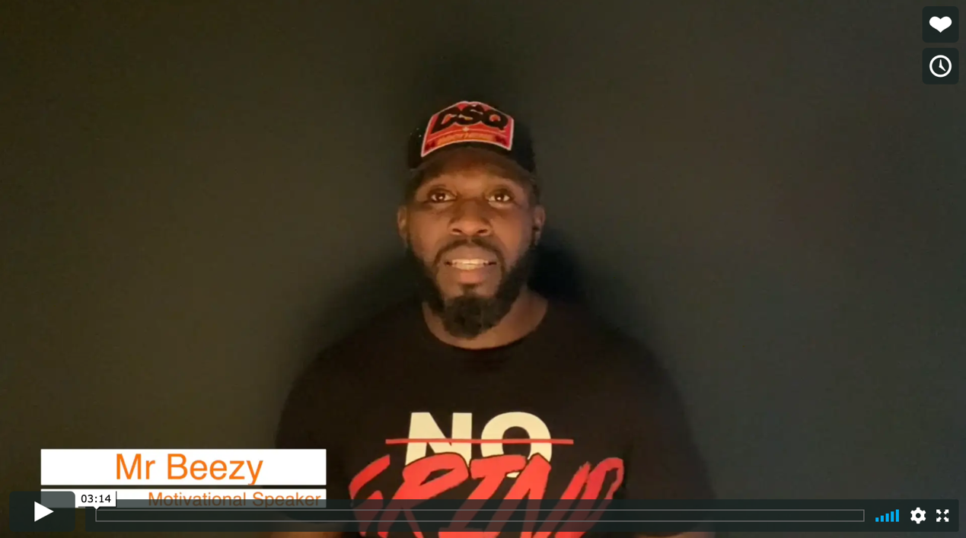

Real life
Be Dedicated
Mr Beezy

Slide 16
© 2020 The PiXL Club Ltd and Hachette UK
This resource may be shared with any school in its current form, and parts thereof, to enhance your work with students. All opinions and contributions are those of the authors. The contents of this resource are not connected with, or endorsed by, any other company, organisation or institution.
If there are any inadvertent omissions or errors in the acknowledgements or usage, this is unintended and we will remedy these on written notification.
Hachette UK own 'Dare to Be You' by Matthew Syed, which may be purchased by individuals and schools, should they wish to do so to enhance these resources for students. Illustrations copyright © Toby Triumph.

