Slide 1

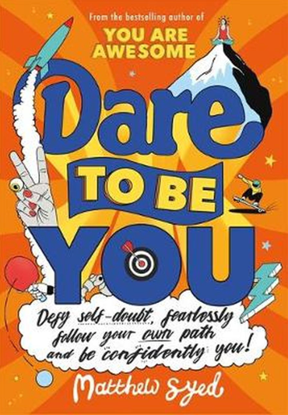
Session 10
Be Deliberate

Slide 2
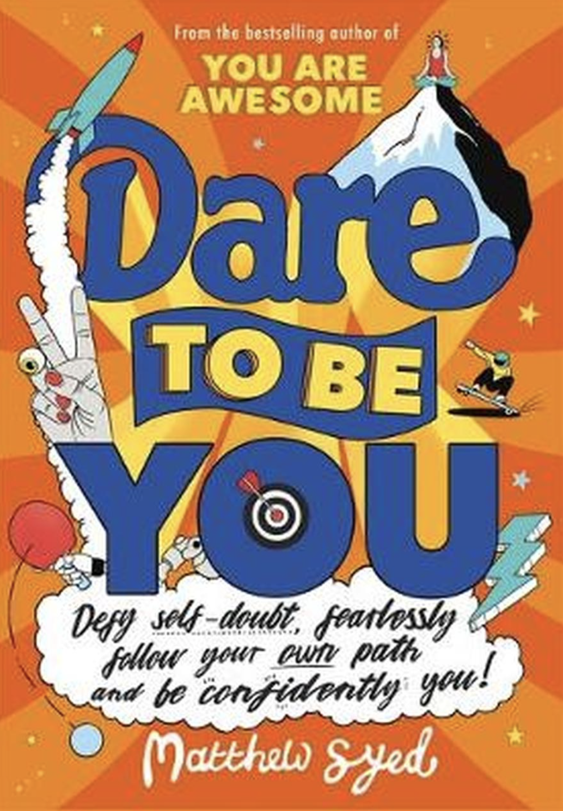
In the last session we looked at:
Why people are sometimes unkind
The benefits of being kind
Reflecting on how we can be kind

Slide 3
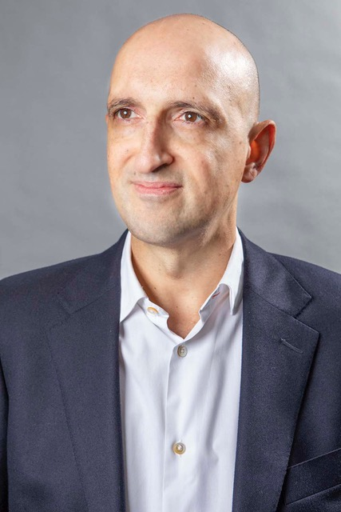
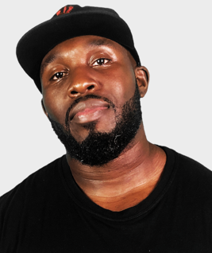
Today we have two people to help us explore ‘Be Deliberate’.
and…
Matthew Syed Author and Broadcaster, Author of ‘Dare to be You’
Mr Beezy
Motivational speaker

Slide 4
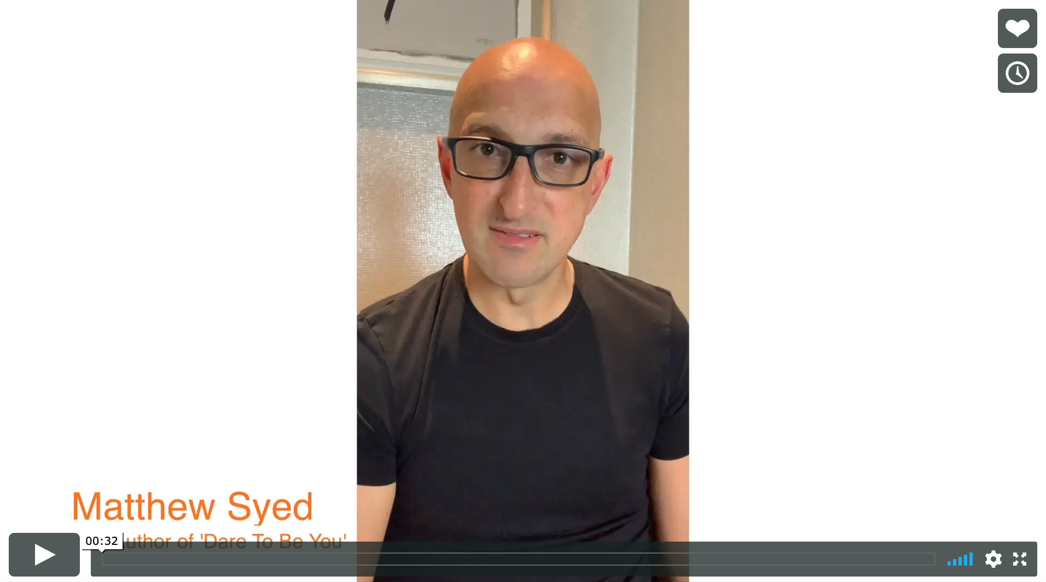

Today we are looking at ‘Be Deliberate’.
Watch this video of Matthew talking about why being kind can benefit us.
Be Deliberate
Matthew Syed
If you are reading along with us, read pages 137–149.

Slide 5
Being kind is more than just a ‘nice’ thing to do!
Being kind releases chemicals in your brain called endorphins that make you feel good.

Slide 6
Decent Doctors
3 top psychologists decided to do some research on kindness.
They chose 600 Belgian student doctors for their research and they made some remarkable discoveries.
The first thing the study showed was that the doctors who had the WORST exam grades were those who were the MOST kind.

Slide 7
In their 1st year, those students who were willing to help others with their homework and share their class notes actually got LOWER grades.
But ONLY in their 1st year.
By the 2nd year, the kind students achieved the SAME grades as everyone else.
By the 6th year, they were getting MUCH BETTER grades than everyone else.
Medical School

Slide 8
By the 7th year, they were getting off-the-scale fantastic grades. Their kindness was a huge factor in their success. But why?
And why didn’t that work in Year 1?

Slide 9
What the research shows…
It comes down to HOW they were learning to be doctors.
In Year 1, they learn mostly from textbooks.
They have to memorise information.
They don’t treat many patients.
The kinder students helped others learn.
They spent so long doing this, they didn’t do well themselves.
Their kindness partly stopped them getting good grades.

Slide 10
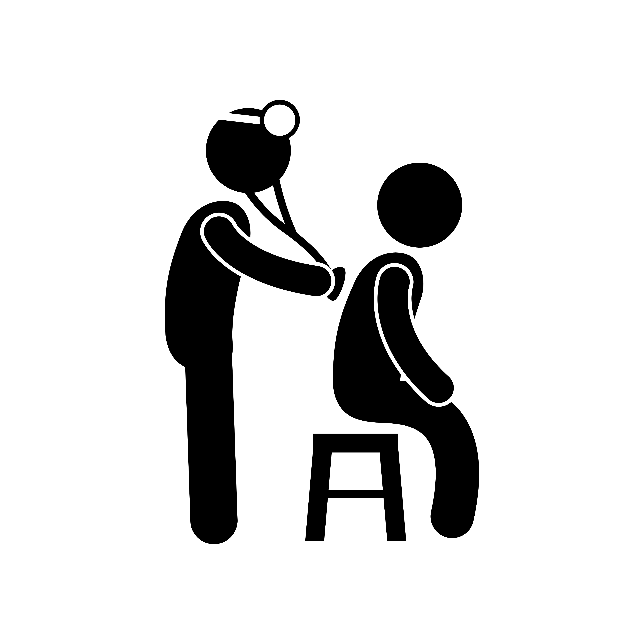
But think about what doctors do in real life…
Doctors treat sick people.
They are with people when they are feeling their worst.
They work closely with others to decide on the best treatments.
They share ideas and consider what is best for the patient.
By the 7th year, the kinder students knew more people.
Their network was bigger.
They were trusted because they were kind and helpful.
People came to them for their ideas.
Their kindness gave them confidence to share opinions about what treatments may work best.
Due to this, they were more successful in their roles.

Slide 11

Which skills matter if you want to be a great doctor?
Knowledge is clearly crucial – you have to know a huge amount of information.
The ability to work with other people.
The ability to gain the trust of a sick person and their family.
The ability to gain respect of a large number of people who will turn to you for help.
It’s about the balance!
Kindness allows you to gain all of these skills.

Slide 12
Kindness is something we need to be
deliberate
about.

Slide 13
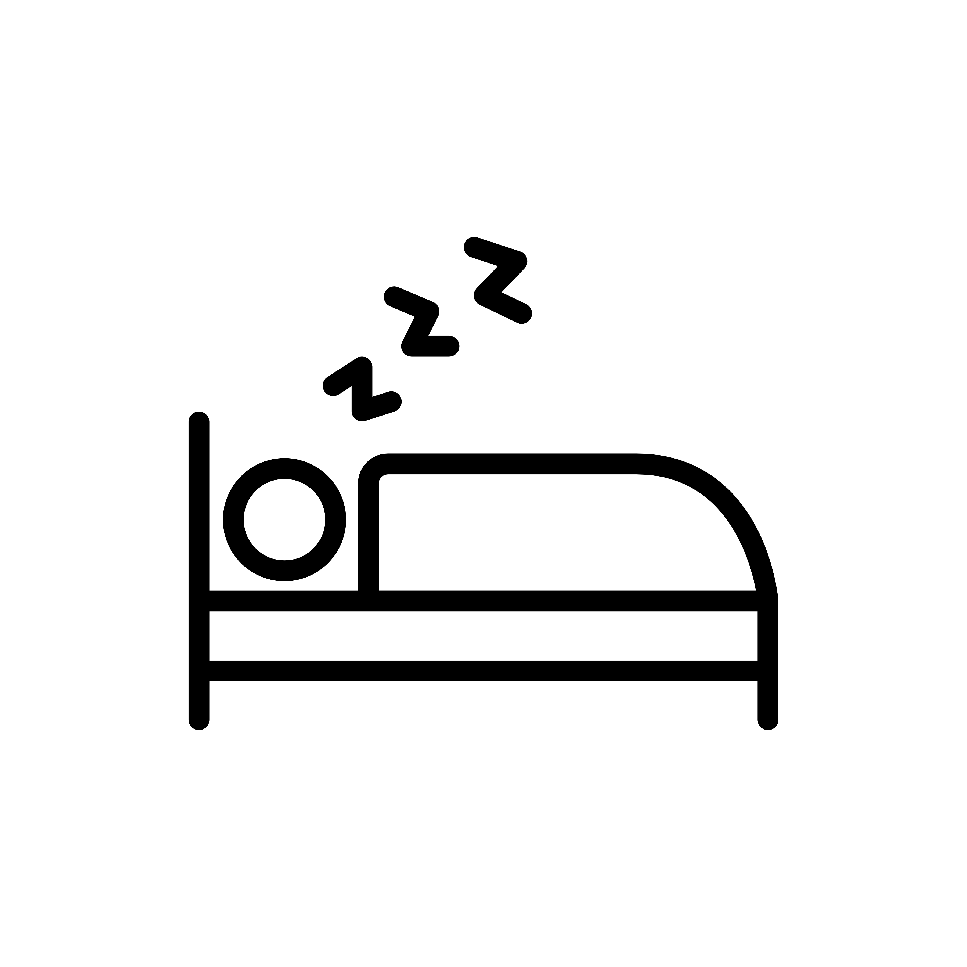




But first, you must be kind to YOURSELF.
Make sure you get plenty of sleep.
Find time to exercise.
Find things that make you feel calm.
Take time away from screens.
Don’t bottle things up.

Slide 14

We need each other.
“Alone we can do so little. Together we can do so much.”
Helen Keller
Kindness has a CASCADE EFFECT. If you are nice and helpful, it makes you feel good and makes other people feel good too.

Slide 15

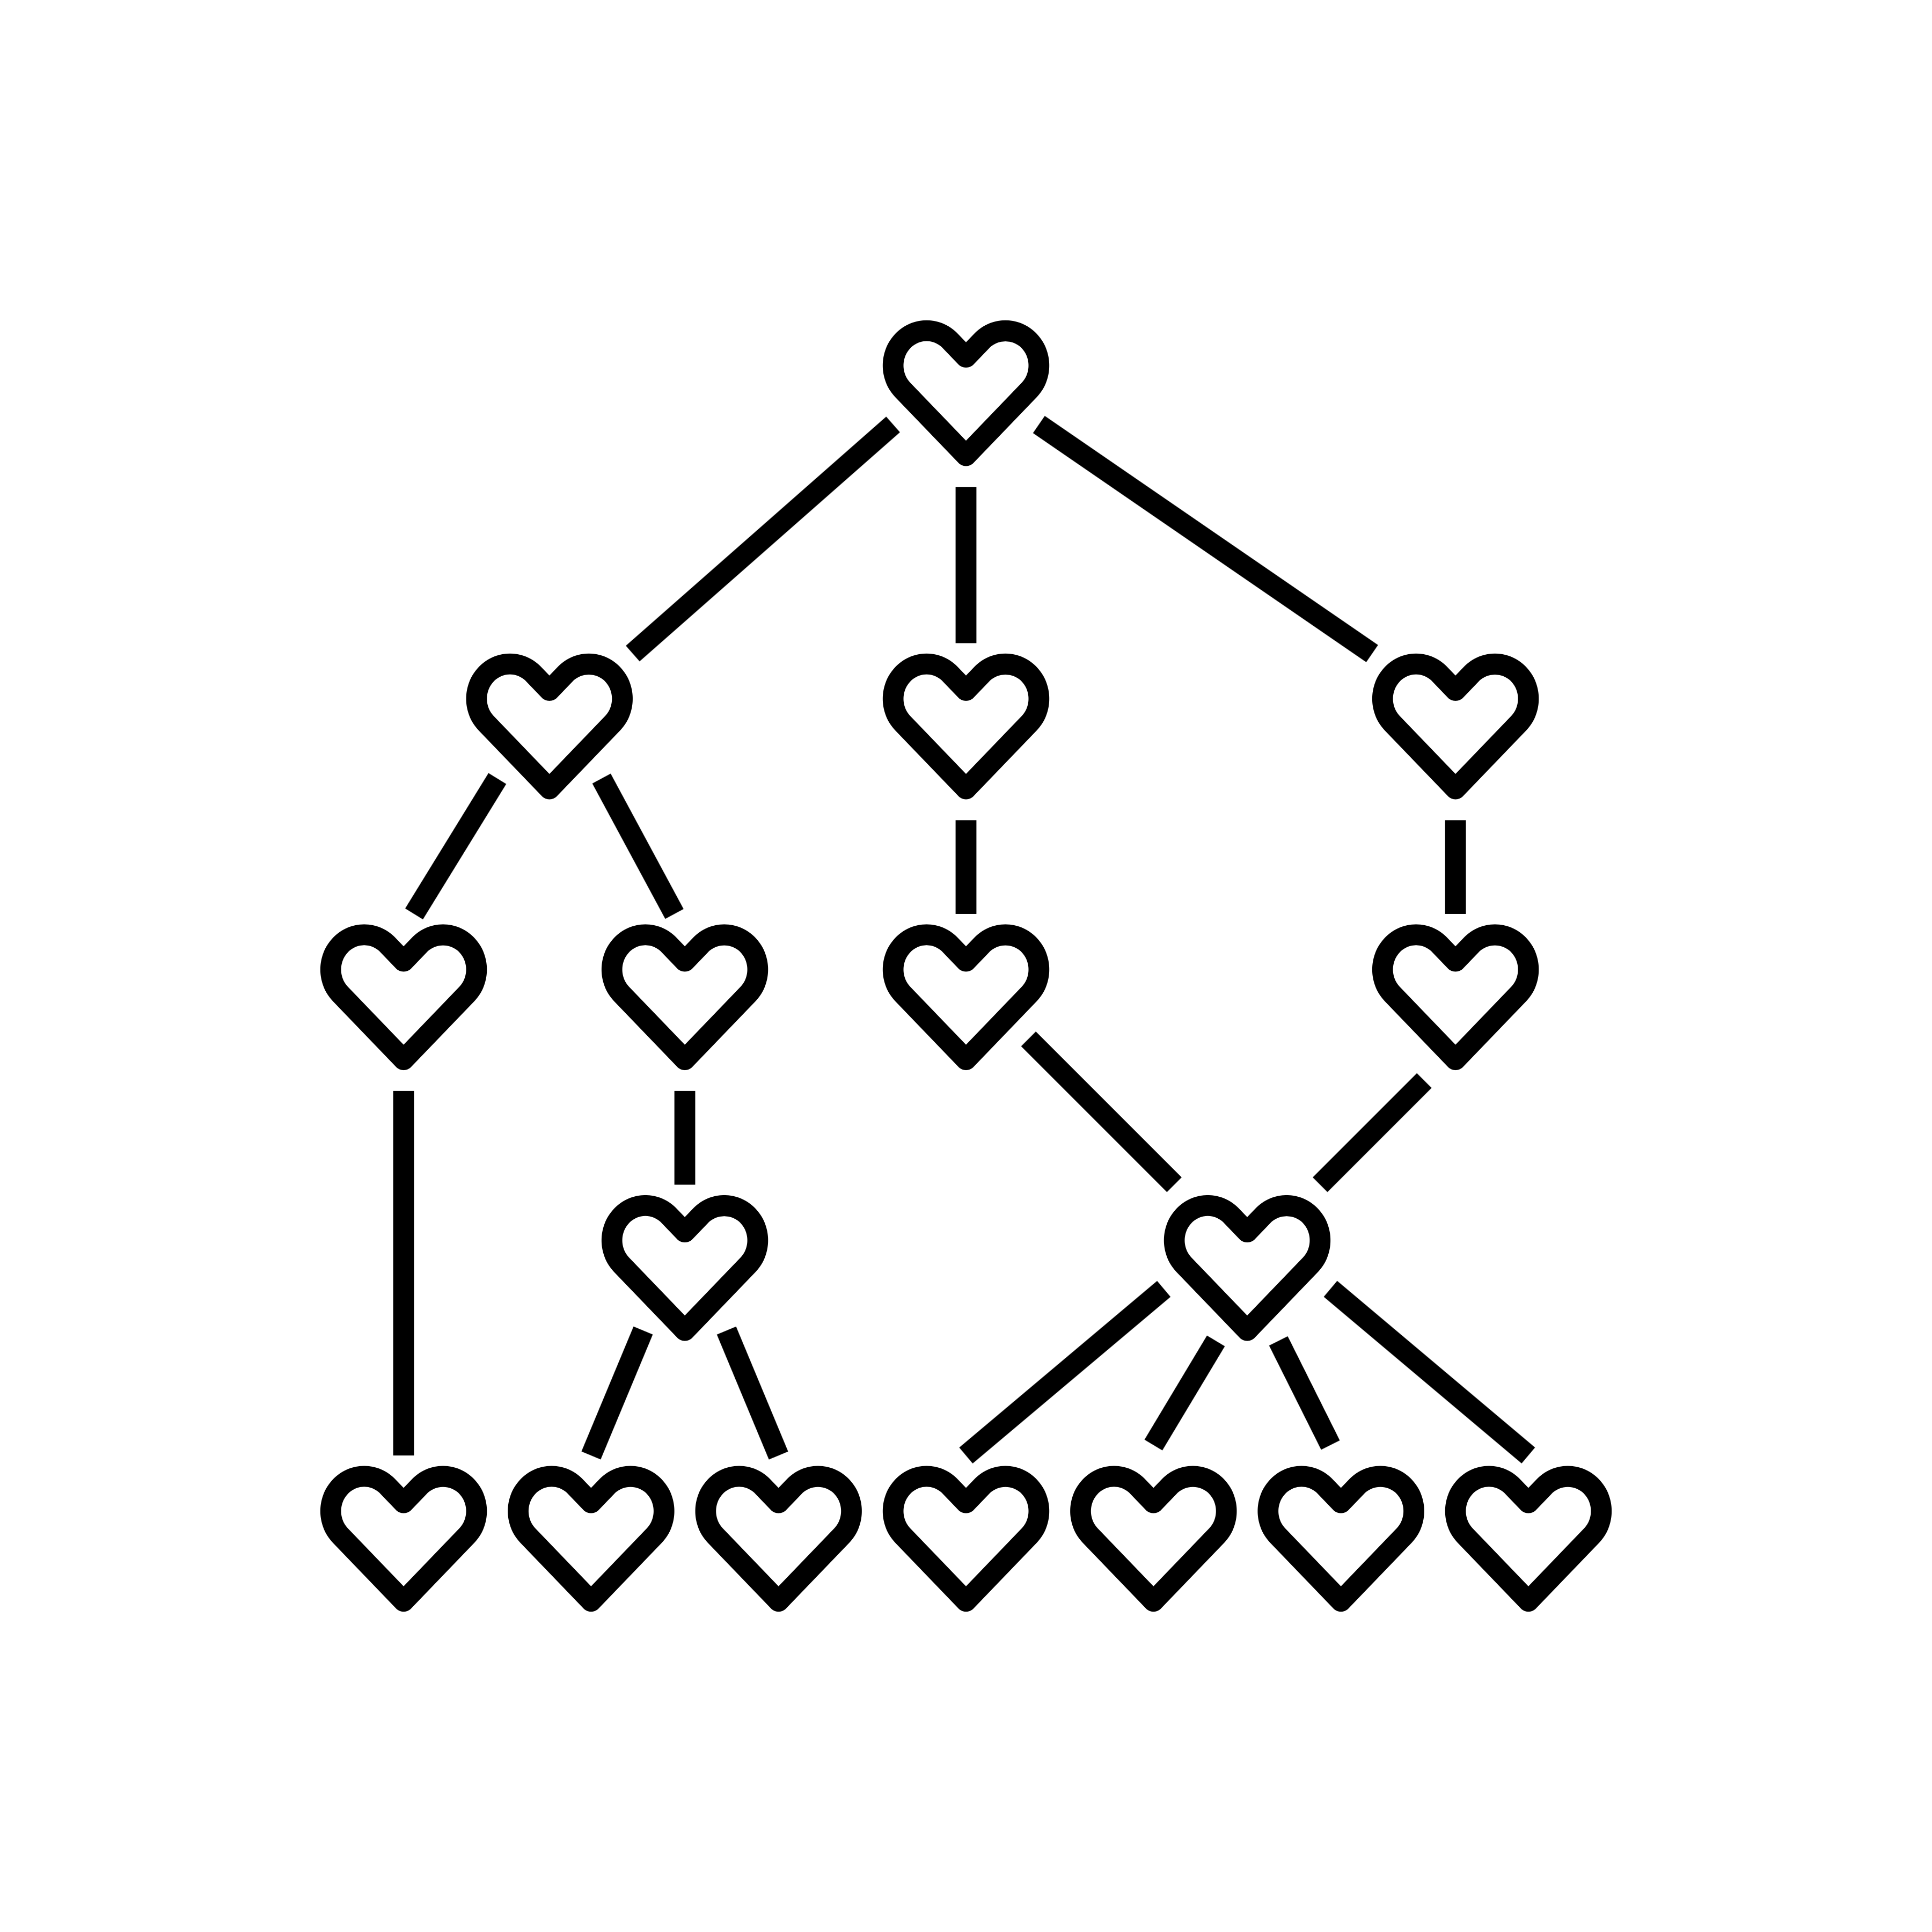
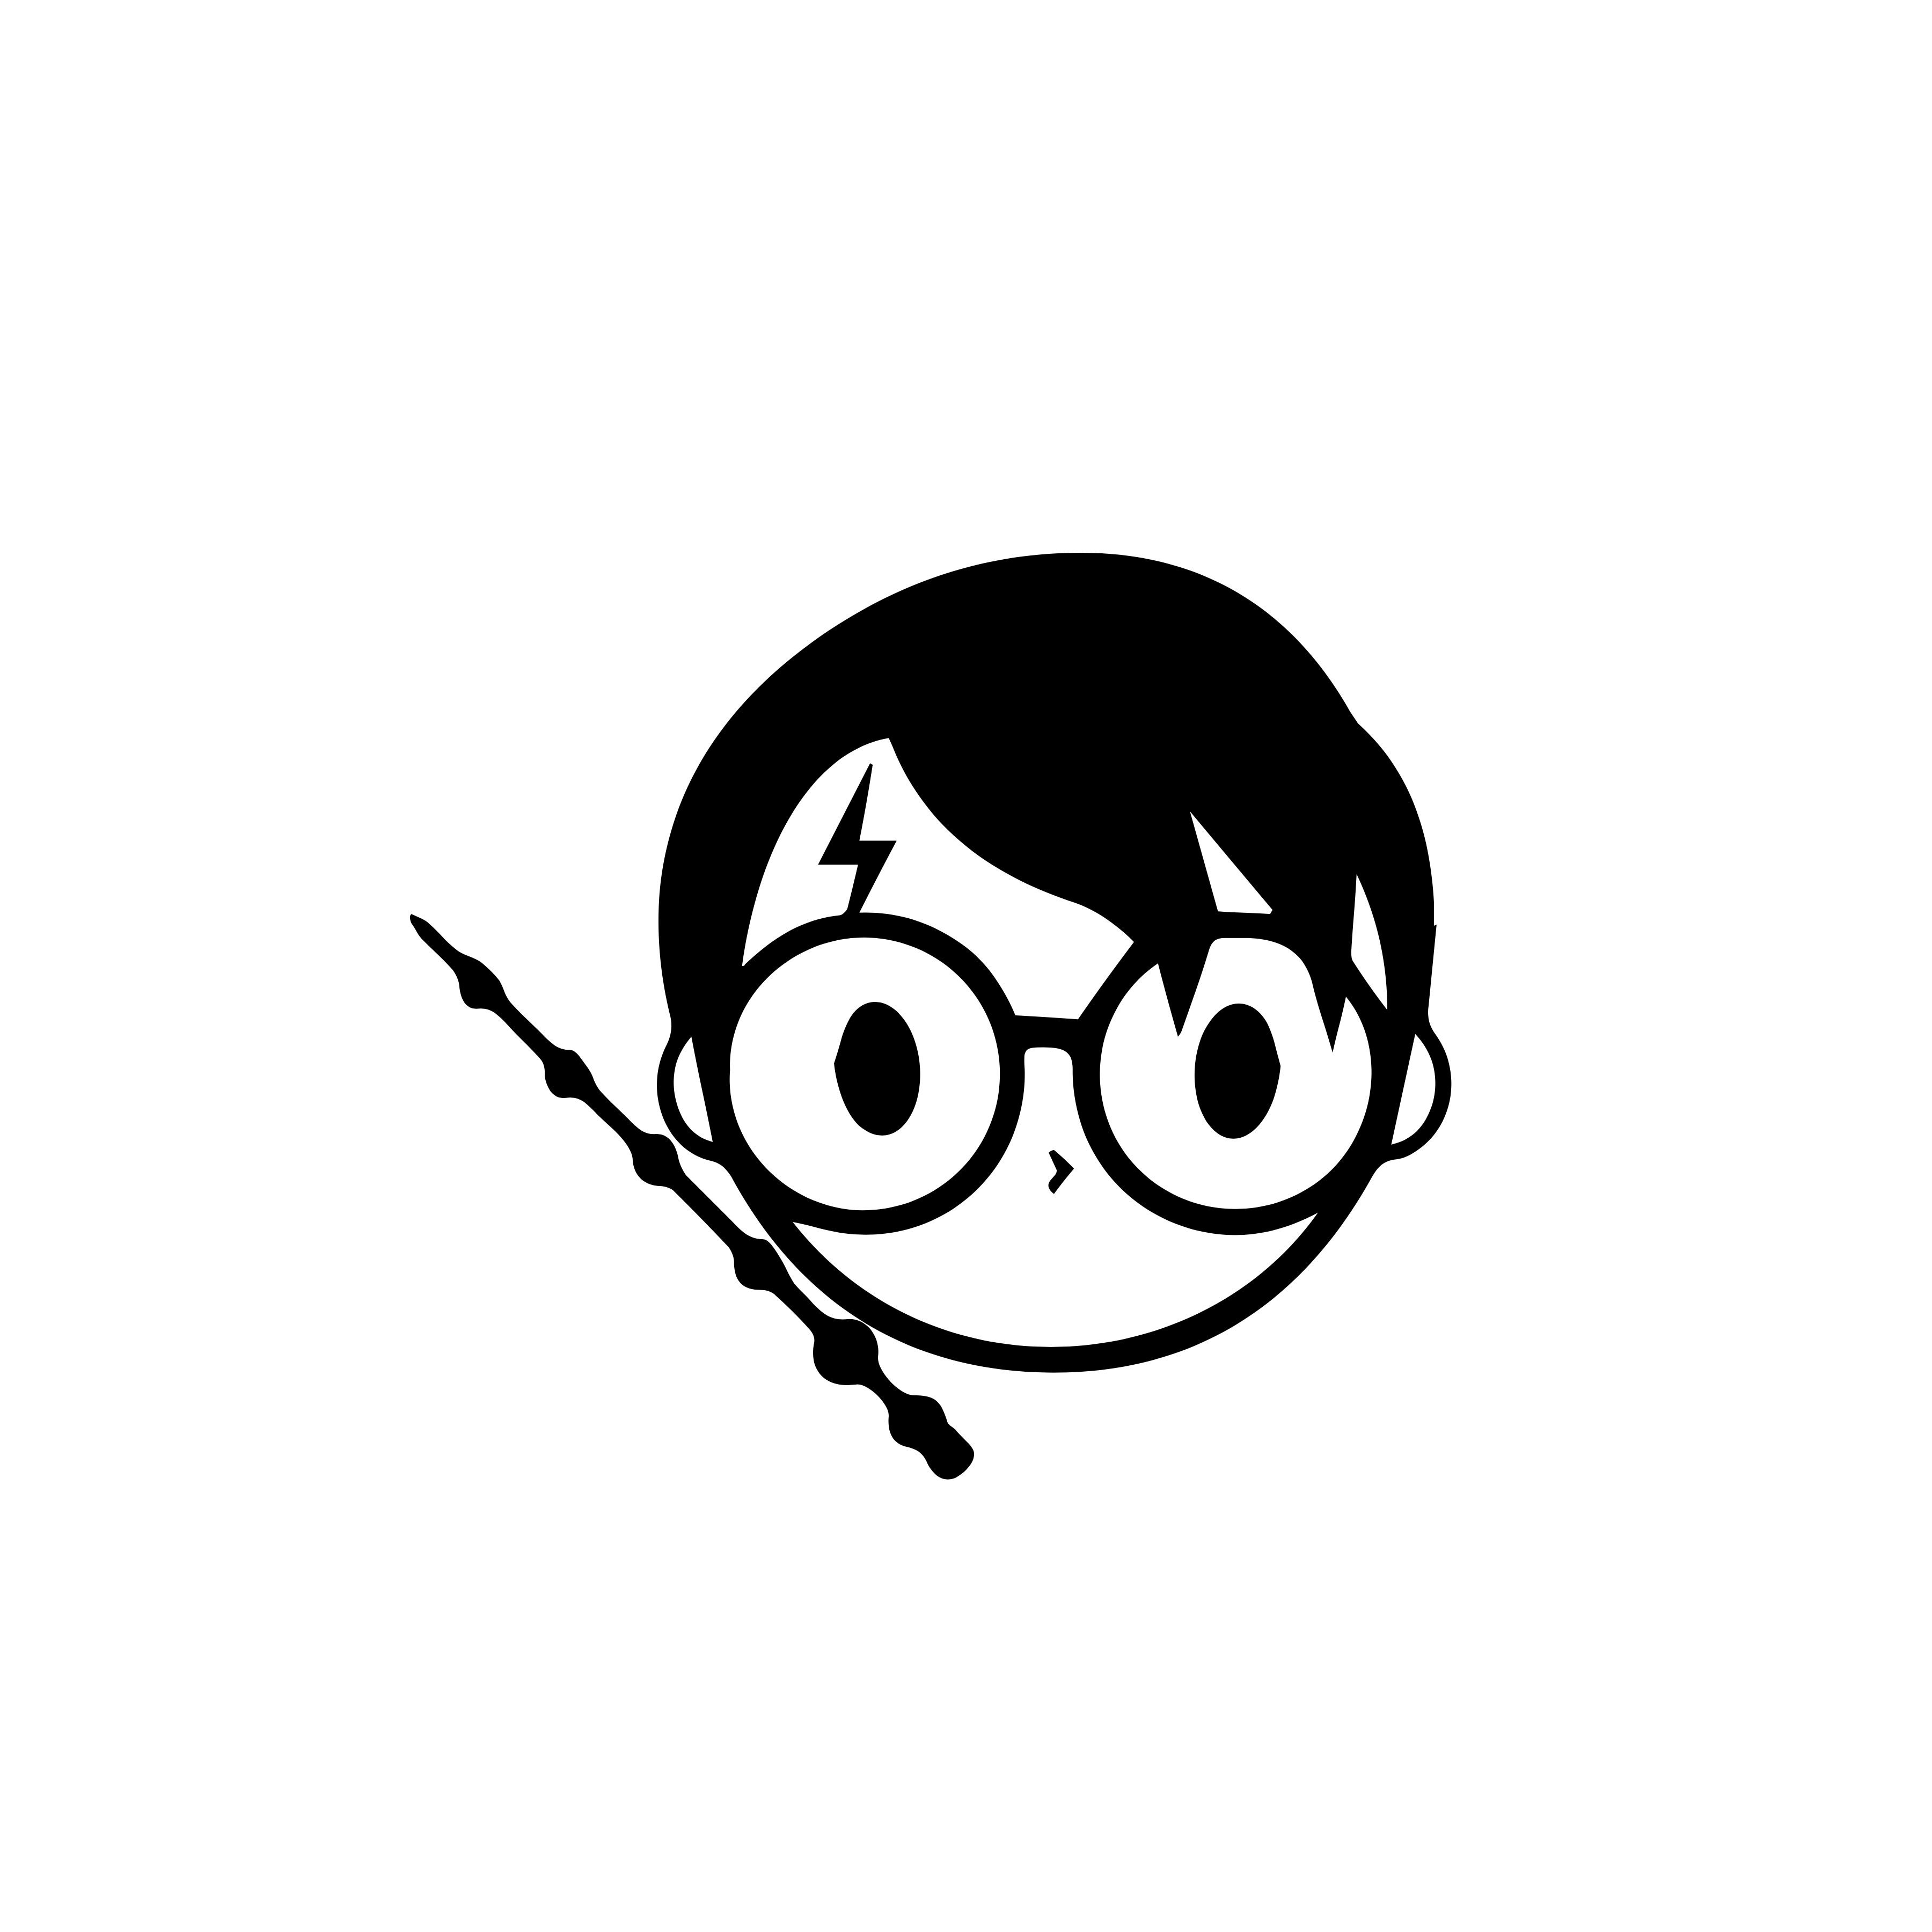
Famous examples of kindness…
The ‘Pay It Forward’ movement encourages people to do 3 unprompted good deeds for 3 different people. There is even a film about it!
Joe Wicks helped us all with PE in lockdown. He earned millions through YouTube adverts but donated it all to the NHS.
J. K. Rowling took a break from writing to email a fan who had been diagnosed with Leukaemia. The fan sadly died soon after, but she lives on in the name of a character in Gryffindor – the house known for its bravery.

Slide 16

Deliberately kind
What could you do that would make someone else feel good?
Think of all the small things you could do to be kind, e.g. open a door for someone.
Write down how it feels when someone is grateful to you for your kindness.
Write down any ideas in your workbook.

Slide 17
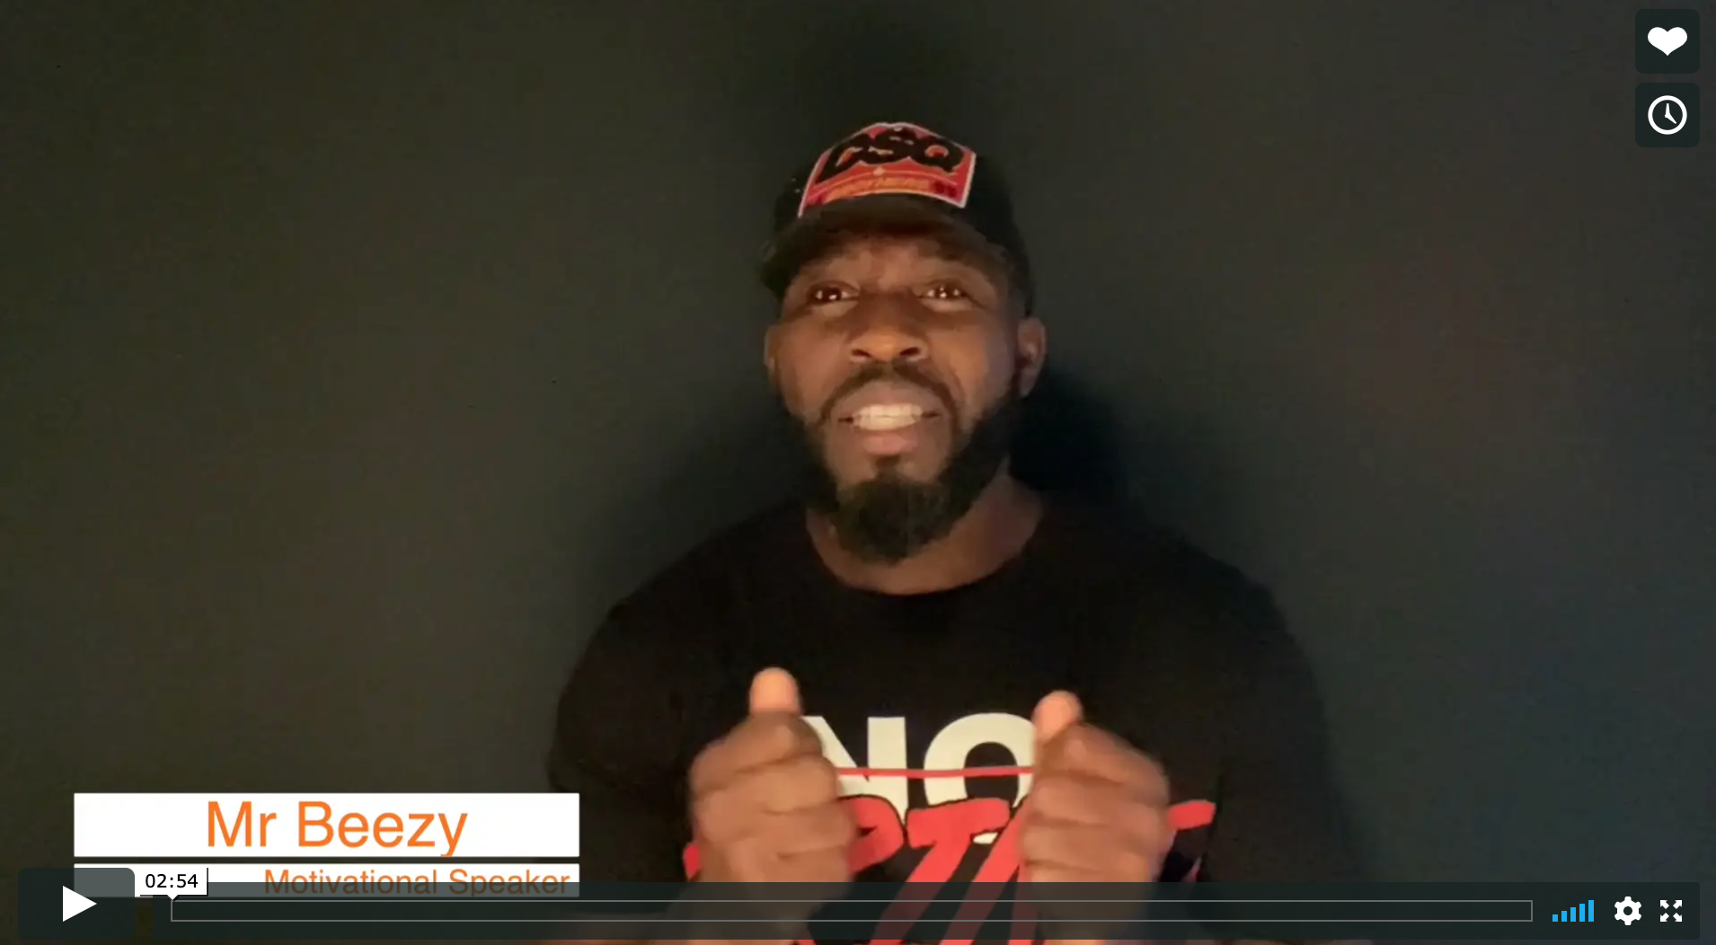

Real life
Be Deliberate
Mr Beezy

Slide 18
© 2020 The PiXL Club Ltd and Hachette UK
This resource may be shared with any school in its current form, and parts thereof, to enhance your work with students. All opinions and contributions are those of the authors. The contents of this resource are not connected with, or endorsed by, any other company, organisation or institution.
If there are any inadvertent omissions or errors in the acknowledgements or usage, this is unintended and we will remedy these on written notification.
Hachette UK own 'Dare to Be You' by Matthew Syed, which may be purchased by individuals and schools, should they wish to do so to enhance these resources for students. Illustrations copyright © Toby Triumph.

