Slide 1


Session 1
Why Change Makers?

Slide 2
Brought to you by the team who created, ‘Be Awesome, Go Big’, this is ‘Change Makers’. We will be walking you through a change journey based on the work of Matthew Syed’s new book, ‘Dare to Be You’.
We hope that by the end of these sessions you will feel more able to embrace who you are, understand your place in the world and be a change maker.

Slide 3
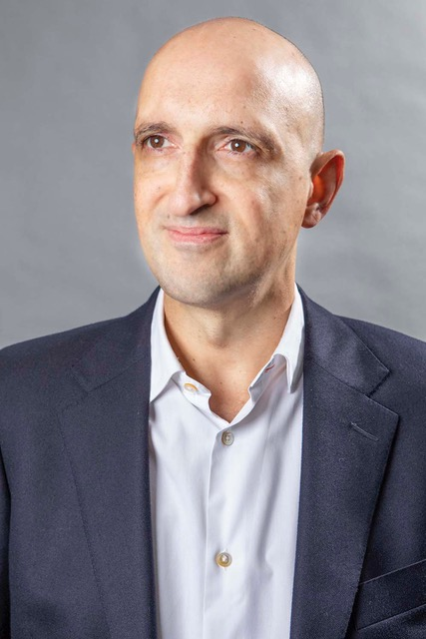
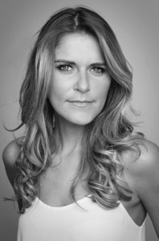
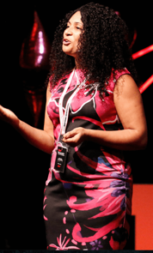
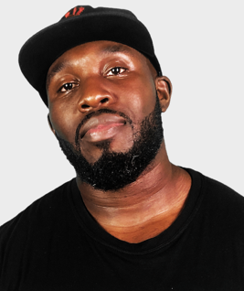
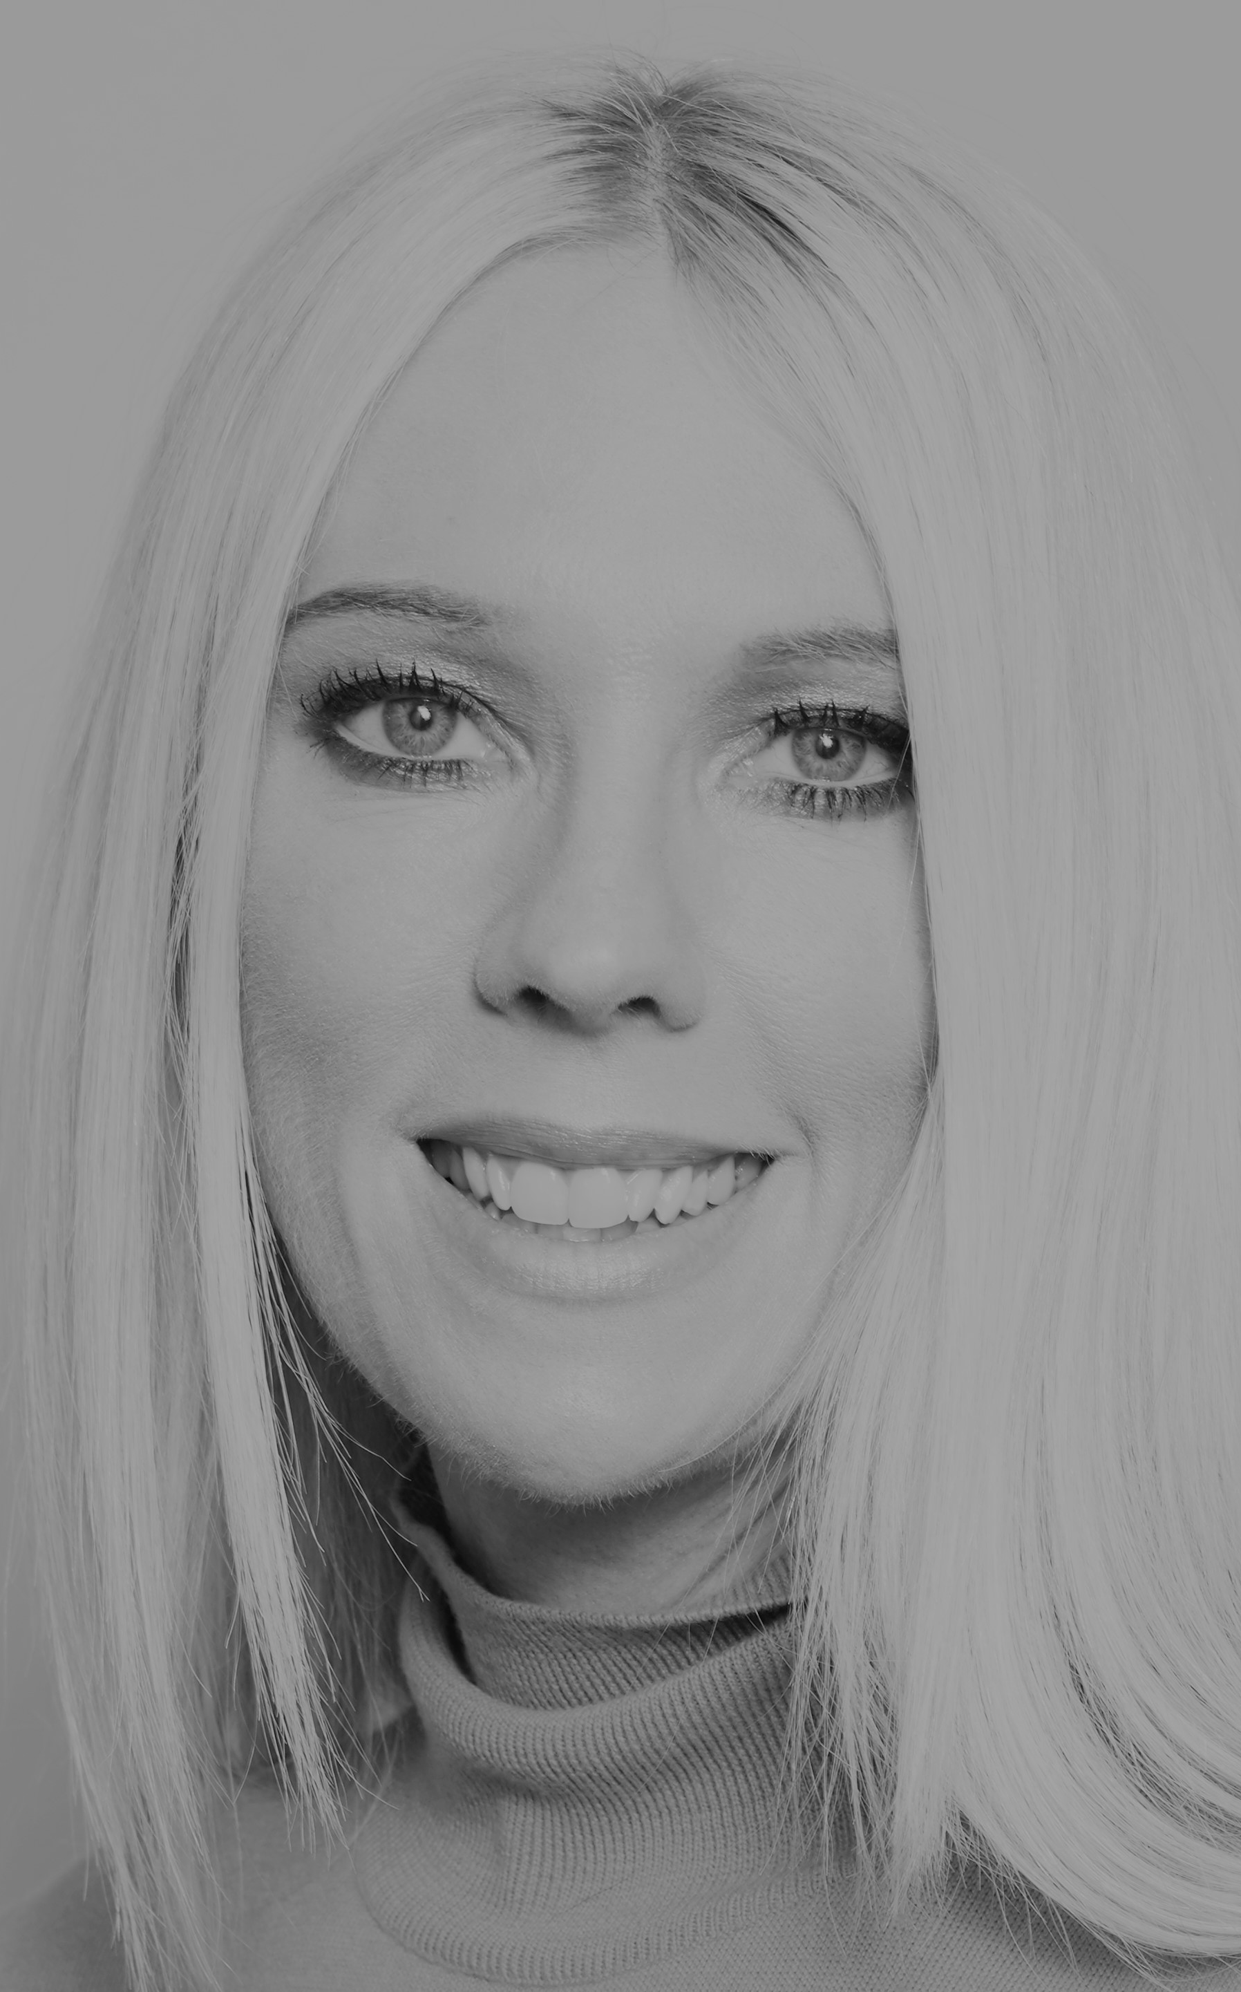
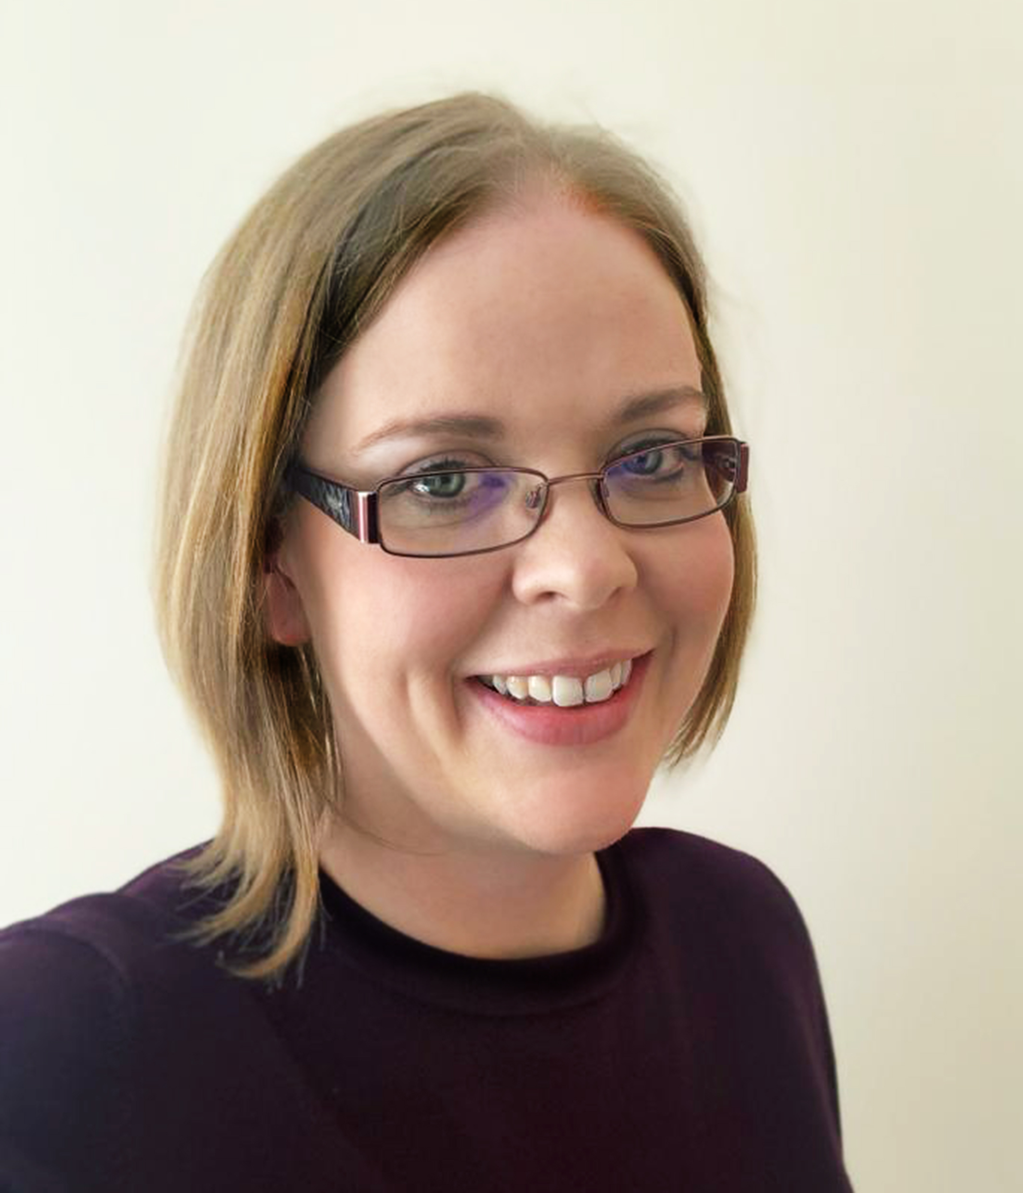
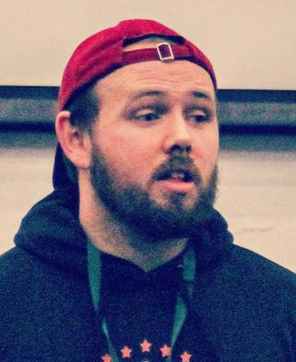


To help you on this journey, we have some special guests who will be sharing their thoughts with us. They are:
Matthew Syed Author and Broadcaster, Author of ‘Dare to Be You’
Gemma Oaten Actress and TV star
Jaz Ampaw-Farr
Resilience ninja!
Mr Beezy
Motivational speaker
Real life
YOU
Kathy Weeks
‘Dare to Be You’ Team
Rachel Johnson
Writer of Change Makers
Cameron Parker
Motivational speaker
And YOU?

Slide 4
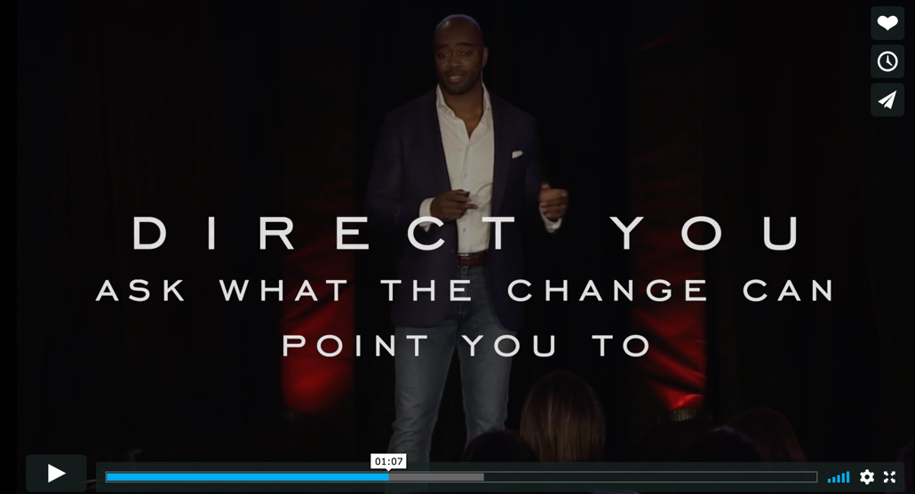

So, why is change so important? Because the world is depending on it.

Slide 5
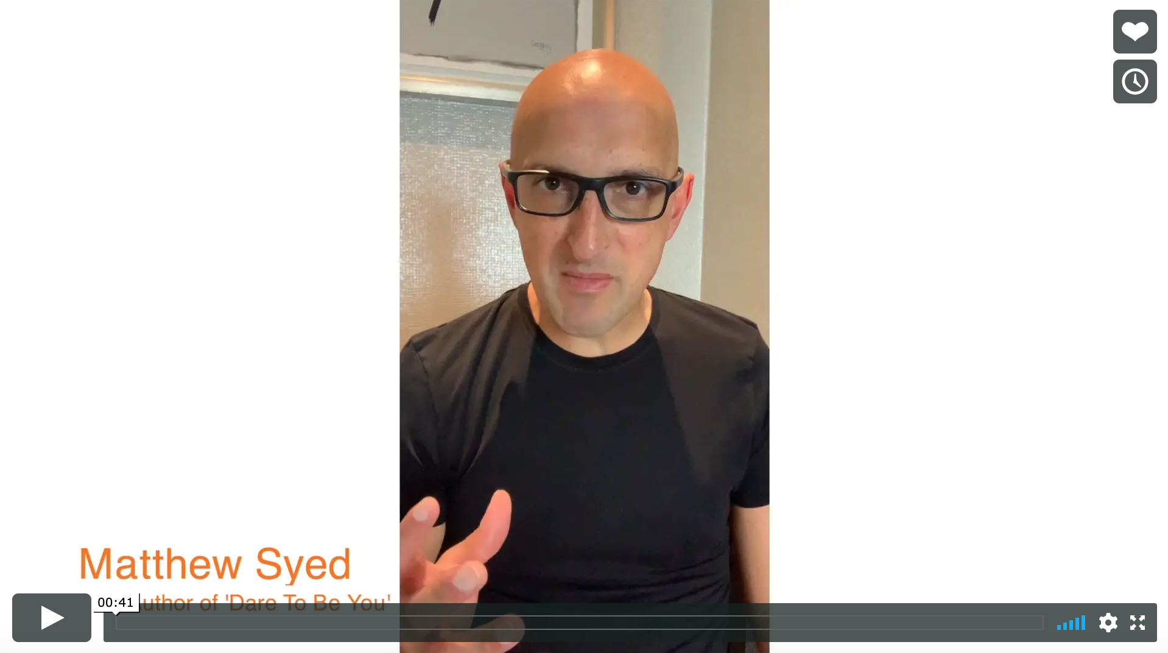
Matthew Syed wrote ‘Dare to Be You’ but why did he
think that this was important?

Slide 6




Everything changes! Change is a part of life.
Seasons change
Transformation can be seen every day
We grow up and experience different things
COVID-19 created a major change

Slide 7



Did you know?
Metamorphosis - how a creature transforms.
Caterpillars are born with everything they need to become butterflies. Some of these parts develop over time and are visible, like wing buds. The others can’t be seen. But the information for these parts is stored in the caterpillar’s cells, waiting to be unlocked.
Before becoming butterflies, caterpillars enter the pupa stage, where they build a little sack, or chrysalis. The chrysalis protects the caterpillar as it begins to turn itself into a liquid, soupy substance.
When they emerge from the chrysalis, they are transformed. They wait until their wings are dry…and then they take their maiden flight.

Slide 8

These sessions will help you navigate through some of the things that will enable you to ‘fly’.

Slide 9
Some things are hard to change because you have no control over them, but more is in your control than you think! What IS in your control?
Your attitude
Your behaviours
Your reactions
Your effort
The way you want to see the world
The person you want to become

Slide 10


History is full of individuals who knew what they wanted, controlled what they could and saw change.
Some, you have heard of.
Many others are not in the history books, but they were change makers all the same!
What did they all have in common?
They knew the change they wanted to make.

Slide 11
What do you want to change?
How I feel about myself
How I feel about my attitude
Being comfortable with being different
How brave I feel
The injustice that I see
The inequality I feel
How I feel about my relationships

Slide 12
There are several factors that make change possible:
Willingness
Am I willing to make a change?
Identification
What do I want to change?
An intention
What am I going to do to change?
An action
Doing something different

Slide 13
What is ONE change that can make a difference to the rest of your life?

Slide 14

Daring to be you
Understanding ‘normal’ doesn’t exist
Grasping that difference is crucial
Knowing who you are
Handling self-doubt
Stepping into being confidently you
Finding your own path

Slide 15

We will look inside the chrysalis to see the adjustments that need to happen for transformation to occur.
This is about you daring to be you.

Slide 16
Throughout the next few weeks, we will be exploring all of these topics. You will have a workbook to work through to help track your thoughts too.
Why Change Makers?
The Doubts
The Difference
Be Daring
Be Distinctive
Be Decisive
Be Determined
Be a Do-er
Be Decent
Be Deliberate
Be Dedicated
Be Change Makers

Slide 17
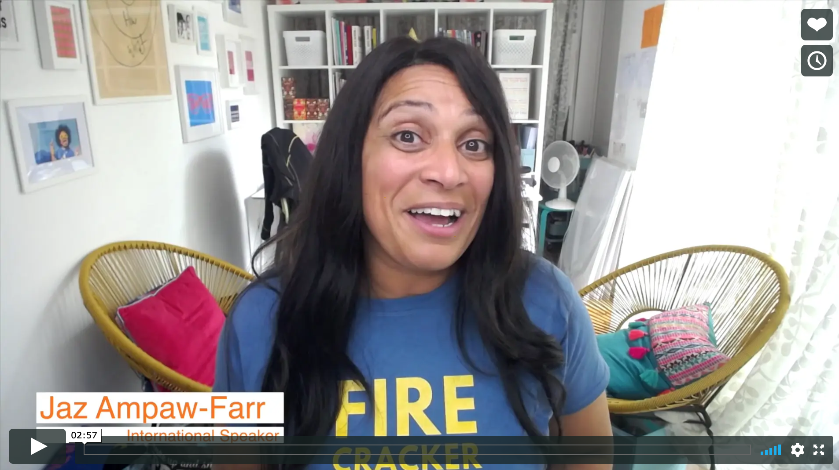
Real life
Why Change Makers?
Jaz Ampaw-Farr

Slide 18
© 2020 The PiXL Club Ltd and Hachette UK
This resource may be shared with any school in its current form, and parts thereof, to enhance your work with students. All opinions and contributions are those of the authors. The contents of this resource are not connected with, or endorsed by, any other company, organisation or institution.
If there are any inadvertent omissions or errors in the acknowledgements or usage, this is unintended and we will remedy these on written notification.
Hachette UK own 'Dare to Be You' by Matthew Syed, which may be purchased by individuals and schools, should they wish to do so to enhance these resources for students. Illustrations copyright © Toby Triumph.

