Slide 1

Workbook
© 2020 The PiXL Club Ltd and Hachette UK
This resource may be shared with any school in its current form, and parts thereof, to enhance your work with students. All opinions and contributions are those of the authors. The contents of this resource are not connected with, or endorsed by, any other company, organisation or institution.
If there are any inadvertent omissions or errors in the acknowledgements or usage, this is unintended and we will remedy these on written notification.
Hachette UK own 'Dare to Be You' by Matthew Syed, which may be purchased by individuals and schools, should they wish to do so to enhance these resources for students. Illustrations copyright © Toby Triumph.

Slide 2
Session 1
Why Change Makers?
What do you want to change?
How I feel about myself
Being comfortable with being different
The injustice that I see
How I feel about my attitude
How brave I feel
The inequality I feel
How I feel about my relationships
What is ONE change that can make a difference to the rest of your life?

Slide 3
Session 2
The Doubts
Write how your Kid Doubt makes you feel.
Kid Doubt is not your friend.
What kind of friend makes you:
doubt yourself all the time?
feel rubbish?
act differently in order to fit in?
feel anxious and nervous?
hold yourself back?

Slide 4
Circle or highlight which 2 of these 8 things you find the most difficult to do:
Make friends with people who like you for YOU.
Make choices based on what you feel is right.
Don’t blindly copy other people. Be YOU.
Ask questions. Keep asking questions. Make things work for YOU.
Don’t be afraid to do things at your own pace.
You should be prepared to be flexible.
Be Kind. And don’t listen to anyone who isn’t kind towards YOU.
Make it happen. Don’t wait. Get out there. It is down to YOU.
What would you add to your own plan?
How does Kid Doubt stop you from being YOU?
There is room here for you to write your own plan if you want to
(we will also come back to this!).

Slide 5
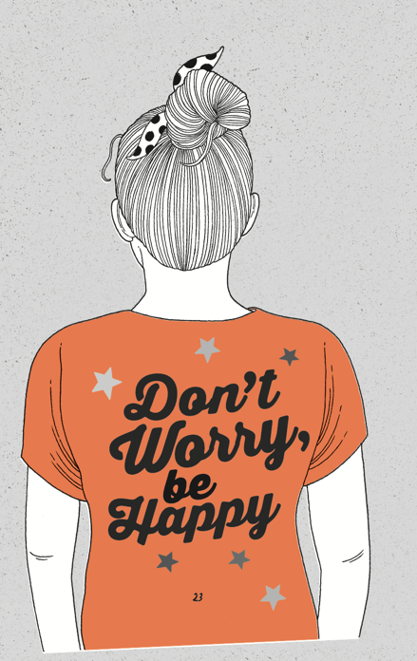
Everyone’s Kid Doubt looks different and says different things to get you down, but what they all have in common is that they
hold us back.
What are the kind of things you worry about?
Did you know?
Research by 72 Point suggests that people spend nearly 2 hours worrying, EVERY SINGLE DAY. That’s 28 days a year!

Slide 6

Session 3
The Difference
So many of us spend SO long trying to be as similar to those around us as we possibly can. It can even mean we do things we don’t like, don’t enjoy and don’t even believe in! WHY do we do this?
When have you tried so hard to fit in that you have done something you don’t even like doing?
What do you think are the problems around creating a version of ‘normal’ from data averages?

Slide 7
What do you think ‘normal’ or ‘perfect’ looks like?
Do you know anyone who meets all of those criteria?

Slide 8
Session 4
Be Daring
Kid Doubt can spring into action when we feel like we are different.
Sometimes we feel like we are different and we are upset by other people’s reactions to that. We can feel like:
We don’t belong
We don’t fit in
We feel shut out
We are being marginalised
We are ‘too different’
When did you last feel that you were different and Kid Doubt had something to say?

Slide 9

So, what is stopping you from embracing your difference and accepting that being different is a good thing?
Have a go at answering these questions:
What is the difference that you bring to the world?
What is the thing about you that Kid Doubt has made
you anxious about, but that you should celebrate?
What are you going to stop trying to hide?

Slide 10

Session 5
Be Distinctive
We have talked about lots of differences: our appearance, our background, our body shape and our experience of life.
But what about differences of opinion?
Answer the questions about how comfortable you are expressing your own opinion:
a) at home
b) at school
c) with your friends
What stops you from expressing your own view?

Slide 11

There are LOADS of things that may make you feel different.
Whatever it is, embrace it and own it.
BE Distinctive!
Complete the reflection:
The difference I can bring is…
The following things give me a different perspective from my friends…
I haven’t always embraced my difference because…

Slide 12

Session 6
Be Decisive
It is time to BE DECISIVE and decide who YOU actually are and who you want to be.
Think about about someone who you have been copying but some of the things you have been copying are not helpful.
Write down what you have been copying that wasn’t really ‘you’. E.g. being unkind to people or wearing clothes that you don’t really like.
What is one thing you want to stop copying?
Think about someone you admire. It could be someone you know or someone famous.
Write down all the things that made you want to copy that person.
Now underline the ones that are going to help you achieve YOUR goals.

Slide 13


If we are going to make a change, we must have an idea about who we want to be. Look at the list below: which words describe who you want to be? Write them in the person outline.
Kind
Compassionate
Empathetic
Determined
Courageous
Decisive
Encouraging
Thoughtful
Friendly
Creative
Hard-working
Caring
Organised
Efficient
Brave
Patient
Optimistic
Honest
Sincere
Spiritual
Daring
Accepting
Truthful
Trusting
Look up these words online or in a dictionary for more explanation

Slide 14
Session 7
Be Determined
Take charge. Ask the questions. You can do it.
Think about:
What can I definitely change?
What do I think I can’t change (but maybe if I’m brave enough to question it I can)?
What can I definitely not change?

Slide 15

Session 8
Be a Do-er
Have a look at this example and then complete one of your own.
Sometimes it helps just to write things down. For example:
ASK THE QUESTION:
Why am I struggling to get organised to complete my schoolwork now I am back at school?
2. THINK OF A SOLUTION:
I could have a routine so that I start getting back into a pattern, including finding the one same place to do all my work.
3. ACT ON IT:
Talk to the adults in my house, get everything set up and start going there to do my work. Create a to-do list each day and tick it off as it is completed.

Slide 16
The power of ‘I could…’
When you use the words ‘I wish’ or ‘they need to’ or ‘someone should’, replace them with the words ‘I could’ or ‘I could ask’.
Examples:
‘They need to set up a drama club at school, we don’t have one.’
Instead try: I COULD set up a drama club at school, we don’t have one.
‘I wish I had someone to help me with my homework.’
Instead try: I COULD ASK someone to help me with my homework.
Try writing out some of your list using ‘I could’ instead of ‘I wish’.

Slide 17
Session 9
Be Decent
When was the last time someone was unkind to you?
How did that feel?
When was the last time you were unkind to someone? What had Kid Doubt been saying to you?

Slide 18

The Kindness Challenge
Kindness makes us feel more in control of our own anxieties, boosts our good brain chemicals and makes us less afraid of meeting new people. It helps others feel good and helps us feel good about ourselves.
Look at some of the kindness challenges you could have a go at. Answer the following questions.
Can you find some way to help out at home or at school?
Can you make an extra effort to include someone in your plans?
Can you say some positive things to someone who feels down?

Slide 19
The Kindness Challenge
Day 1
Write down one thing you want to do today to make something better for somebody else.
Day 7
Write down something you’re good at doing that makes people smile. Try and do it today.
Day 2
Write down one thing you want to do today that will make you feel better than how you felt yesterday.
Day 8
Write down something you would like to feel today. Try and make someone else feel that.
Day 3
Write down one thing you could do to make someone feel good today.
Day 9
Write down something you could start doing that would be kind to yourself. Try and start it today.
Day 4
What is the kindest thing you could do today for someone you love?
Day 10
Who haven’t you spoken to in ages? Send them a letter or an email today and tell them you were thinking of them.
Day 5
What is the kindest thing you saw/watched/heard someone else do yesterday?
Day 11
Who is the person who understands you more than anybody else? Write to them to express what they mean to you and that you are grateful to have them in your life.
Day 6
What is the kindest thing you could do today for yourself?
Day 12
Who is the person you find challenging to be around? Try and think of something good about them.

Slide 20





Session 10
Be Deliberate
How could you be deliberate with routines?
Make sure you get plenty of sleep.
Find time to exercise.
Find things that make you feel calm.
Take time away from screens.
Don’t bottle things up.
You need to be kind to YOU.

Slide 21

Deliberately kind
What could you do that would make someone else feel good?
Think of all the small things you could do to be kind, e.g. open a door for someone.
Write down how it feels when someone is grateful to you for your kindness.

Slide 22

Session 11
Be Dedicated
Write down the bumps in the road you have faced.
What caused it?
How did you feel about it?
What did you do about it?
How did you get back up and keep going?
How kind were you to yourself and others during it ?
After these lessons, what would you do differently now?

Slide 23
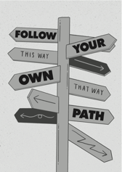
Follow your own path – what does that mean?
Look at Matthew Syed’s Manifesto for Change on the next page – is this the same as yours or would you change something?
Write your own in the space provided.

Slide 24
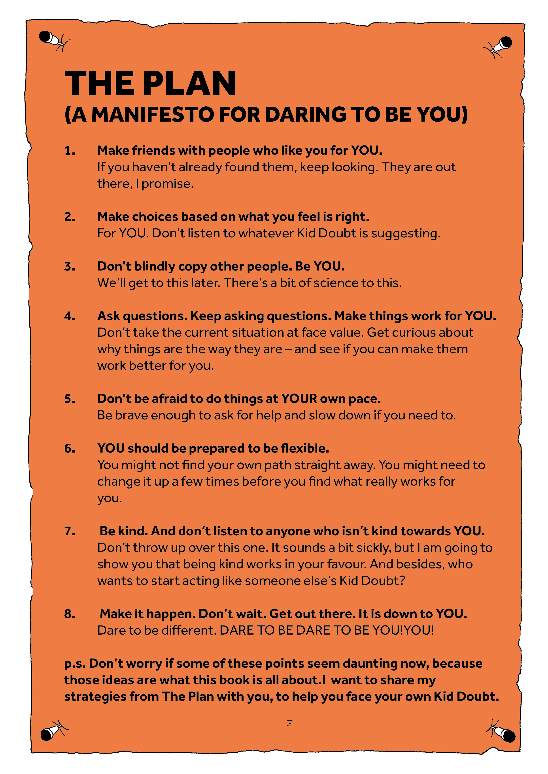

Slide 25

Session 12
Be Change Makers
WHO do you want to BE?
It’s time to commit and DARE TO BE YOU.
Have a go at writing your thoughts:
What 3 words do you hope people will use to describe you?
When people are around you, how do you want them to feel?
How kind are you to those who are different to you?

