Slide 1
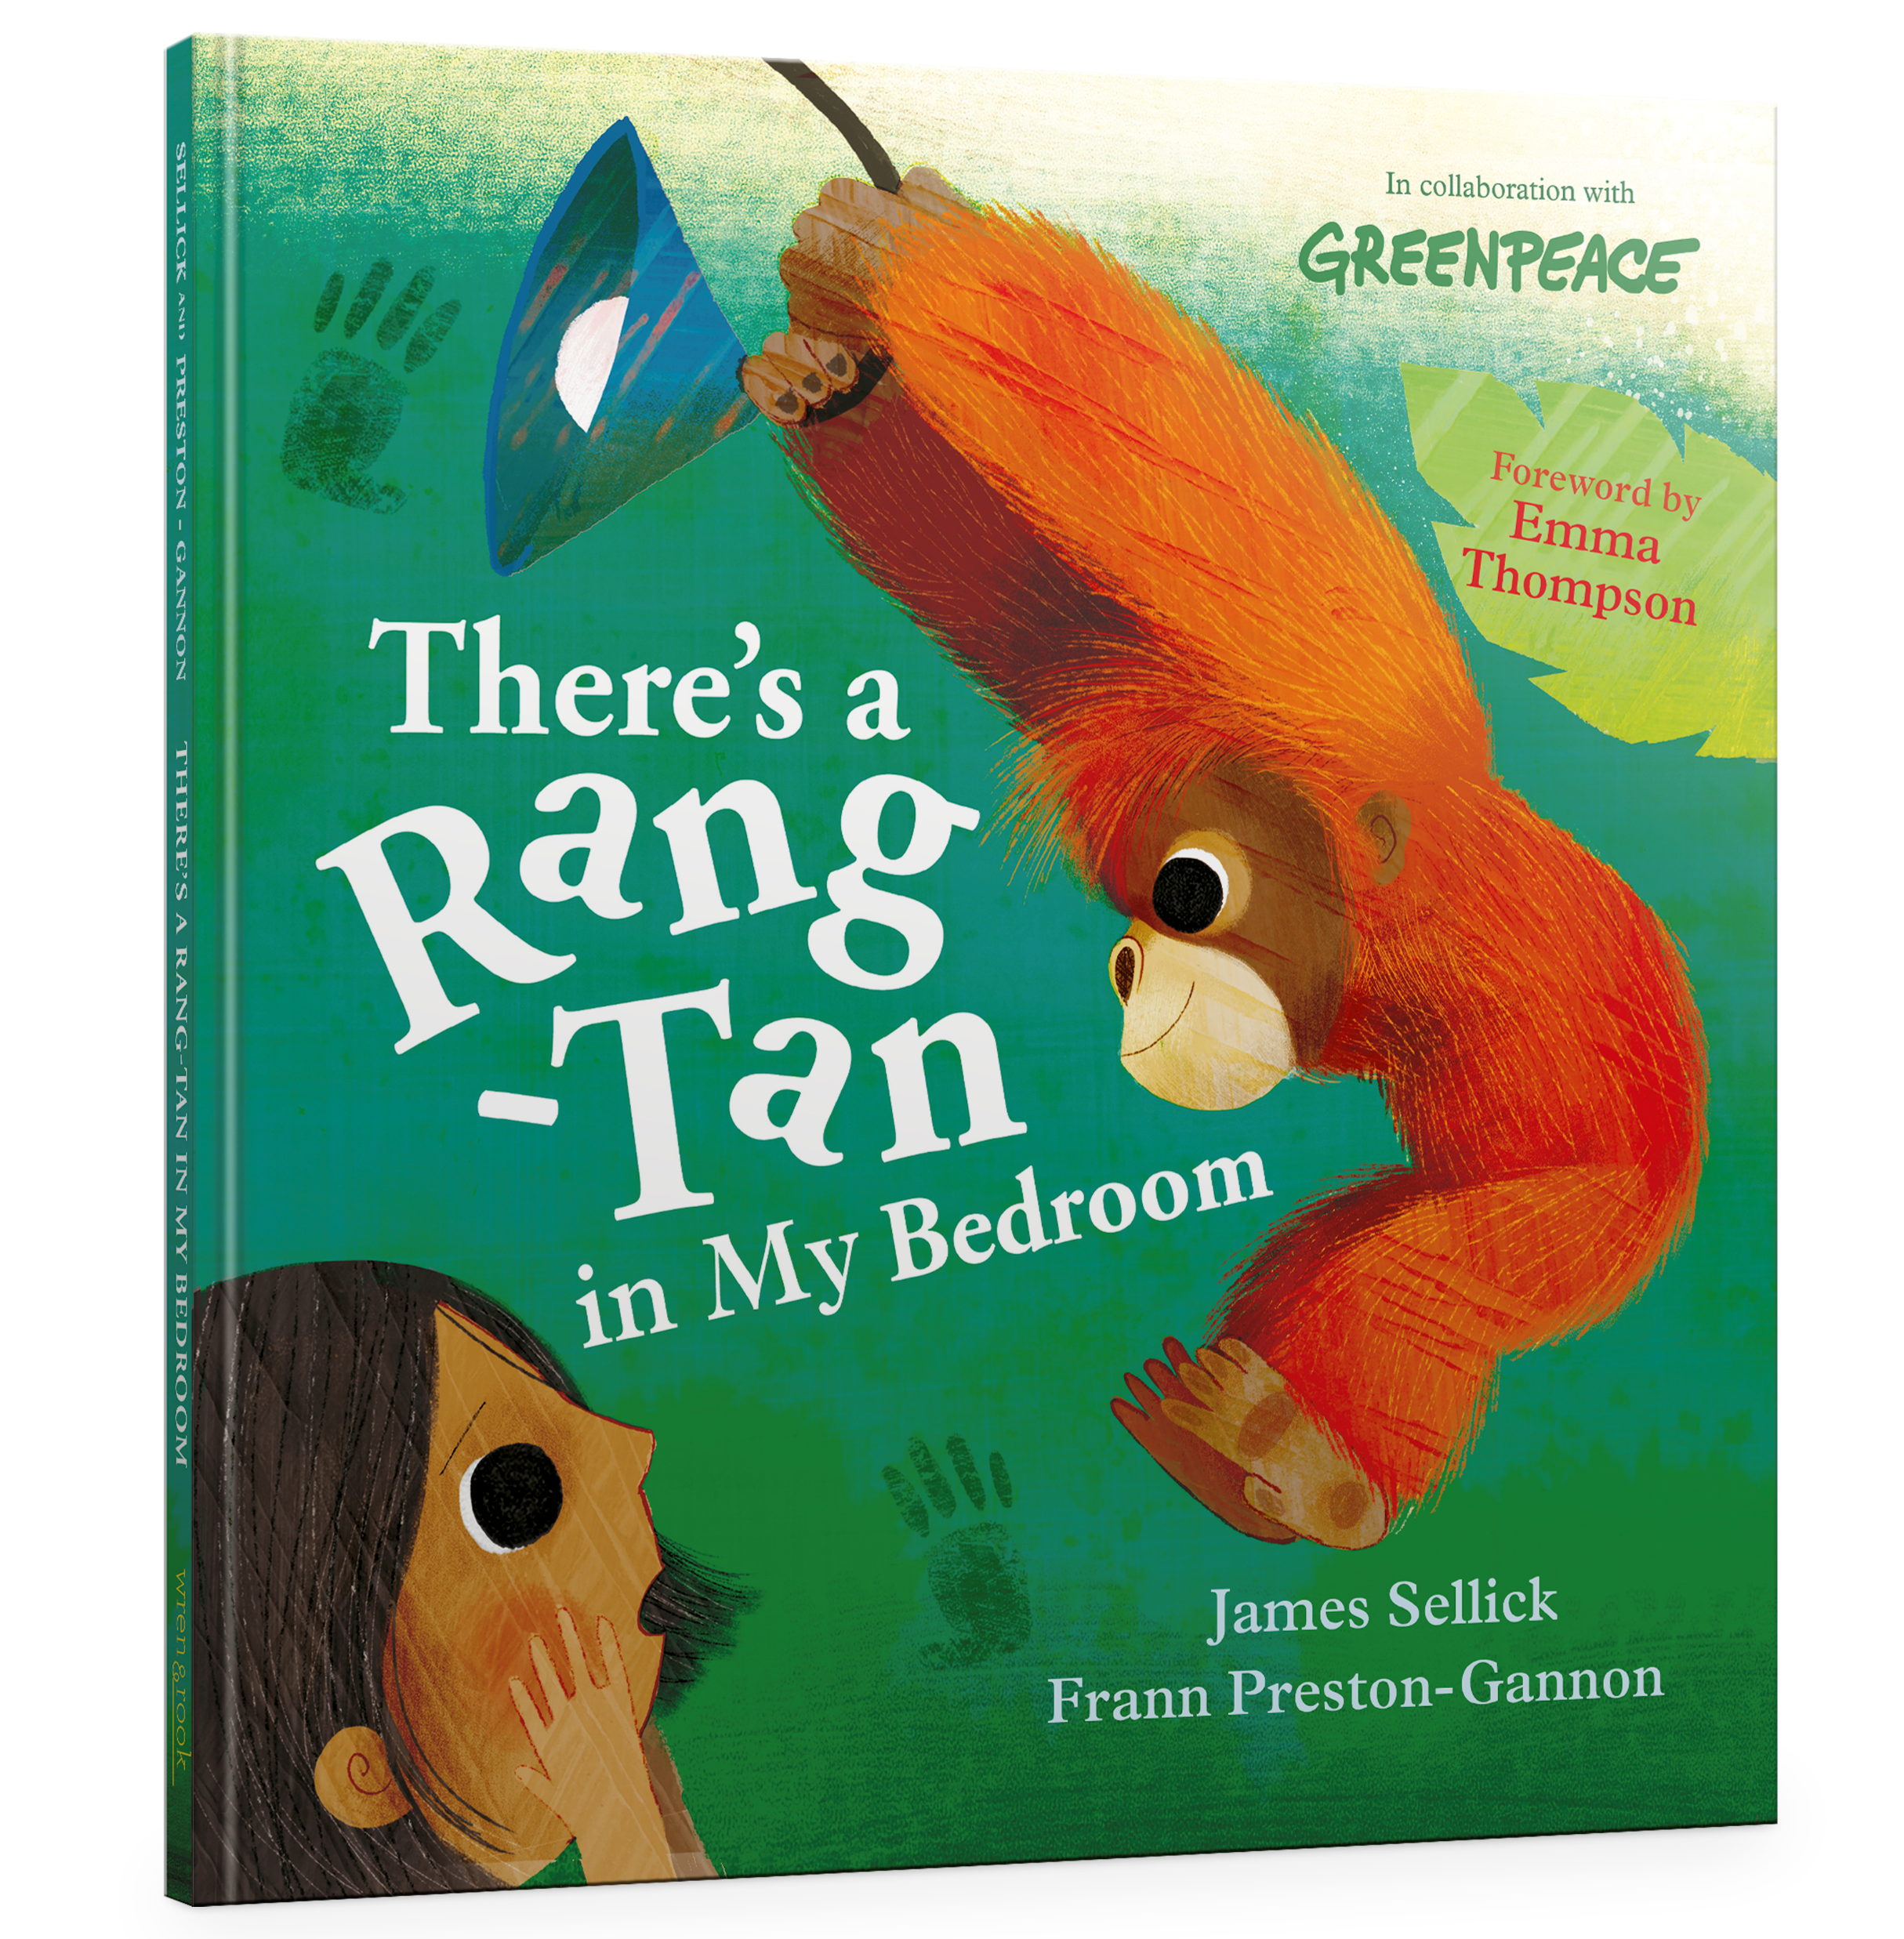
Rewards Chart
Task | Tick when completed
Research palm oil free products
Tell a friend and/or family member about sustainable palm oil
Find out what products you have at home that contains palm oil
Have a look at the food labels in your fridge. Write down a list of those that contain palm oil.
Go to the supermarket and find products which are palm oil free or use sustainable palm oil
Write and send a campaign letter to a company that uses unsustainable palm oil in their products
Once you’ve completed all the tasks return this sheet to your teacher to receive your certificate.
There’s a Rang-tan in My Bedroom
by James Sellick and Frann Preston-Gannon

