Slide 1


Who is….?

Slide 2
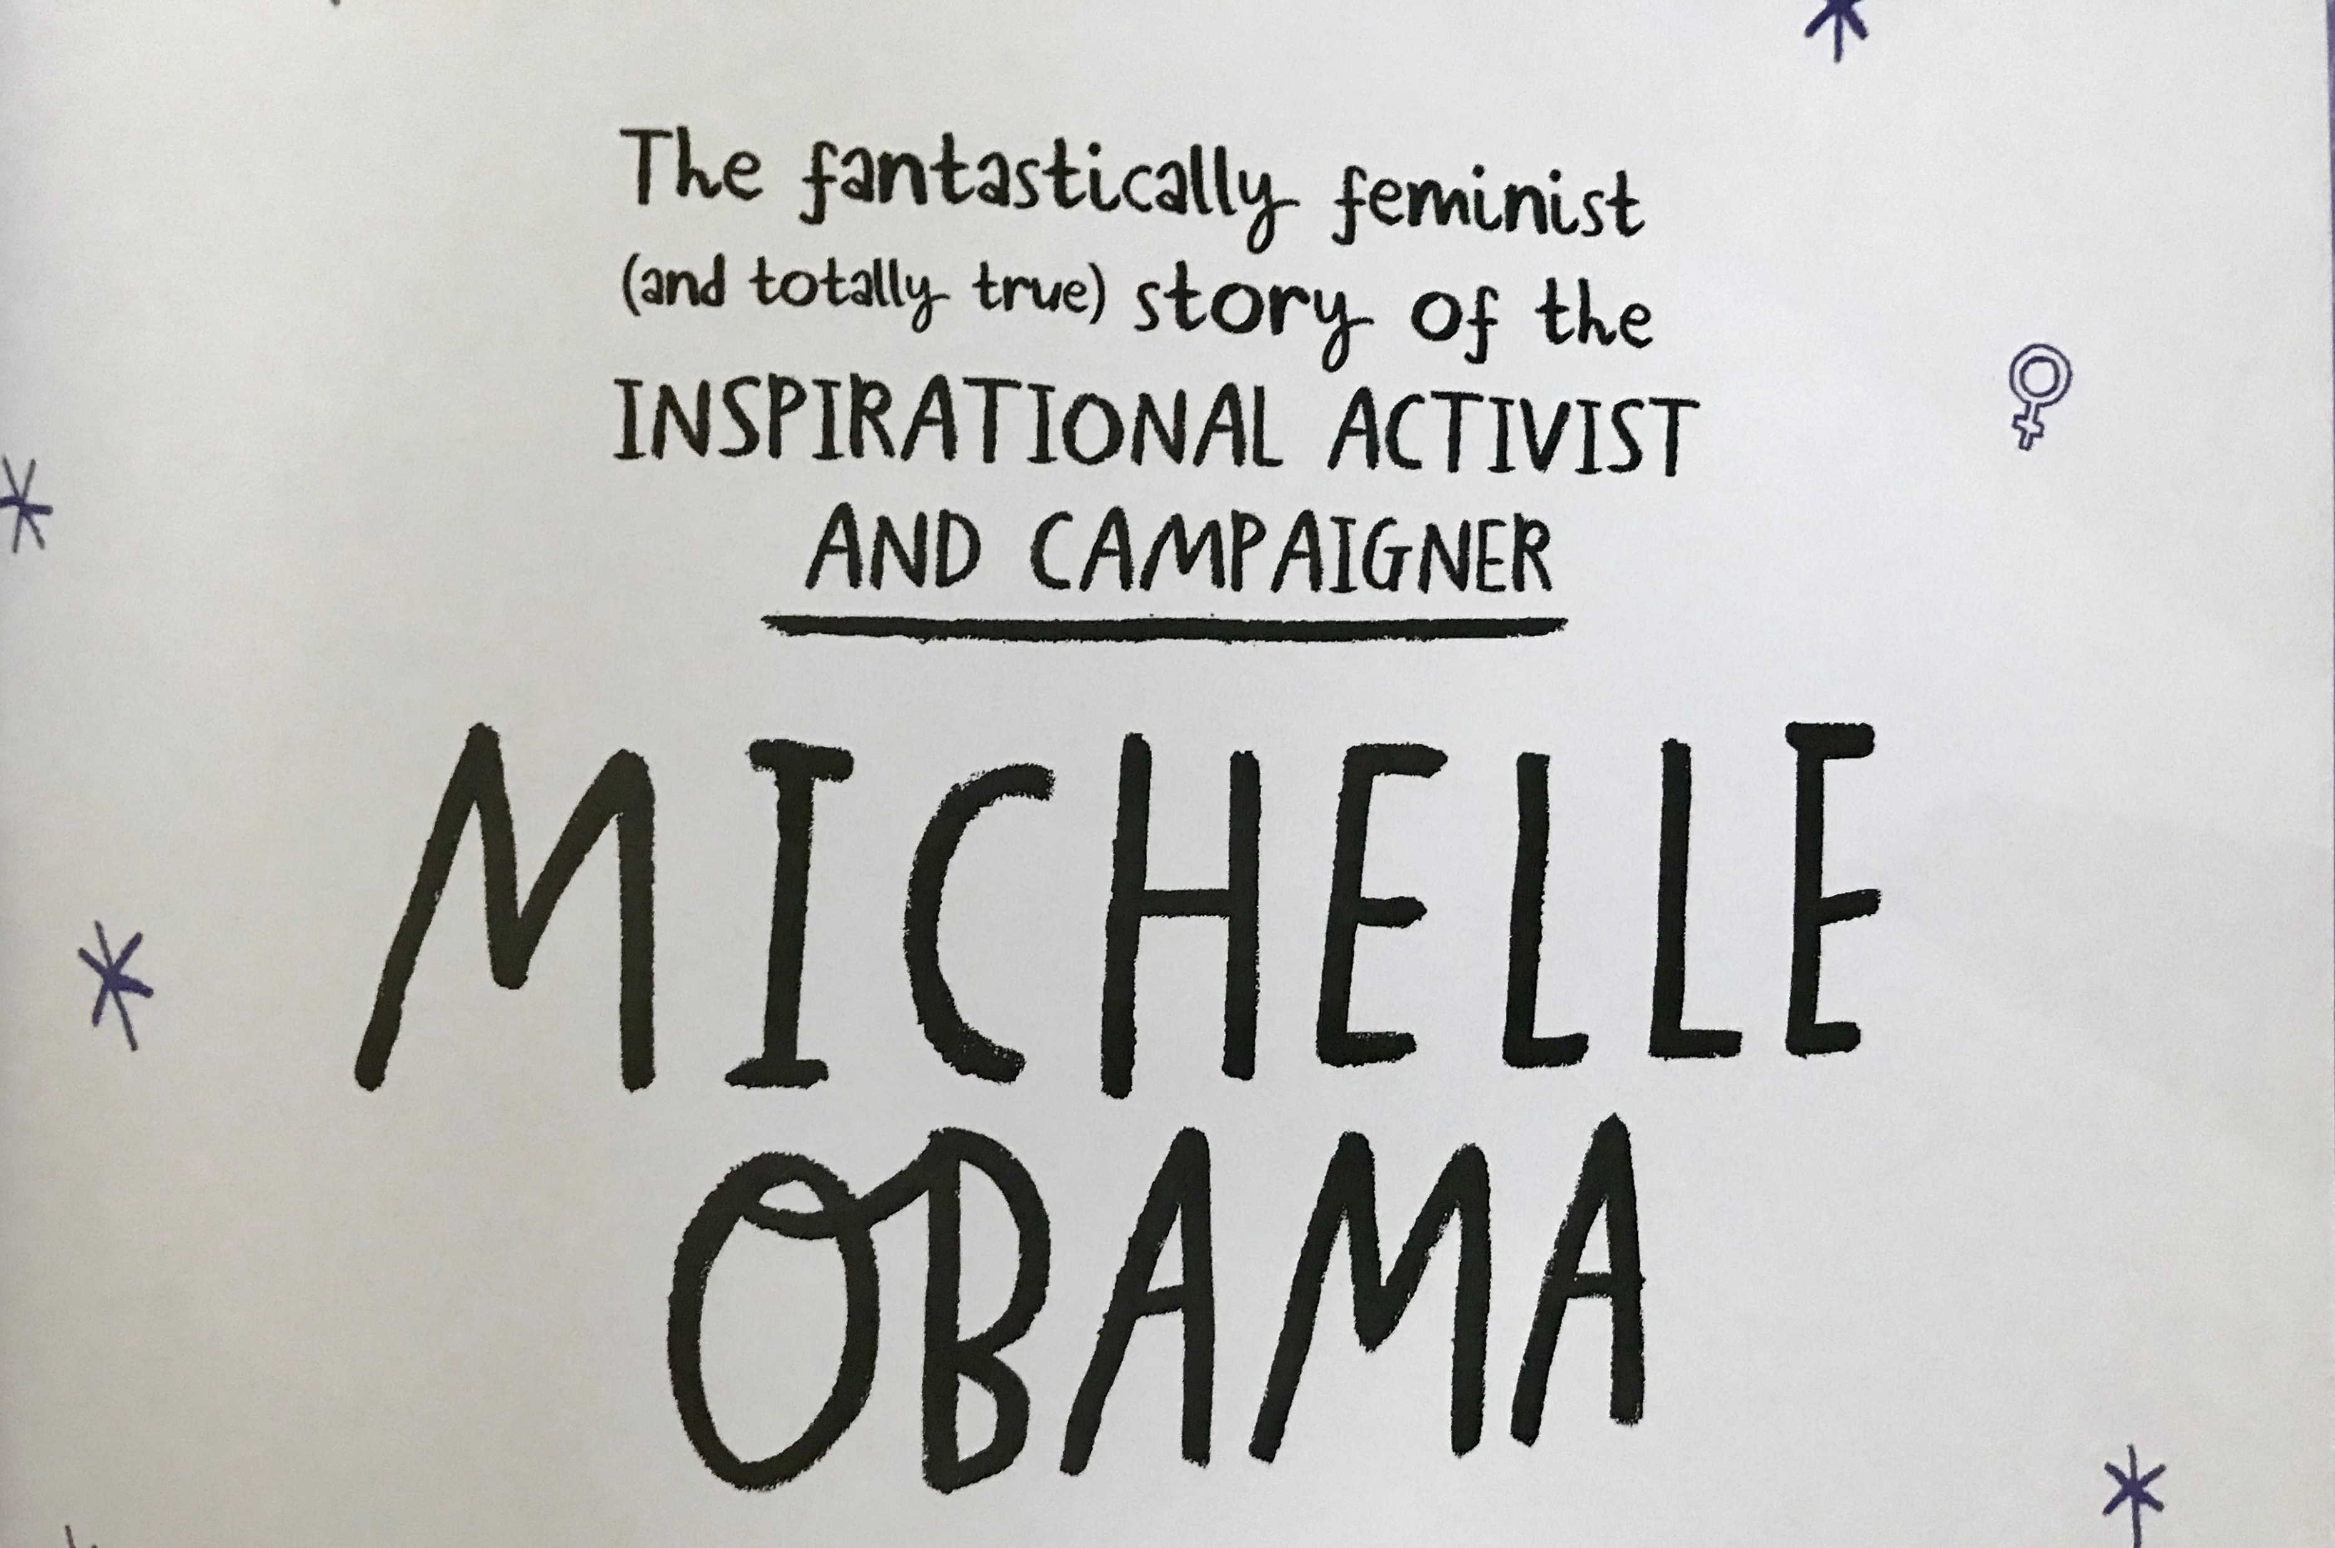
feminism is the advocacy of women’s rights and equality

Slide 3
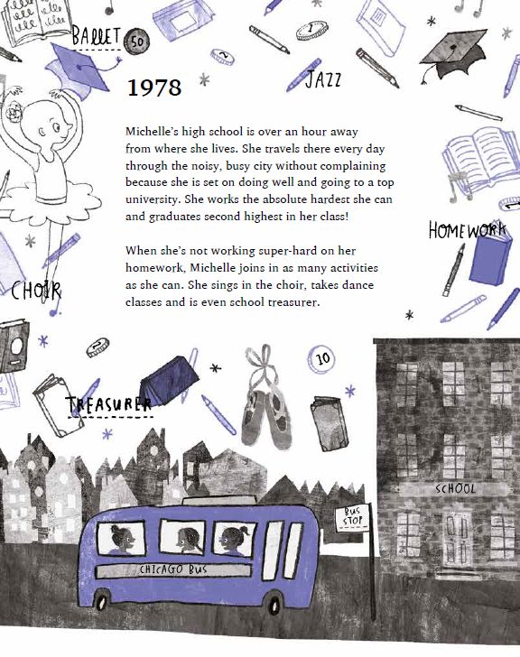
Pause and Ponder:
What inspiring attributes and actions do we see here?

Slide 4
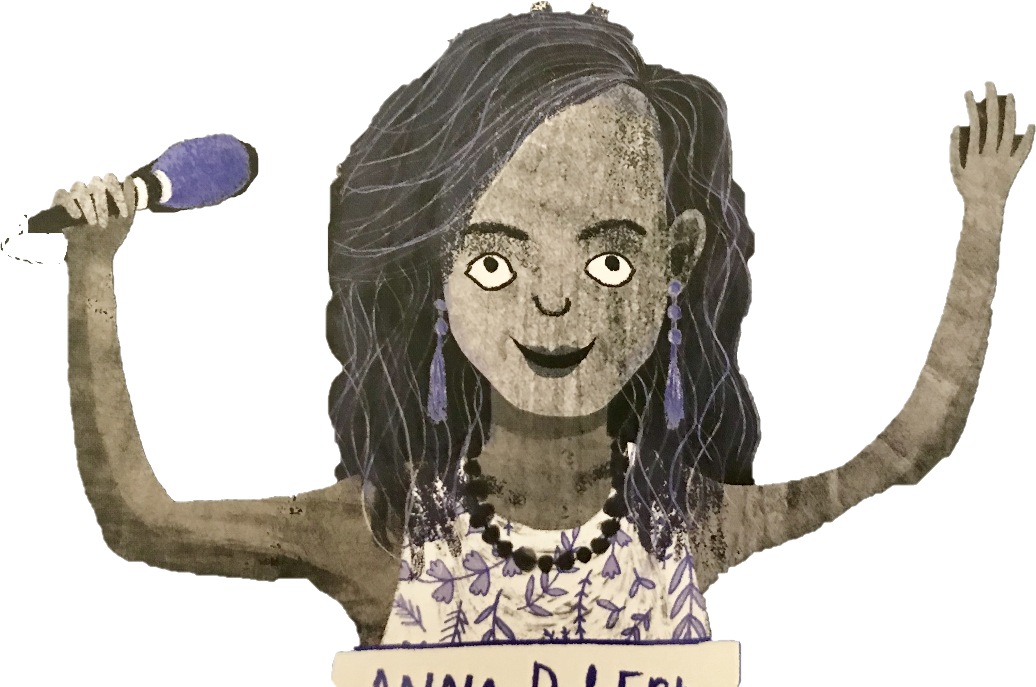
“works the absolute hardest”
“without complaining”

Slide 5
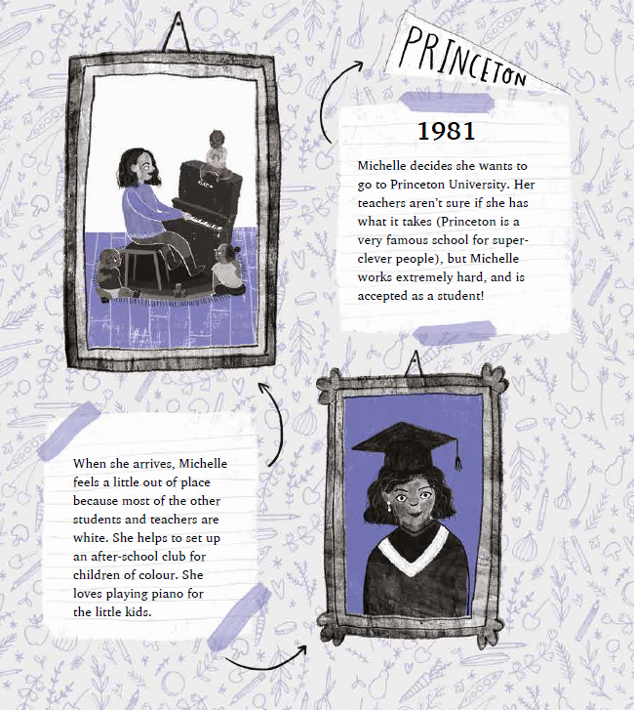
Pause and Ponder:
What inspiring attributes and actions do we see here?

Slide 6
“a little out of place……helps set up an after school club for children of colour”
“works extremely hard”
“works the absolute hardest”
“without complaining”

Slide 7
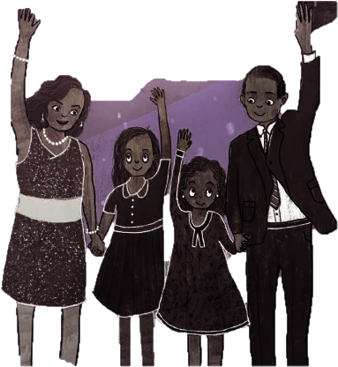
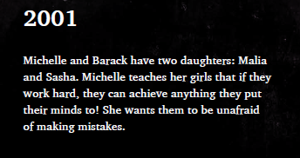
Pause and Ponder:
What inspiring attributes and actions do we see here?

Slide 8
“a little out of place……helps set up an after school club for children of colour”
“works extremely hard”
“works the absolute hardest”
“If they work hard, they can achieve anything”
“without complaining”

Slide 9

Pause and Ponder:
What inspiring attributes and actions do we see here?

Slide 10
“a little out of place……helps set up an after school club for children of colour”
“works extremely hard”
“If they work hard, they can achieve anything”
“works the absolute hardest”
“without complaining”
“Family is very important to Michelle”

Slide 11

What will YOUR
story be?

