Slide 1
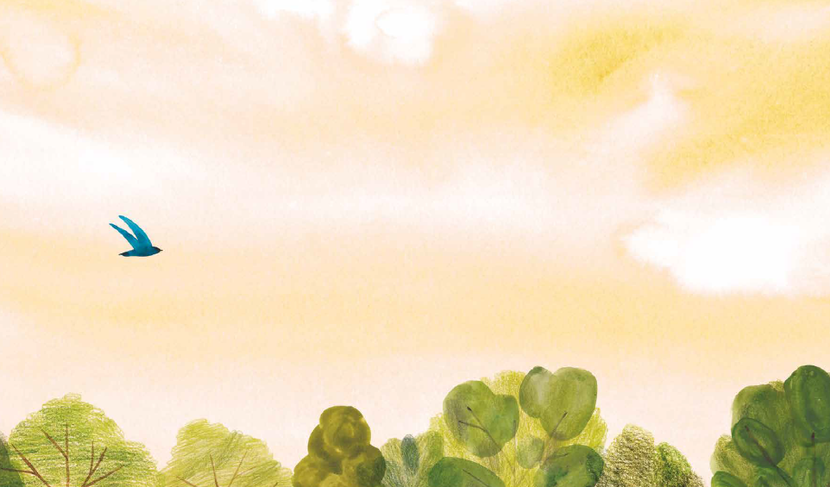
What’s the difference?
I want . . .
I need . . .

Slide 2

song
refrain
melody
ditty
tune

Slide 3
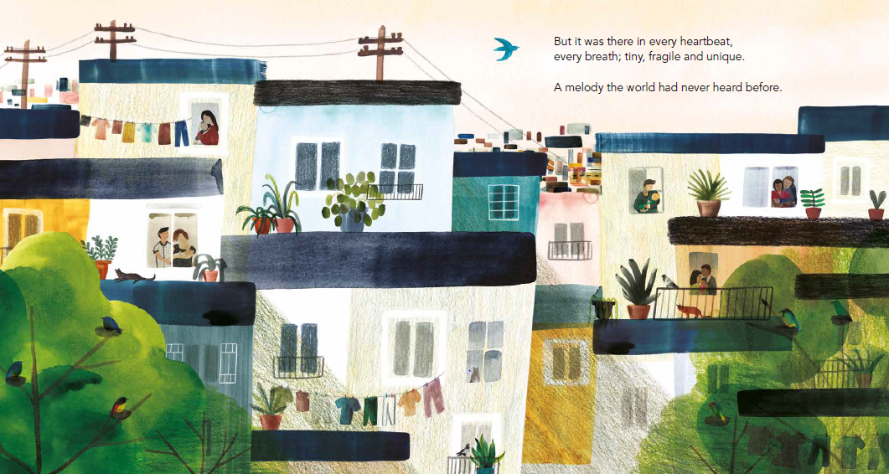
tiny
unique
fragile

Slide 4
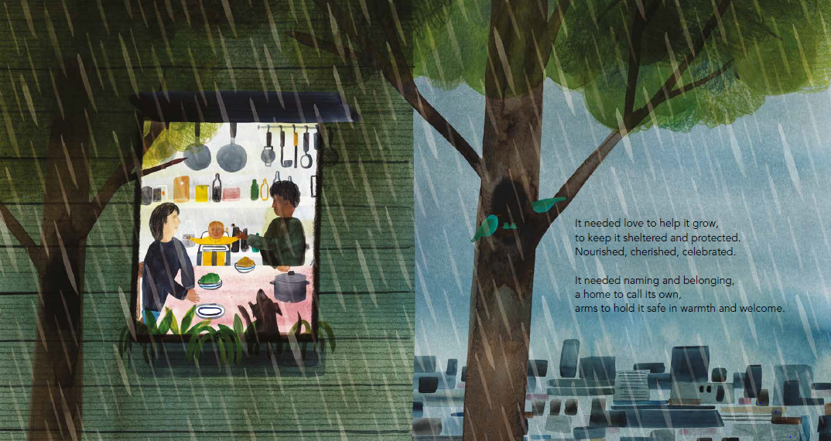
It needed ...

Slide 5
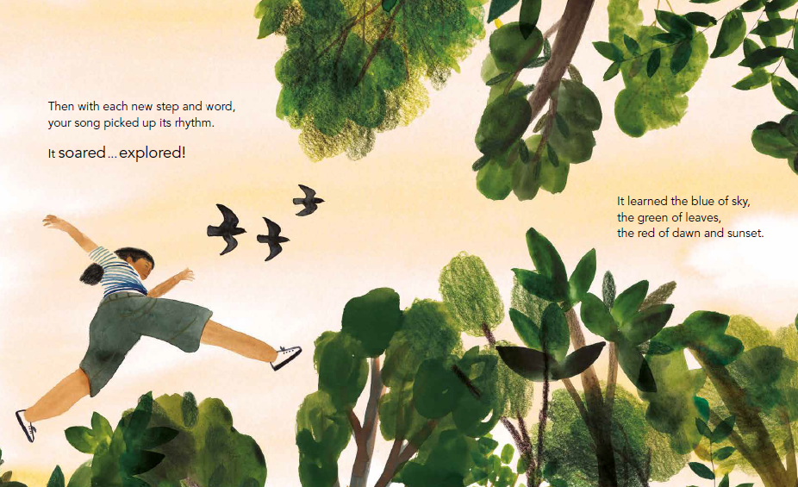
It soared ... explored!

Slide 6
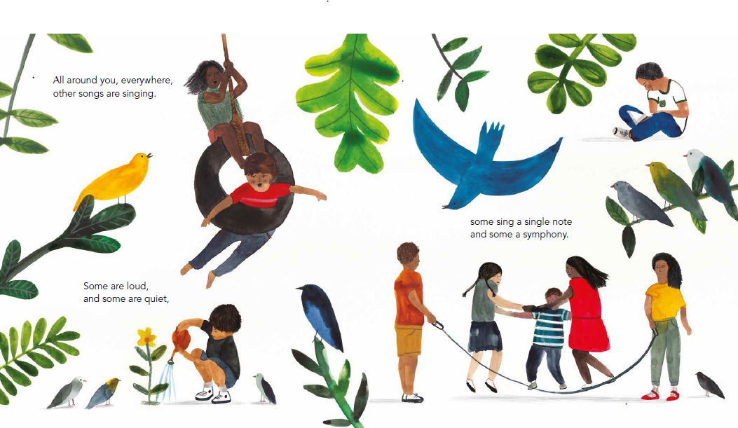
Unique
It soared ... explored!

Slide 7
What is your song about?

Slide 8
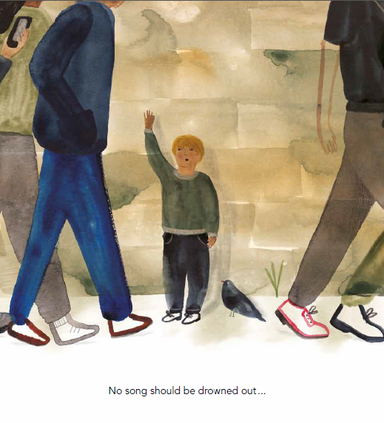
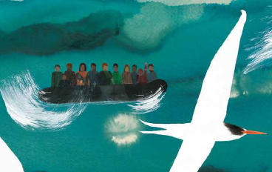
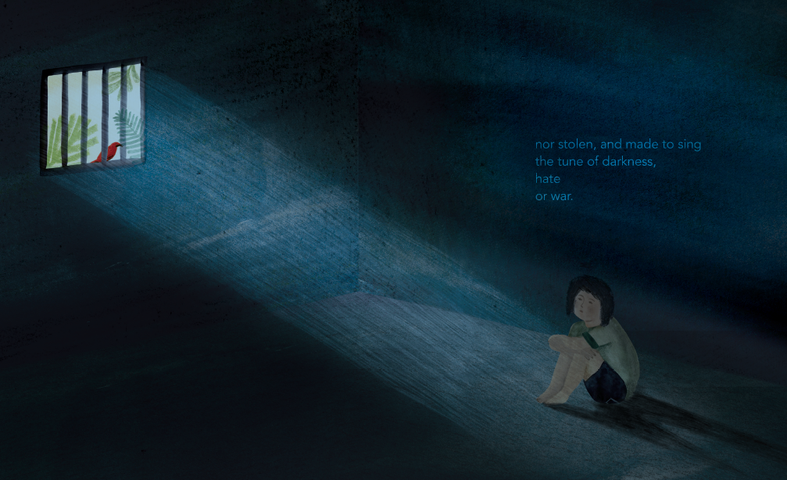

Slide 9
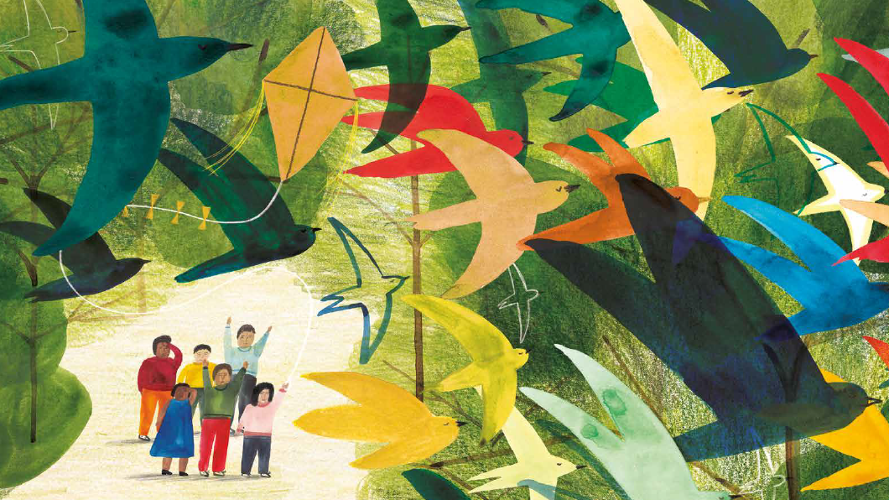
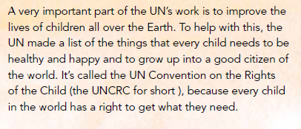
For together, we raise our voices
for the right of every song to sing out loud, bold and unafraid.

Slide 10
For together, we raise our voices
for the right of every song to sing out loud, bold and unafraid.

