Slide 1
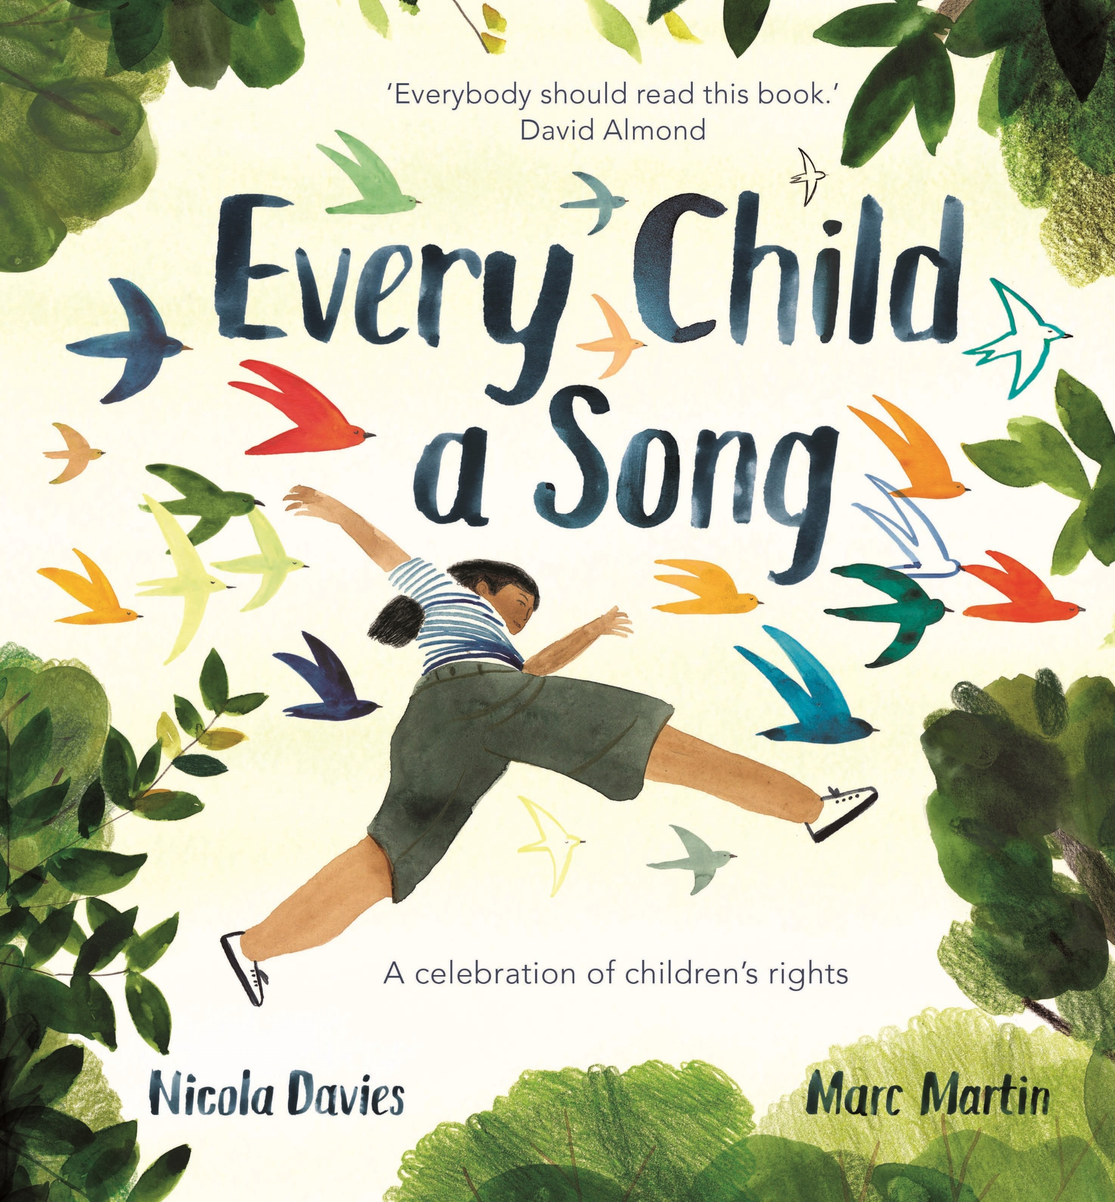

Every Child a Song by Nicola Davies
This book has been written in celebration of 30 years since the UNCRC – the UN Convention for Children’s Rights. It is a great book to celebrate differences and uniqueness of individuals. It is a great stimulus to discuss Children’s Rights and those who have them met and those that do not.
9781526361417 HB £12.99
These assembly resources have been created by Reading Rocks.
About the book:
A lyrical and unique non-fiction picture book by award-winning children's author Nicola Davies. With tenderness and heart, Nicola introduces young readers to the universal rights that every child is entitled to under the United Nations Convention on the Rights of the Child.
Using the metaphor of song, the book opens with the arrival of a newborn and its unique 'song', then pans out to explore all the essential things that every song needs to thrive - love, protection, a home, a name, the chance to explore and learn. In the latter half of the book, the issues of child labour, exploitation and war are sensitively introduced to emphasise that we all must play our part in championing children's rights and offering support to those who need it most.
With deeply moving watercolour illustrations by award-winning artist Marc Martin, this is a book that encourages children and adults alike to speak up for young people all around the world, and to treat one another with compassion and kindness.
Before you Read:
Ask children to consider:
What’s the difference between something you want and need?’
Can you name some things you need? want?
Activity:
Take some props to support a sorting activity, such as a family photo, water bottle, blanket, lunchbox, mobile phone, fancy shoes, football shirt etc… Can children discuss those we need/want?

Slide 2
Introducing the book:
Look at the title. What does it mean every child is a song? Can we really be a song? Explain that the author Nicola Davies has chosen this image to represent something important in the book to us.
Look at different words for song.
What do we know about songs?
I wonder if this is why Nicola Davies chose this image for us.
Reading Aloud:
Start the read aloud from ‘When you were …’ (skip the foreword this time)
Read the whole book through, without pausing for discussion so the words flow.
Focusing in:
On the page ‘But it was there in every heartbeats’, encourage the children to look closely at the windows. What do they spot? What do the words tiny and fragile suggest about young children and children’s rights. Is the word unique similar or does it suggest something different? Who should protect children/children’s rights when they are very young?
On the page ‘It needed love…’, ask children why they think the author and illustrator chose to have rain in this part? What does it suggest? Look closely at the words. Draw out: sheltered, protected, nourished, cherished, celebrated. Are these wants or needs? Shelter and nourishment seem obvious as basic needs, but do children think a sense of belonging and being celebrated are basic rights?
On the page ‘Then with each new step…’, if children have these basic needs, what will it develop in them? You could ask children to pick a colour they have learned about. Give an example of your own … the turquoise of salty sea, the yellow of happy sunshiny days…
On the page ‘All around you,….’, play children 3 or 4 short clips of varying music styles/genres. Focus back on the word UNIQUE. What right do you think all children should have? Is it ok to be different? How do we treat others who are different? Are we all different?
Slide 7 – what is your song about? Allow children to share what is unique and special about them with a partner. What do they hope their song will show to others?
Slide 8 – what do children notice about the birds/songs in this part of the book? How are the birds different? In the first 2, the birds’ wings are closed and they are separated from their owner. What does this show about their rights? Is this ok? In the third, the birds are flying despite of the situation. What does this suggest? Ask children if ALL children, no matter what deserve children’s rights?

Slide 3
To Conclude:
Slide 9 – conclude by sharing the foreword information on the UNCRC.
You may wish to consider how your school could support children who don’t have all their rights. Children may be inspired to fundraise or raise awareness.
Follow on ideas:
Create a display with birds. Each child in the class can draw a bird and/or write on what is unique about them.
Create posters about the articles shown in the back of the book. They could be put up around school to promote them. Children can illustrate ways these rights are delivered in their homes and at school.

