Slide 1
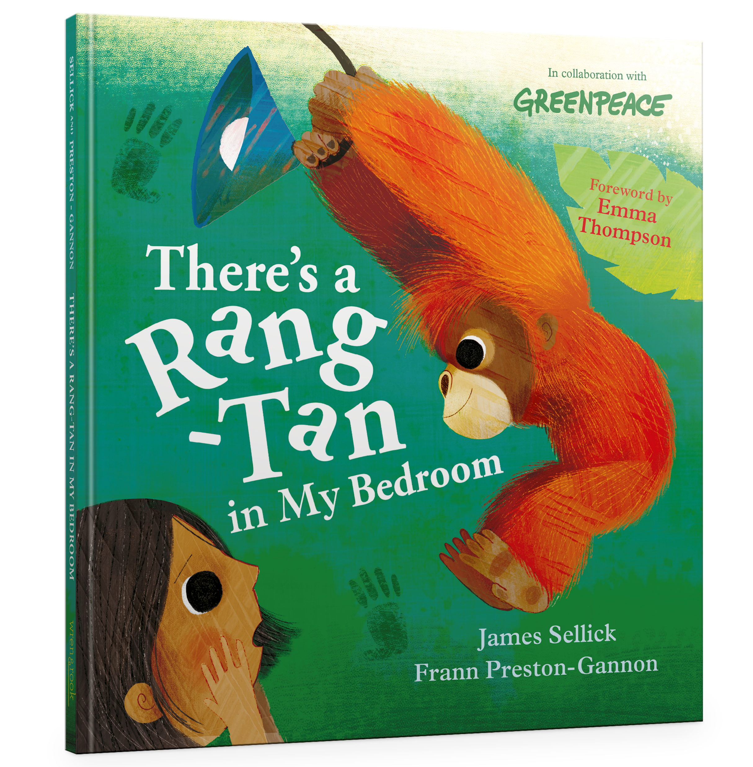
Assembly ideas for
Share the text with children in an assembly – this is best done under a visualiser as the illustrations are so special
After sharing the text, children will remember the TV advert – they may wish to talk about the similarities. It would be a good time to also show the TV advert. Explain that Greenpeace (may need some further description) were involved in both the advert and the book as a way to raise concerns
Explain to the children that we are going to do some follow-up work in classes related to the book and then have another showcase assembly where the work is shared
It would be a great idea to plan a fund-raising day for Greenpeace – children could dress up as orangutans or something of their choice related to palm oil. They could decorate t-shirts/ hats to wear on the day
Set a date to have a showcase assembly where parents are invited. The book could be read from the front and each class could present some of their work and explain what they have been doing
There’s a Rang-tan in My Bedroom
by James Sellick and Frann Preston-Gannon

Slide 2
Assembly ideas for
Year Group: Nursery
Vocabulary Activity:
Read the story slowly with nursery and ask what happens on each page. The illustrations in this book are beautifully special and there is much discussion to be had around the feelings of the little girl and the orangutan.
How do the illustrations show us the characters’ feelings? Share some of the illustrations and focus on facial expressions, body language and how the character is standing/looking etc.
Encourage the children to use ‘because’ in their responses. Demonstrate this by modelling sentences like this, ‘I think the little girl is angry because she is holding the cookie high in the air and her eyes are really big. She looks cross.’
Writing Activity:
Task: To speak in role as a character
Purpose: To describe how a character is feeling
Teachers could make head bands for children to wear that have a picture of the character on. When the child wears the head band with the orangutan, they speak in role as the orangutan. This can also be done holding an image of the character too.
There are many apps such that allow children to take a photograph of an illustration, then record their voice. The mouth in the illustration will move as the child’s recording plays.
There’s a Rang-tan in My Bedroom
by James Sellick and Frann Preston-Gannon

Slide 3
Assembly ideas for
Year Group: Reception
Vocabulary Activity:
Focus on the middle of the story to ensure that the children understand the actual crux of the story.
How does the little girl help the orangutan? Focus on the pages in the middle of the story.
She writes the letter, does a speech and her campaign. Ask the children to discuss what she might have written in the letter. What might she have said in the speech? What is the main message that she would include?
Writing Activity:
Task: To write a postcard to the orangutan
Purpose: To tell orangutan that you are helping her
Give the children a template of a postcard with the address printed. Word cards should be presented to children to use with key words needed for this task (orangutan, help, love).
As with all good practice, oral rehearsal is key to reception children producing a successful piece of writing. Children say aloud what they want to say to the orangutan.
Children write their message to orangutan.
Children can illustrate the other side of their postcard or can choose a picture from the book to stick on their postcards.
Teachers may ‘post’ these postcards and then send a reply from orangutan to the children.
There’s a Rang-tan in My Bedroom
by James Sellick and Frann Preston-Gannon

Slide 4
Assembly ideas for
Year Group: Year 1
Vocabulary Activity:
Read the story again and point out that we hear the little girl’s voice first and then the orangutan’s second.
What can you remember that the little girl said? What can you remember that the orangutan said? Allow the children to talk in pairs about what the characters tell us.
Make a table on the board and take the feedback from the children, scribing their ideas in the appropriate column. Teachers can review children’s feedback and guide children to summarise – the little girl’s story (she takes my shoe/ steals cookies/ howls at shampoo) and the orangutan’s story (humans destroy my forest/ took my family)
There’s a Rang-tan in My Bedroom
by James Sellick and Frann Preston-Gannon

Slide 5
Assembly ideas for
Writing Activity:
Task: To write a speech bubble in role as a character from the book (children can choose to write as the orangutan or the little girl)
Purpose: To describe how a character is feeling
In year 1, children should use the capital letter ‘I’ when writing in role. This is the perfect opportunity to apply this in a purposeful task.
After completing the vocabulary activity, it makes sense that the children write in role as a character from the book. Allow the children some ownership to choose the character they would like to write in role as.
Children can use the table generated in the vocabulary session to help structure their ideas for writing their speech bubble.
Share some sentence stems, ‘I feel,’ ‘I think,’ and ‘I hope.’
There’s a Rang-tan in My Bedroom
by James Sellick and Frann Preston-Gannon

Slide 6
Assembly ideas for
Year Group: Year 2
Vocabulary Activity:
Focus on the blurb of the book (back cover). Reread this together and again in pairs.
Are you happy with how the author has summarised the story? Teachers may need to explain what ‘summarise’ means to the children. Do you think the author told us too much/ just the right amount of information or not enough? How does the author summarise the whole story in less than 50 words?
Take opinions from children – let them vote on the question (they could go to different parts of the room for each option yes/no/just right). If they are not happy with the blurb, what extra information would they have liked to be included?
Highlight the noun phrases used – ‘little girl,’ ‘mischievous orangutan,’ ‘naughty rangtan.’ Ask children to suggest some more noun phrases that could have been included.
There’s a Rang-tan in My Bedroom
by James Sellick and Frann Preston-Gannon

Slide 7
Assembly ideas for
Writing Activity:
Task: To write a letter to the orangutan
Purpose: To apologise for what has happened
Although the children have done nothing wrong, after watching the advert and reading the book, children will feel sorry for the orangutan.
Teacher can scribe ideas about why we feel sorry – what has happened?
The letter could be structured as an apology, and then a promise for what we will do next.
Remind the children of letter writing conventions and complete a guided writing session to model some ideas that children could include.
Children should be provided with a word mat of vocabulary for children to include.
There’s a Rang-tan in My Bedroom
by James Sellick and Frann Preston-Gannon

Slide 8
Assembly ideas for
Year Group: Year 3
Vocabulary Activity:
Focus on the 3 pages towards the end of the book, ‘How Can You Help’.’
Why did the author choose to include these pages? What is the main purpose of this piece of writing? What is the author’s aim? Give children time in pairs to talk about what this piece is trying to do. Teachers may need to further explain this and talk about what is the job of these pages.
Writing to instruct: ‘’how you can help’; ‘here are three things you can do’; sentences starting with verbs ‘share/tell/ask’; use of commands ‘turn the page’ and the use of subordination if _______ they’ll __________.
Top Tips for Writing a Campaign Letter: this text is set out more like a set of instructions (numbered, commands, imperative verbs).
Discuss the difference between how these 2 sets of instructions are organised in different ways (one in clear sections/ other more simple in numbered instructions).
There’s a Rang-tan in My Bedroom
by James Sellick and Frann Preston-Gannon

Slide 9
Assembly ideas for
Writing Activity:
Task: To write a campaign letter
Purpose: To explain why orangutans need our help
Audience: Local MP
Teach/remind children of the conventions of letter writing (they may have written letters before).
Discuss the audience of this task – local MP. Explain to children that this is a formal letter, we are not writing to our friends. Therefore, we must choose the vocabulary, sentence structure and punctuation that matches this level of formality. Children may suggest subordinating conjunctions (because, if, when etc); rhetorical questions and including facts. Explain to children that they should not use contractions in this formal letter.
Remind children that the purpose of the task is to explain why orangutans need help therefore they may need to use causal conjunctions (because of this, as a result of this, this means that) to join their ideas.
There’s a Rang-tan in My Bedroom
by James Sellick and Frann Preston-Gannon

Slide 10
Assembly ideas for
Year Group: Year 4
Vocabulary Activity:
Re-read the story with the children and discuss how the book is written in 2 voices. Explore how the child’s voice is first and then the orangutan’s voice is written in italics. Discuss how this could have been written as a conversation using dialogue.
We use dialogue to convey character or to move the action on. Can you create an example of each that could be included in this book? Allow children some time to look closely at the pages of the book and then select a section to write the relevant dialogue.
Children may need a check-list to remind them what they will need to include when they write dialogue (inverted commas around the direct speech; new speaker, new line; punctuation inside the inverted commas and a comma used correctly). Children may benefit from a further discussion about the uses of dialogue
There’s a Rang-tan in My Bedroom
by James Sellick and Frann Preston-Gannon

Slide 11
Assembly ideas for
Writing Activity:
Task: To write a sequel to this story
Purpose: To entertain the reader (think about impact of the writer on the reader)
Audience: Before deciding on the audience, what impact do you want on your reader? Do you want to shock them/ make them laugh/ frighten them/ take them on an adventure or something else? Once children know this, they can decide on their plot.
Remind children that writers write with their reader in mind. Writers entertain their reader. So, what impact do we want to have on our reader?
Once the children know what impact they want to have on their reader, they will know what to include in their plot.
Look back at the vocabulary session just taught and remind children about the function of dialogue (convey character or move the action on). When using dialogue in your story – what will its function be?
There’s a Rang-tan in My Bedroom
by James Sellick and Frann Preston-Gannon

Slide 12
Assembly ideas for
Year Group: Year 5
Vocabulary Activity:
Focus on the double page spread near the back of the book ‘All About Orangutans.’
How does the language chosen in this informative section engage younger readers? Give children the double page spread and ask them to find evidence of language that shows that the intended audience for this piece is a younger reader.
Noun phrases (beautiful orangutans, leafy tree nests, ape cousins); questions to hook the reader (doesn’t Rang-tan look a little bit like you?); clear definition (of the meaning of the word ‘orangutan’); pronouns and determiners to engage (we’re, your family) and well-chosen conjunctions to sequence the piece (so, but, and, if, instead)
There’s a Rang-tan in My Bedroom
by James Sellick and Frann Preston-Gannon

Slide 13
Assembly ideas for
Writing Activity:
Task: To write an information leaflet about palm oil
Purpose: To inform the reader about palm oil explain why orangutans need our help
Audience: Parents of children in the school (to be included with the school’s newsletter)
After the vocabulary session, children have established why the double spread was for a younger audience. Now, they are going to create an information leaflet for an older audience – parents. What needs to change? Discuss that the formality is different. We are no longer writing for a younger audience. So we must select vocabulary, grammar and sentence structure that matches our audience.
How will the children organise their ideas? Will they use subheadings, sections, text boxes, pictures, captions etc?
There’s a Rang-tan in My Bedroom
by James Sellick and Frann Preston-Gannon

Slide 14
Assembly ideas for
Year Group: Year 6
Vocabulary Activity:
Focus on the foreword written by Emma Thompson (opening of the book). Show the children a photograph of Emma Thompson and explain that she is an actress.
What is Emma Thompson’s tone in this foreword and how does her choice of language support this? Ask children to highlight and annotate these double pages to answer the question.
Personal tone written in the first person; recapping a personal experience; short sentences for impact in the penultimate section; mixture of fact and opinion to inform and persuade and she includes dialogue from the orangutan.
There’s a Rang-tan in My Bedroom
by James Sellick and Frann Preston-Gannon

Slide 15
Assembly ideas for
Writing Activity:
Task: To write a narrative poem
Purpose: To explain why orangutans need our help
Audience: Governors of the school
Remind children that poems do not need to rhyme. Poems can be powerful vehicles for expressing an opinion – children are writing less but in turn, saying more. Every word counts.
Children may need to be reminded of the conventions of poetry where the lines can over run and punctuation is the poet’s own license.
Teachers may like to use the poem ‘Granny’ by Vernon Scannell (as featured in the 2018 KS2 Reading Test) as an example of a narrative poem to inspire children.
Children may structure the verses around the text or the advert – before we knew about palm oil/ finding out about palm oil/ what we can do about it.
Asking governors to judge the wining poems adds an additional motive for the children when writing their poetry and gives the task a genuine purpose and audience.
There’s a Rang-tan in My Bedroom
by James Sellick and Frann Preston-Gannon

